Slide 1
Farm Hands: Maximizing Hand Health for the Workplace Carla Wilhite and Trish Siegel University of New Mexico AgrAbility Virtual National Training Workshop Tuesday, February 20, 2017 11:00 a.m. ET

Slide 2
Basic Webinar Instructions
Audio available through computer or phone.
Check sound via Communicate menu at top left
Closed captions: use arrow to expand or contact the Media Viewer window.
Expand/contract any of the windows in the right-hand column with the arrows. May need to do this to see video of presenter.
Expand/contract the size of the right-hand column.

Slide 3
Basic Webinar Instructions
Questions and comments
Click Chat icon at top right of screen (it should turn blue). Enter message in box, choose who to send it to, and click send. You may enter questions about the presentation at any time. Please don’t use Q & A option.)
In addition, during the Q & A period, if you have a web microphone, click the “Raise Hand” icon to indicate that you have a question. We will enable your microphone or phone connection.

Slide 4
Basic Webinar Instructions
4 quick survey questions + opportunity to share comments
Session recorded and archived with PowerPoint files at www.agrability.org/Online-Training/archived
Problems: use chat window or email jonesp@purdue.edu

Slide 5
AgrAbility: USDA-sponsored program that assists farmers, ranchers, and other agricultural workers with disabilities.
Partners land grant universities with disability services organizations. Currently 20 state projects
National AgrAbility Project: Led by Purdue’s Breaking New Ground Resource Center.
Partners include:
Goodwill of the Finger Lakes
APRIL (Association of Programs for Rural Independent Living
Colorado State University
More information available at www.agrability.org

Slide 6
Farm Hands: Maximizing Hand Health for the Workplace
Carla Wilhite, OTD, OTR/L
University of New Mexico-School of Medicine
Division of Occupational Therapy
Trish Siegel, OTD, OTR/L
University of New Mexico-School of Medicine
Division of Occupational Therapy

Slide 7
Session Description
Session learning objectives:
Participants will become familiar with basic hand anatomy and understand typical functions of the hand.
Participants will increase their knowledge of common hand injuries and cumulative trauma disorders of the hand in the farm workplace.
Participants will verbalize strategies for improving hand health for those with arthritis or those with hand limitations from injury, and those at risk for arthritis or injury.

Slide 8
What is a hand?
A paired organ dominantly controlled by the opposing brain hemisphere
Our chief way for physically manipulating the environment
Our richest source of tactile feedback
Photo from: File:Rad 062001 hand x-ray false color nevit.jpg
From Wikimedia Commons, the free media repository
Notes:
Photo: x-ray of two handsPhoto from: File:Rad 062001 hand x-ray false color nevit.jpg
From Wikimedia Commons, the free media repository
The hand is an engineering marvel: 27 bones, ligaments, muscles, tendons, nerves, blood vessels, skin and nails. A versatile tool with strength and agility for completing routine tasks and precision movements (Telcom, 2015).
Practical Exercise: tuck your thumbs into the palms of your hands. Now tie your shoes. (precast.com)

Slide 9
Anatomy
Structures
Shoulder
Upper arm
Forearm
Wrist
Hand
Fingers
Notes:
Photo: illustration of the ventral part of a human showing bone, muscle and tendons of the upper torso, shoulder, and hand

Slide 10
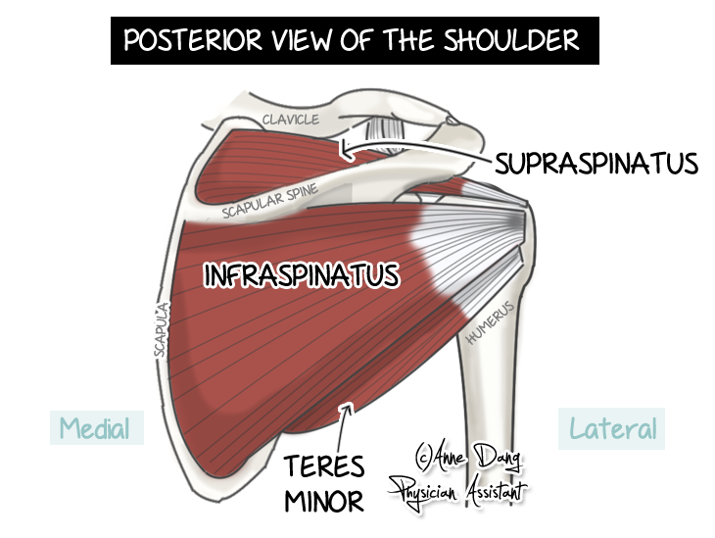
Shoulder
Shoulder provides stability and dynamic movement to position hand for function
Main components
Scapula
Clavicle
Movement derives from:
Upper back
Rotator cuff
Notes:
Photo: illustration showing dorsal view of the thoracic spine, ribs, shoulder blade, humerus, radius, ulna, carpals, metacarpals, and phalanges of the right arm

Slide 11
Upper arm and forearm
Bony structure
Humerus
Radius
Ulna
Movements derive from:
Flexors
Extensors
Supinators
Pronators
Source: Creative Commons
Notes:
Photo: same as slide 6

Slide 12
Wrist
Carpal bones
Movements
Deviation
Flexion
Extension
Source: www.assh.org
Notes:
Photo: illustration of the two rows of carpal bones: distal and proximal row

Slide 13
Wrist Movements
Metacarpals
Phalanges
Movements
Flex
Extend
Pronation/supination
Deviations
Photo Source: http://www.revolutionarytennis.com/Resources/wristandhandterm.jpeg
Notes:
Photo: x-ray of ventral left hand

Slide 14
Connective tissues
Muscles
Move bony segments of the body
Tendons
Termination of a muscle into bone
Cartilage
Lines the articular joint surfaces
Ligaments
Connect across joints
Joint lubrication and bursa
Nerve and vascular networks

Slide 15
Hand Functions
Grasping patterns
Hook, spheres, cylinders
Power vs. precision
Pinches
Palmar
Lateral
Tip to tip
Fine motor manipulation
Sensation
Pain, touch, discrimination, object identification, vibration

Slide 16
Stats on Hand Injuries
Over 1 million hand injuries in the workplace every year (OSHA, 2007)
20% of disabling work injuries are from hand injuries
205,000 injuries to wrists/hands/fingers involve days away from work (all industries) (Bureau of Labor Statistics, 2006)
Notes:
Because of versatility, hand is subject to many types of injuries: strains, sprains from excessive force, excessive repetitive motion, awkward posture, contact with surface conditions, skin irritations, burns, punctures, lacerations, cuts, fractures, bites, amputations (Telcom, 2015).

Slide 17
Common hand injuries in farm work
Contributing factors
Farmer state of mind
i.e. attention, attitude toward safety
Musculoskeletal forces
i.e. wear and tear
Removal of safety shields or other protective equipment
Malfunction of equipment
Lack of training or skill
Wrong tool
Source: American Farm Bureau Photo Gallery
Notes:
Photo: Farmer in pickup truck, road disappearing behind with a feedlot in the view

Slide 18
Mechanisms of farm hand injuries
Bites from farm animals
Bites from insects
Wounds
Punctures
Canines
Crushing/tearing wounds
livestock
Risk of infection
Disease
Source: www.assh.org
Notes:
Photo: animal puncture bite on the right index finger

Slide 19
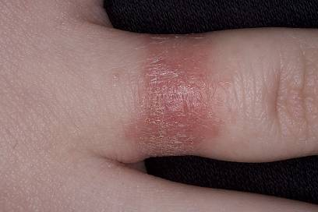
Mechanisms of farm hand injuries
Chemicals
Plants
Vaccines
Fertilizers
Herbicides
Pesticides
Wounds
Contact dermatitis
Lesions
Source: www.dermnet.com
Notes:
Photo 1: Photo of poison ivy on dorsum of hand, lots of papules and redness
Photo 2: Contact dermatitis on 2nd digit of hand, like a red band around the finger

Slide 20
Mechanisms of farm hand injuries
Falls
Ladders
Stairs
Objects
Slippery hazards
Injuries
Colles (radial wrist) fracture
Scaphoid Non-union
Hand fractures
Source: Creative Commons
Notes:
Photo: an x-ray of a humeral fracture at the elbow

Slide 21
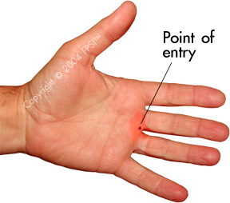
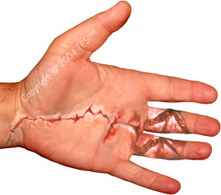
Mechanisms of farm hand injuries
Machinery
Augers
Belts
Chains
Saws
Hitches
Hydraulic leaks
Mufflers/engines
Wounds
Amputations
Fractures
Avulsions
Crushing
Lacerations
Contusions
Burns
Notes:
Photo 1: Hand showing pinpoint injection of hydraulic fluid, source: copyright photo from Fluid Power Safety Institute: fair use
Photo 2: Hand showing decompression of pinpoint injection wound, source: copyright photo from Fluid Power Safety Institute: fair use

Slide 22
Mechanisms of farm hand injuries
Wounds
Tendon lacerations
Flexion
Extension
http://www.davidlnelson.md/Tendon_Surgery.htm
Notes:
Photo: view is of the palm of a hand that has been opened for surgery. The two ends of a flexor tendon is being stitched back together with thread, needle, and a pair of forceps

Slide 23
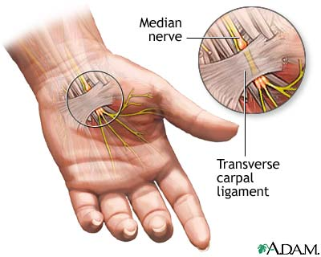
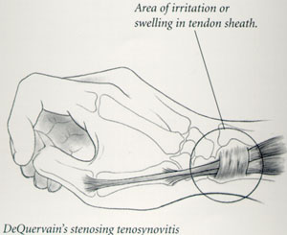
Mechanisms of farm hand injuries
Musculoskeletal forces
Cumulative trauma
Repetitive use
Injuries
Sprains/strains
Tendonitis
Carpal tunnel
Bursitis
Cysts
Vascular compromise
Arthritis
Source: http://orthoinfo.aaos.org
Notes:
Photo 1: An illustration of tendonitis (deQuervain’s) of the right hand
Photo 2: An illustration showing the left palm of a hand showing the median nerve and the transverse carpal ligament

Slide 24
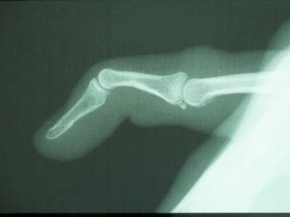
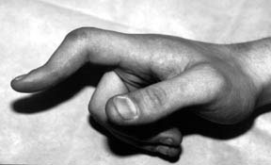
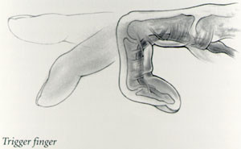
Mechanisms of farm hand injuries
Arthritis and Joint involvement
Pain
Joint enlargement
Joint erosion
Nodes
Deformities
Notes:
Photo 1: Illustration of arthritic nodes on the fingers
Photo 2: x-ray showing a subluxation of the PIP joint of a finger, making a swan neck deformity
Photo 3: black and white photo showing a boutonniere’s deformity
Photo 4: illustration showing what a trigger finger looks like

Slide 25
Mechanisms of farm hand injuries
Vibration
Cold and heat
Vascular compromise
Nerve damage
Thermal injury
Raynaud’s syndrome (sympathetic)
Source:http://www.assh.org
Notes:
Photo: x-ray with contrast showing the aterial circulation of the right hand

Slide 26
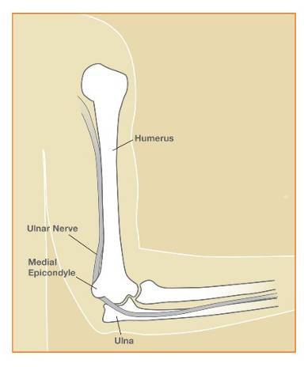
Mechanisms of farm hand injuries
Related injuries that affect hand function
Brachial plexus injury
Cubital tunnel
Rotator cuff trauma
Nerve injuries proximal to the hand
Mechanism
Pulling/pushing
Overuse
Dislocations
Lacerations/crushing
Source: http:www.assh.org
Notes:
Photo one: Illustration showing the brachial plexus of nerves from the neck and into the arm
Photo two: illustration showing where the ulnar nerve typically gets impinged behind the medial epicondyle of the humerus

Slide 27
Prevention of Hand Injuries
Design to fit body size
No such thing as “average size”
Provide adjustability in work station
Design to fit body posture
Three work positions: lying, sitting, and standing
But, transient postures of every kind between these postures (asymmetry):
Stooping, squatting, kneeling
Notes:
Source: Nordin, Anderson, & Pope. (1997). Musculoskeletal disorders in the workplace. St. Louis: Mosby, inc.

Slide 28
Prevention of Hand Injuries
Designing for Hand Use
Hand tasks fall into five major groups
Fine manipulation (writing, assembling small parts)
Fast movements to an object (hitting a switch)
Frequent movements between targets (larger parts from bins to assembly)
Forceful activities with little displacement (turning a wrench)
Forceful activities with large displacements (hammering)

Slide 29
Working with Tools
Hand tools
Purpose of tool handle is to maintain secure control
Tool should fit contours of hands
Tool for right or left (or both)?
Does tool require precision grip or power grip?
Consider energy between tool handle and hand, and tool to object
Manual tools or power?

Slide 30
Working with Tools
General principles
Keep all tools in good condition with regular maintenance
Use the right tool for the job
Examine each tool for damage before use; don’t use damaged tools (tag as “Do Not Use”)
Use the right PPE, with the right fit
Secure work with clamps or a vise
Don’t pull on cords, don’t carry by cords
Direct tools away from others
Do not use electrical tools in damp/wet areas unless they are approved for use
Source: OSHA.gov
Notes:
Examples: Right tool for job: don’t use a chisel as a screwdriver, don’t use the hand as a hammer,
Tool condition: get rid of wrenches that slip, wooden handles that are split, don’t use tools that might spark near flammables

Slide 31
Prevention of Hand Injuries by Agricultural Workers
Most effective control is to “engineer out” the risk of injury
When risk cannot be designed out: then use safety procedures and use of shields and personal protective equipment
Source: Nordin, Andersson, & Pope (1997)
Notes:
Illustration showing a man in a messy shop, and one in a neat and organized shop

Slide 32
Prevention of Hand Injuries by Agricultural Workers
Be familiar with personal protective equipment
Use correct gloves and safety equipment
Remove rings, watches, jewelry when working with power tools or on equipment
Do not wear gloves near machine gears or other devices
Replace gloves that are stretched, ragged, or torn
Keep machine guards in place
Use push sticks with table saws
When using sharp blades or needles keep point away from the body, cut away from the body, use retractable blades

Slide 33
Fitting Gloves
Many kinds of gloves
Rubber
Polyvinyl alcohol (PVA)
Nitrile
Neoprene
Polyvinyl chloride (PVC)
Cotton
Wire mesh
Kevlar
Welding
Leather
Anti-Vibration
Notes:
Photo: blue welding gloves, source: creative commons
Which glove is best?
cotton-light duty material handling and cleanup work
leather-equipment handling, general construction, heavy cleanup, welding, moderately hot or cold material handling
shock absorbing-operating rotary hammers/vibrating equipment
Kevlar or wire: working with sheet metal, glass, heavy cutting (don’t prevent punctures)
rubber, nitrile, neoprene, PVC, PVA-chemical gloves CHOSEN for the specific chemical being used
Insulated-extreme high/low temps, lineman’s gloves for electricity
Inspect gloves before use for tears, excessive wear, and punctures
Store in clean, dry location
Discard if saturated with oils or chemicals
Leak test gloves (don’t blow into it with your mouth however: use plastic tubing or an air hose)
Get right fit of glove: not too big, not too small. Must be JUST right. Sizing charts available, but nothing like trying it on first.
Glove limitations: can get caught in rotating machinery (chains, gears, grinders), allergies to glove materials, chemicals penetrating gloves, failure under extreme conditions

Slide 34
Prevention of Hand Injuries by Agricultural Workers
Take a break every hour or switch to another activity to prevent overuse of repetitive hand movements
Break tasks into short sessions
Store tools to prevent accidents
Avoid sustained/constant gripping and awkward motions
Plan ahead, arrange work space
(Source: adapted from American Society of Hand Therapists, www.asht.org)

Slide 35
Preventive Skin Care
Limit exposure to irritants
Use protective creams to be used under or without gloves
Wear a cotton liner under rubber or synthetic gloves to limit affect of sweating
Wash hands immediately after using chemicals
Washing hands-
Don’t wash hands with solvents, harsh soaps, or abrasives
Use right cleanser for the job (soap free: Cetaphil, Neutrogena)
Place cleanser in numerous locations where it’s needed
Apply an after-work conditioning cream to replenish moisture in the skin (not oily or greasy)

Slide 36
Preventive Skin Care
Hand Exam
After work: Look for cuts, rashes, abrasions
Get medical evaluation if necessary
Clean and bandage all cuts and abrasions
Immediately remove any splinters/foreign materials
In winter:
Avoid contact of fingers/hand with moisture (and/or wear waterproof gloves)
Minimize sweating of hands
Best insulation is Thinsulate® glove with multiple layers

Slide 37
General Exercises
Upper extremity warm-up exercises
Fold your hands together, turn palms away from body, extend arms, hold 10 seconds and repeat 8 times (upper back and shoulder)
Then do it over head
Hold arm across chest, use opposite hand to push elbow gently toward chest, alternate with other arm (upper back and shoulder)
Extend arm, palm down, take opposite hand and bend wrist gently downward. Then do palm up, and stretch wrist back gently.
Gently open/close fists
“Play the piano”
(Source: Adapted from ASHT)
Notes:
Exercises should never be painful when completing them

Slide 38
Tendon glides
Notes:
Graphic: tendon glides of hand. Source: Creative Commons

Slide 39
Strengthening
Notes:
Graphic: theraputty exercises. Source: Creative Commons
Theraputty comes in different hardnesses. Yellow is usually a good starter color for weak hands.

Slide 40
Arthritis Considerations
Joint Protection
Modify your activity level or method of doing a task to avoid excessive pain.
Pain that lasts more than one hour after an activity or includes joint swelling indicates that the activity was too stressful.
Slide objects along a counter or workbench rather than lift them.
Hold bulky or heavy objects close to your body when carrying them so you can support the weight on your forearms
(source: Mayo Clinic)
Pain Control
Medications (OTC/prescribed)
Contrast baths
Gentle Exercises
Adaptive Devices
http://www.arthritis.org/living-with-arthritis/pain-management/joint-protection/arthritis-devices.php

Slide 41
Discussion
Think of a client you have worked with that could benefit from assistive technology that is protective and/or supportive??????
Discuss examples
Questions for the Expert???
(Ask Trish!!)

Slide 42
References
Agger W.A., Cogbill T.H., Bush H. Jr., Landercasper, J., & Callister, S.M. (1986). Wounds caused by corn-harvesting machines: An unusual source of infection due to gram-negative bacilli, Review of Infectious Diseases, 8, p. 927-931.
Athanasiov, A., Gupta, M.L. & Frager, L.J. (2006). An insight into the grain auger injury problem in Queensland, Australia. Agricultural Safety and Health, 12, p. 29-42.
Browning, S.R., Truszczynska, H., Reed, D. & McKnight, R.H. (1998). Agricultural injuries among older Kentucky farmers: The Farm Family Health and Hazard Surveillance Study. American Journal of Industrial Medicine, 33, p. 341-353.
Carruth, A.K., Sharke, L., Moffett, B. & Prestholdt, C. (2001). Women in agriculture: Risk and injury experiences on family farms. Journal of American Women’s Association, 56, p. 15-18.
Dillon, C., Petersen, M. & Tanaka, S. (2002). Self-reported hand and wrist arthritis and occupation: Data from the U.S. National Interview Survey-Occupational Health Supplement. American Journal of Industrial Medicine, 42, p. 318-327.
Faivre, I. (2015). Protect your hands and your livelihood. Retrieved from https://ohsonline.com/Articles/2015/Protect-Your-Hands
Hansen, T.B. & Carstensen, O. (1999). Hand injuries in agricultural accidents. Hand Surgery, 24, p. 190-192.
Hart, R.G., Smith, G.D. & Haq, A. (2006). Prevention of high-pressure injection injuries to the hand. American Journal of Emergency Medicine, 24, p. 73-76.
Kato, A.E., Fathallah, F.A., Miles, J.A., Meyers, J.M., Faucett, J., Janowitz, I. & Garcia, E.G. (2006). Ergonomic evaluation of winegrape trellis pruning operation. Agricultural Safety and Health, 12, p. 17-28.
Khachemoune, A., Khecmoune, K. & Blanc, D. (2006). Assessing phytophotodermatitis: Boy with erythema and blisters on both hands. Dermatology Nursing, 18, p. 153-154.
Layde, P.M., Nordstrom, D.L., Stueland, D., Brand, L. & Olson, K.A. (1995). Machine-related occupational injuries in farm residents. Annals of Epidemiology, 5, p. 419-426.
O’Neill, J.K., Richards, S.W., Ricketts, D.M. & Patterson, M.H. (2005). The effects of injection of bovine vaccine into a human digit: A case report. Environmental Health, 4, p. 21.
Occupational Dermatology Research and Education Centre (n.d.). Skin care in the workplace. Retrieved from http://www.occderm.asn.au
Occupational Safety and Health Administration (2002). Hand and power tools. Retrieved from https://www.osha.gov/Publications/osha3080.html
Paulsen, E., Sogaard, J. & Andersen, K.E. (1998). Occupational dermatitis in Danish gardeners and greenhouse workers (lll). Compositae-related symptoms. Contact Dermatitis, 38, p. 140-146.
Rautiainen, R.H., Lange, J.L., Hodne, C.J., Schneiders, S. & Donham, K.J. ( 2004), Injuries in the Iowa Certified Safe Farm Study. Agricultural Safety and Health, 10, p. 51-63.

Slide 43
References
Roquelaure, Y., Dano, C., Dusolier, G., Fanello, S. & Penneau-Fontbonne, D. (2002), Biomechanical strains in the hand-wrist system during grapevine pruning. International Archives of Occupational Environmental Health, 75, p. 591-595.
Safety and Health Council of North Carolina (2010). Hand safety in the workplace. Retrieved from
Schmid, L., Dreier, D., Muff, B., Allgayer, B. & Schlumpf, U. (1999). Lifelong heavy agricultural work and development of arthrosis of the hand-case study. Rheumatology, 58, p. 345-350.
Schwab, C.V., Freeman, S.A. & Pollard, T. (2000). Assessment of the condition of Iowa augers, auger-related injuries, and farmers’ perceptions about auger-related injuries. Agricultural Safety and Health, 6, p. 117-129.
Smith, B.L. (1987). An inside look: Hand injury-prevention program. Journal of Hand Surgery, 12, p. 940-943.
Stal, M., Hansson, G.A., Moritz, U. ( 1999). Wrist positions and movements as possible risk factors during machine milking. Applications Ergonomics, 30, p. 527-533.
Stal, M., Pinzke, S., Hansson, G.A. & Kolstrup, C. (2003). Highly repetitive work operations in a modern milking system: A case study of wrist positions and movements in a rotary system. Ann Agriculture Environmental Medicine, 10, p. 67-72.
Tanaka, S., Petersen, M. & Cameron, L. (2001). Prevalence and risk factors of tendonitis and related disorders of the distal upper extremity among U.S. workers: comparison to carpal tunnel syndrome. American Journal of Industrial Medicine, 39, p. 328-335.
Tanaka, S., Wild, D.K., Cameron, L.L. & Freund, E. (1997). Association of occupational and non-occupational risk factors with the prevalence of self-reported carpal tunnel syndrome in a national survey of the working population. American Journal of Industrial Medicine, 32, p. 550-556.
Tan, K.K., Fishwick, N.G., Dickson, W.A., & Sykes, P.J. (1991). Does training reduce the incidence of industrial hand injuries? Journal of Hand Surgery (Br.), 17, p. 323-326.
Telcom Insurance Group (2017). The key to hand injury prevention. Retrieved from
Walker-Bone, K. & Palmer, K.T. (2002). Musculoskeletal disorders in farmers and farm workers. Occupational Medicine (London), 52, p. 441-450.
Zhou, C. & Roseman, J.M. (1994). Agricultural injuries among a population-based sample of farm operators in Alabama. American Journal of Industrial Medicine, 25, p. 385-402.

