Slide 1

Federal Update: AgrAbility and Related Programs
2017 AgrAbility Virtual NTW
February 22, 2017
Notes:
1

Slide 2
Welcome from the National Institute of Food and Agriculture (NIFA)

Slide 3
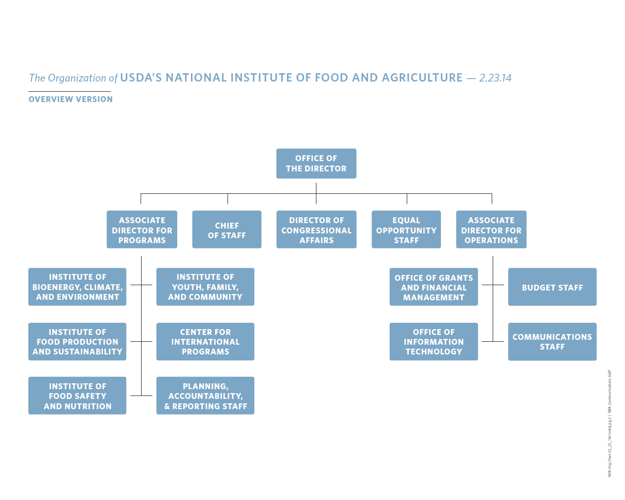
Notes:
For the benefit of those of you who might not be that familiar with NIFA.
NIFA is one of four USDA agencies that make up USDA’s Research, Education, and Economics mission area.
NIFA does not perform actual research, education, and extension but, rather, helps fund research, education and extension at state and local levels and provides program leadership in these areas at the national level.

Slide 4

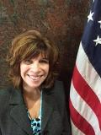
AgrAbility Admin. Oversight at NIFA
Brad Rein
Division Director
Agricultural Systems
Caroline Crocoll
Division Director
Family & Consumer Sciences

Slide 5
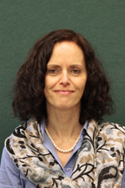

AgrAbility Program Oversight at NIFA
Aida Balsano, Ph. D.
National Program Leader
Division of Family & Consumer Sciences
Institute of Youth, Family and Community
Steven Thomson, Ph. D.
National Program Leader
Division of Agricultural Systems
Institute of Food Production and Sustainability

Slide 6


AgrAbility Team at NIFA
Lelan Dixon, M.A.
Program Specialist with DAS/IFPS
Marietta Pannell
Program Assistant with DAS/IFPS

Slide 7
FY 2017 in Focus

Slide 8
NIFA Budget in FY 2017
Continuing Resolution
  Funds NIFA activities through April 28, 2017
  At 2016 level, reduced by 0.19%
The FY 2017 NIFA budget request was for $1.38 billion, covering 57 distinct funding lines.
NIFA will continue to release Requests for Applications (RFA) for competitive programs.
  AgrAbility RFA was released in January, 2017.
  Applications are in. Assembling 2017 AgrAbility panel.

Slide 9
AgrAbility in FY 2016
Farm Safety funding line (which includes AgrAbility & Youth Farm Safety) was at $4,610,000
After administrative costs, approximately $4.1 million was allocated toward AgrAbility
  20 continuing SRAPs & 1 new NAP
  SRAPs received up to $180,000
  NAP received $532,294
For details: http://cris.csrees.usda.gov/cgi-bin/starfinder/0?path=fastlink1.txt&id=anon&pass=&search=cg=*-41590-*&format=WEBTITLESG

Slide 10
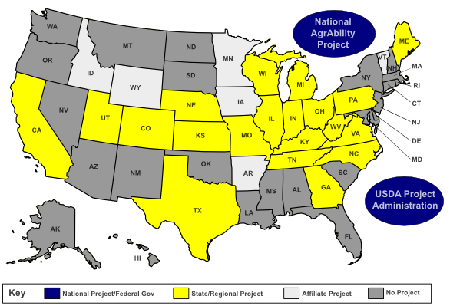
http://www.agrability.org/contact-lists/

Slide 11
Smith-Lever 3(d)
NIFA exploring ways that under-represented groups and institutions can be included in competitive program under this funding line.
Notes:
Smith-Lever 3(d): NIFA is interested in exploring ways that underrepresented groups and institutions can be included in competitive programs under this funding line. NIFA places a high priority on exploring funding opportunities for 1890s, 1994s, Hispanic-serving and other minority serving institutions in research and extension programs, including competitive extension programs under Smith-Lever 3(d).

Slide 12
Streamlined Process for
Continuation Grants
NIFA has recently approved a new streamlined process for continuation grants. The new process was rolled out on November 14, 2016.
Two pilots were run to arrive at the streamlined process: one on Tribal Programs and another on a subset of AFRI Programs.
A cost assessment for Tribal programs:
  an estimated savings for NIFA = 7.5 hours
  an estimated savings for the award institutions = 22.5 hours

Slide 13
Continuation Grants Process in 2017
Current awardees will not need to go through Grants.gov. Rather, they will submit continuation applications directly to NIFA AgrAbility Program Leads.
Letters will be coming out soon with more information on how to submit your continuation applications.
If you are experiencing any issues with your continuations or continuation applications, let us know how we can assist.

Slide 14
Youth Farm Safety Education and Certification FY2016
NIFA funds Safety in Agriculture for Youth (SAY) project
Multi-institution, started as a two-year project
(at $300,000 in FY16)
  Develop a national strategy to enhance awareness, access and use of the farm safety materials by youth and adults who instruct/work with youth.
  Build upon current standards and curriculum;
  Determine alignment of safety resources to national educational standards;
  Develop a national clearinghouse for Ag safety and health curricula for youth

Slide 15





SAY Project Team Partners
Notes:
FY 2017 RFA for YFSEC expected to be released within the next few weeks.

Slide 16
Beginning Farmer and Rancher Development Program
For all projects funded from 2009 to 2016 (256 projects), click on “Read the Abstract” at: nifa.usda.gov/funding-opportunity/beginning-farmer-and-rancher-development-program-bfrdp.
The Digital Library of the BFRDP clearinghouse, FarmAnswers.org, has over 4,000 items: publications, videos, apps, on-line courses, and more.
Notes:
Even though farm safety was not specifically named by Congress in the BFRDP legislation until 2014, a number of projects funded so far did address the topic of farm/farmer safety in their trainings. Most notably, a project led by Penn State developed a simple yet comprehensive manual on farm safety for beginning farmers and BFR educators. The manual assists farm owners and managers in developing health and safety management plans for their agricultural operations. The manual outlines reasons for a safety and health plan along with hands-on activities and steps to take to develop a successful safety and health plan.

Slide 18
NCERA197: Agricultural Safety and Health Research and Extension
Initiated 2000
Members: 17 LGU’s, 2Canada, 2 NIOSH
National Land Grant Research and Extension Agenda for Agricultural Safety and Health
  Agricultural Equipment on Public Roads
  Agricultural Confined Spaces
Received 2014 North Central Region Award for Excellence
http://www.nimss.org/lgu_v2/homepages/home.cfm?trackID=17236
Notes:
NIFA provides programmatic oversight for the multistate group NCERA-197: Agricultural Safety and Health Research and Extension.
NCERA197 will: a) summarize the research literature, engineering needs and outreach opportunities related to agricultural safety and health; b) convene a national conference on a current topic related to agricultural safety and health; c) encourage more research and outreach by land grant universities; and d) support youth safety activities, and e) encourage increased standards activity to reduce hazards and risks of agricultural work.

Slide 19
https://newfarmers.usda.gov/
Notes:
USDA’s New Farmers website, provides one-stop shop for beginning farmers to learn more about accessing USDA services that can help their operations thrive.“ The website has in depth information for new farmers and ranchers, including: how to increase access to land and capital; build new market opportunities; participate in conservation opportunities; select and use the right risk management tools; and access USDA education, and technical support programs. These issues have been identified as top priorities by new farmers.
AgrAbiity is featured on the website, under New Farmers tag → Education and Assistance.
Use this as a resource in your work with new farmers.
Check out STEP 3: RESOURCES FOR NEW FARMERS -- Access to Land and Capital

Slide 20
Rural America at a Glance
To access the report: https://www.ers.usda.gov/publications/pub-details/?pubid=80893
Notes:
Released December 1, 2016.
This report highlights the most recent indicators of social and economic conditions in rural areas, focusing on the U.S. rural economy, including employment, population, poverty trends, and educational attainment trends.

Slide 21
NIFA Science Week
The week of February 27th, 2017.
An internal series of listening sessions to solicit ideas from and engage national program leaders in a dialogue about the future directions of NIFA’s science programs.
Input gleaned from science week will be used to strengthen NIFA’s strategic planning efforts, inform the new administration and priorities in the FY18 RFAs, and propose priorities for future budget initiatives.
Social and Ag Sciences informing AgrAbility work are well represented.

Slide 22

Partner with NIFA to Highlight Your Accomplishments
http://nifa.usda.gov/impacts

Slide 23
http://nifa.usda.gov/
https://twitter.com/USDA_NIFA

Slide 24
Stay Connected
Aida Balsano
National Program Leader (Primary) for the AgrAbility Program
abalsano@nifa.usda.gov
202-720-4436
Steven Thomson
National Program Leader (Secondary) for the AgrAbility Program
Steven.J.Thomson@nifa.usda.gov
202-401-6301

Slide 25


Slide 26

Thank You!

