Slide 1

AgrAbility and Related Programs
2015 AgrAbility Virtual NTW
Dec. 1, 2015
Notes:
1

Slide 2

Basic Webinar Instructions
Check sound via Audio>Test Computer Audio.
Please don’t activate camera.
Closed captions: use arrow to expand the Closed Captions window to view.
Expand/contract any of the windows in the right-hand column with the arrows.
Expand/contract the size of the right-hand column.

Slide 3
Basic Webinar Instructions
Questions and comments
  Click Chat icon at top right of screen (it should turn blue). Enter message in box, choose who to send it to, and click send. You may enter questions about the presentation at any time
  In addition, during the Q & A period, if you have a web microphone, click the “Raise Hand” icon to indicate that you have a question. We will enable your microphone

Slide 4
Basic Webinar Instructions
5 quick survey questions + opportunity to share comments
Session recorded and archived with PowerPoint files at www.agrability.org/Online-Training/archived
Problems: use chat window or email agrability@agrability.org

Slide 5
Potential Webinar Issues
Audio continues, but slides don’t advance
  Move your mouse or hit Enter
Disconnection with presenters
  Hang on – we’ll reconnect as soon as possible
Disconnection with participants
  Log in again

Slide 6

AgrAbility: USDA-sponsored program that assists farmers, ranchers, and other agricultural workers with disabilities.
  Partners land grant universities with disability services organizations. Currently 20 state projects
  National AgrAbility Project: Led by Purdue’s Breaking New Ground Resource Center. Partners include:
    Goodwill of the Finger Lakes
    The Arthritis Foundation, Heartland Region
    University of Illinois at Urbana-Champaign
    Colorado State University
  More information available at www.agrability.org

Slide 7
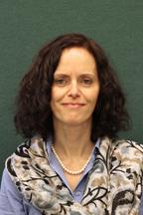
USDA/NIFA Welcome
Strengthening Families, Farms, Communities and the Economy
Aida Balsano, Ph.D.
National Program Leader
Research and Evaluation & Rural Health
Institute of Youth, Family and Community
Division of Family & Consumer Sciences

Slide 8
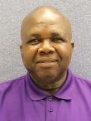

Denis Ebodaghe, Ph.D.
National Program Leader
(special focus: 1890 LGUs)
  Lelan Dixon, M.A.
  Program Specialist

Slide 9


USDA/NIFA Welcome
Caroline Crocoll
Division Director
Family & Consumer Sciences
Brad Rein
Division Director
Agricultural Systems

Slide 10
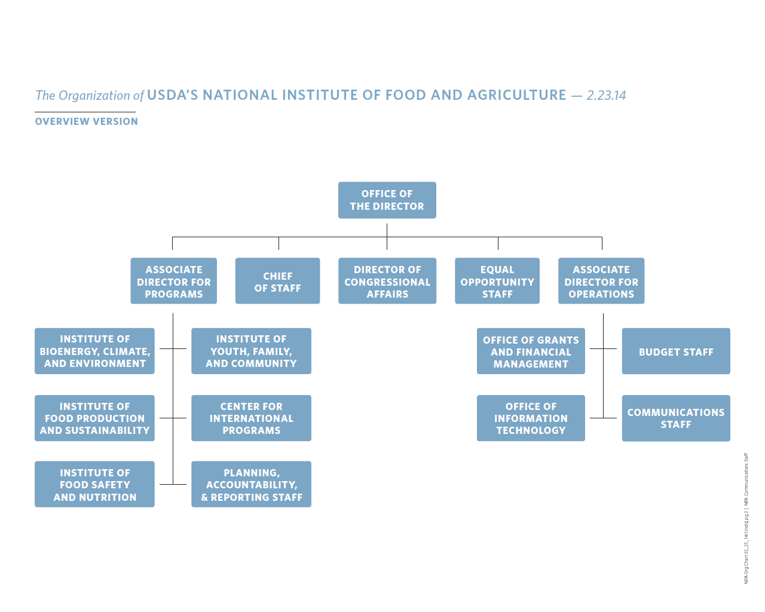

Slide 11
Farm Safety at NIFA

Slide 12
AgrAbility in FY 2015
Approximately $4.1 million
  17 continuing SRAPs
  1 continuing NAP
  3 new SRAPs
SRAPs received up to $189,000
NAP received $521,457
One-time additional increase
For details: http://nifa.usda.gov/press-release/usda-awards-21-agrability-grants-expand-access-farming-americans-disabilities-0

Slide 13
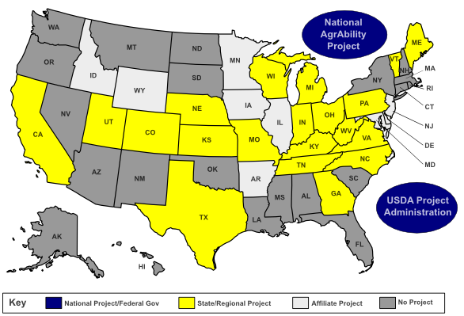
http://www.agrability.org/Contact-lists/index.cfm

Slide 14
Youth Farm Safety Education and Certification FY2013-FY2015
NIFA funds Safety in Agriculture for Youth (SAY) project
Multi-institution, started as a two-year project
(at $300,000 FY13-14; $150,000 in FY15)
  Develop a national strategy to enhance awareness, access and use of the farm safety materials by youth and adults who instruct/work with youth.
  Build upon current standards and curriculum;
  Determine alignment of safety resources to national educational standards;
  Develop a national clearinghouse for Ag safety and health curricula for youth

Slide 15





SAY Project Team Partners

Slide 16



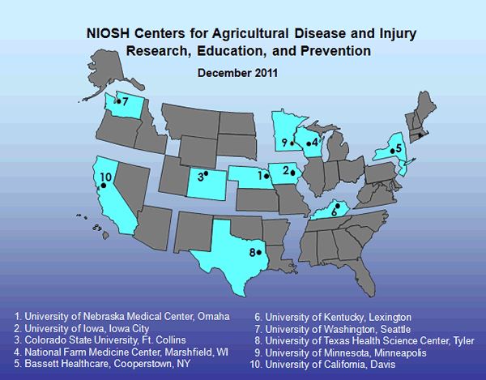










SAY National Steering Committee

Slide 17
Beginning Farmer and Rancher Development Program
19 of the 185 projects touch on farm safety
The University of Minnesota Center for Farm Financial Management
  The National BFRDP Clearinghouse
  http://farmanswers.org/ (over 140 items to date on farm safety)
Award to Penn State to develop Safety and Health Management Planning for Beginning Farmers and Ranchers
  https://articles.extension.org/pages/71180/safety-and-health-management-planning-for-general-farmers-and-ranchers

Slide 18
NCERA197: Agricultural Safety and Health Research and Extension
Initiated 2000
Members: 19 LGU’s, 3 Canada, 3 NIOSH
National Land Grant Research and Extension Agenda for Agricultural Safety and Health
  Agricultural Equipment on Public Roads
  Agricultural Confined Spaces
Received 2014 North Central Region Award for Excellence
http://www.nimss.org/lgu_v2/homepages/home.cfm?trackID=17236

Slide 19
AFRI National Robotics Initiative
NSF/NIFA initiated 2012
HUMAN DETECTION AND TRACKING FOR AGRICULTURAL WORKFORCE SAFETY Carnegie Mellon University
FRAIL-BOTS: FRAGILE CROP HARVEST-AIDING MOBILE ROBOTS UC - Davis
HUMAN-MACHINE COLLABORATION FOR AUTOMATED HARVESTING OF TREE FRUIT Washington State University
INTELLIGENT IN-ORCHARD BIN MANAGING SYSTEM FOR TREE FRUIT PRODUCTION Washington State University
COOPERATIVE HUMAN-ROBOT NETWORKS FOR AGRICULTURAL APPLICATIONS University of Illinois

Slide 20
AFRI Agricultural Systems & Technology
AN INNOVATIVE SYSTEM TO IMPROVE ENVIRONMENT AND PRODUCTIVITY OF AVIARY HEN HOUSING
by Iowa State University (2014-2017)
  Engineering an innovative mitigation system for litter-based alternative hen houses;
  Improving indoor air quality, thus hen and worker welfare;
  Alleviating hen heat stress, thus enhancing their welfare and productivity; and
  Lowering environmental footprint.

Slide 21
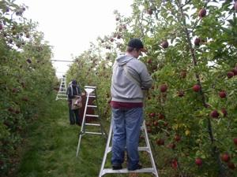
Specialty Crop Research Initiative
New innovations and technology focus area projects:
Comprehensive automation for specialty crops (apple harvester)
Innovative technologies for thinning of fruit – eliminates ladders and hand thinning
Crop signaling for automated weed/crop differentiation and mechanized weed control in vegetable crops. (eliminate need for hoeing)
http://nifa.usda.gov/funding-opportunity/specialty-crop-research-initiative-scri

Slide 22
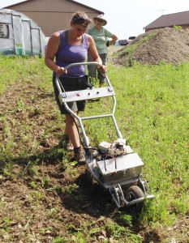
Small Business Innovative Research (SBIR)
RESEARCH & DEVELOPMENT OF ERGONOMIC TOOLS & EQUIPMENT FOR WOMEN LIVESTOCK FARMERS
by Green Horn Tools, LLC
http://www.greenherontools.com/about-us_SBIR-grant.php

Slide 23
FY 2016 in Focus

Slide 24
FY 2016 Federal Budget
Continuing Resolution until Dec. 11, 2015.
President’s proposed FY-16 total discretionary & mandatory funding: $1,687,543,000
Farm Safety (AgrAbility) & Youth Farm Safety at
$4,610,000

Slide 25
AgrAbility in FY 2016
Stakeholders' Input
  Held Listening Session on Nov. 18th
  Policy@nifa.usda.gov Subject: FY2016 AgrAbility
FY 2016 Request for Applications (RFA)
  NAP applications only
  Estimated RFA release time: Late winter
  Consider serving on the FY16 AgrAbility panel
    abalsano@nifa.usda.gov
    debodaghe@nifa.usda.gov

Slide 26
Beginning Farmer and Rancher Development Program (BFRDP)
FY-16 RFA released
Application deadline: January 21, 2016
Program and resources:
  http://nifa.usda.gov/program/beginning-farmer-and-rancher-development-program
BFRDP Grant Applicant Webinar
December 2, 2015
1pm – 4pm EST
http://nifa-connect.nifa.usda.gov/bfrdp16/

Slide 27

Rural America at a Glance
To access the report: http://www.ers.usda.gov/media/1952235/eib145.pdf

Slide 28
https://newfarmers.usda.gov/

Slide 30
Don Albrecht, WRDC
don.albrecht@usu.edu
435-797-9732
Stephan Goetz, NERCRD
sgoetz@psu.edu
814-863-4656
Scott Loveridge, NCRCRD
loverid2@msu.edu
517-432-9969
Steve Turner & Rachel Welborn, SRDC
srdc@ext.msstate.edu
662-325-3207

Slide 31
Farm Safety Within the Context of
Health and Wellness
Cooperative Extension’s
National Framework for Health and Wellness Approved 3/2014 by Extension Committee on Organization and Policy
  Full Report http://www.aplu.org/members/commissions/food-environment-and-renewable-resources/CFERR_Library/national-framework-for-health-and-wellness/file
JOE article (6/2015): Strategic Directions for Extension Health and Wellness Programs

Slide 32
NIFA Data Gateway

Slide 33

Partner with NIFA to Highlight Your Accomplishments
http://nifa.usda.gov/impacts

Slide 34
http://nifa.usda.gov/
https://twitter.com/USDA_NIFA

Slide 35
Stay Connected
Aida Balsano
National Program Leader for the AgrAbility Program
abalsano@nifa.usda.gov
202-720-4436

Slide 36


Slide 37

Thank You!

