Slide 1

Federal Update
2014 AgrAbility Virtual NTW
Dec. 2, 2014

Slide 2

Basic Webinar Instructions
Need speakers or headphones to hear the presentation. No phone connection.
Check sound via Meeting > Audio Setup Wizard
Questions about presentation
  Type into chat window and hit return.
  During the Q & A period, if you have a web cam/ microphone, click the “Raise Hand” icon to indicate that you have a question. We will enable your microphone

Slide 3
Basic Webinar Instructions
4 quick survey questions
Session recorded and archived with PowerPoint files at www.agrability.org/Online-Training/virtualntw along with resource materials
Problems: use chat window or email agrability@agrability.org

Slide 4
Known Webinar Issues
Echo
  Check to see if you are logged in twice
Disconnection with presenters
  Hang on – we’ll reconnect as soon as possible
Disconnection with participants
  Log in again

Slide 5

AgrAbility: USDA-sponsored program that assists farmers, ranchers, and other agricultural workers with disabilities.
  Partners land grant universities with disability services
  Organizations. Currently 20 state projects
  National AgrAbility Project: Led by Purdue’s Breaking New Ground Resource Center. Partners include:
    Goodwill of the Finger Lakes
    The Arthritis Foundation, Heartland Region
    University of Illinois at Urbana-Champaign
    Colorado State University
  More information available at www.agrability.org

Slide 6
Federal Update
2014 AgrAbility Virtual NTW
Dec. 2, 2014

Slide 7
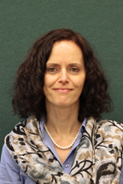
USDA/NIFA Welcome
Strengthening Families, Farms, Communities and the Economy
Aida Balsano, Ph.D.
National Program Leader
Institute of Youth, Family and Community
Division of Family & Consumer Sciences

Slide 8
Office of the Director
Equal Opportunity Staff
Institute of Food Production and Sustainability
Institute of Bioenergy, Climate, and Environment
Institute of Food Safety and Nutrition
Institute of Youth, Family, and Community
Office of Grants and Financial Management
Office of Information Technology
Budget Staff
Division of Animal Systems
Division of Bioenergy
Division of Nutrition
Division of Community and Education
Awards Management Division
Applications Division
Communications Staff
Division of Plant Systems - Protection
Division of Global Climate Change
Division of Food Safety
Division of Youth and 4-H
Policy and Oversight Division
Operations and Administrative Systems Division
Planning, Accountability, & Reporting Staff
Division of Plant Systems - Production
Division of Environmental Systems
Division of Family and Consumer Sciences
Financial Operations Division
Information Policy, Planning, and Training Division
Center for International Programs
Division of Agricultural Systems

Slide 9

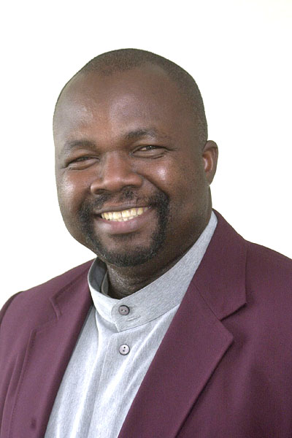
AgrAbility Staff at NIFA
National Program Leaders
Program Specialist
Aida Balsano
Denis Ebodaghe
(special focus: 1890 LGUs)
  Lelan Dixon

Slide 10
AgrAbility in FY 2014
Approximately $4.1 million
6 continuing SRAPs
1 continuing NAP
14 new SRAPs
  20 applications accepted for review
All SRAPs received $180,000/year
Notes:
NAP to continue to enhance outreach to 1890s and veterans in 2014-2015.

Slide 11
FY 2015 Federal Budget
Continuing Resolution until Dec. 11, 2014.
Mid-term Elections 2014
114th Congress begins in January 2015
House and Senate Agriculture and Agriculture Appropriations Committees
Another CR? Sequestration in 2015?

Slide 12
AgrAbility in FY 2015
Stakeholders' Input
  Listening Session -- December 18th , 2-4pm Eastern Time;
  at Policy@nifa.usda.gov; Subject: FY2014 AgrAbility RFA;
  or directly to abalsano@nifa.usda.gov;
FY 2015 Request for Applications (RFA)
  Late winter/early spring;
  Consider serving on the FY15 AgrAbility panel.

Slide 13
Other Federal Updates
Beginning Farmer and Rancher Development Program (BFRDP)
Rural Health and Safety Education (RHSE)
Rural America at a Glance
Extension Committee on Organization and Policy (ECOP) Health and Wellness Framework
Regional Rural Development Centers

Slide 14
Beginning Farmer and Rancher Development Program (BFRDP)
BFRDP 2015 Applicant Webinar
December 9, 2014 (if RFA published soon)
2pm – 3:30pm EST
http://nifa-connect.nifa.usda.gov/bfrdp15rfa/
Program and Resources
http://www.csrees.usda.gov/funding/bfrdp/bfrdp.html

Slide 15
Rural Health and Safety Education (RHSE)
Open to 1862, 1890, and 1994 LGUs
1 year funding
In FY 2014, approx. $1.4 million
  Up to $150,000/project
  12 new projects funded
Program and previous grantees
http://nifa.usda.gov/funding/rfas/rural_health.html

Slide 16
Notes:
By ERS; Nov. 2014.

Slide 17
Rural America at a Glance
To access the report: www.ers.usda.gov/publications/eb-economic-brief/eb26.aspx.
To see how USDA has invested in rural communities across the country: www.usda.gov/opportunities.

Slide 18
Health and Wellness Framework
Extension Committee on Organization and Policy (ECOP)
  Executive Summary https://www.aplu.org/document.doc?id=5115
  Full Report https://www.aplu.org/document.doc?id=5134

Slide 20
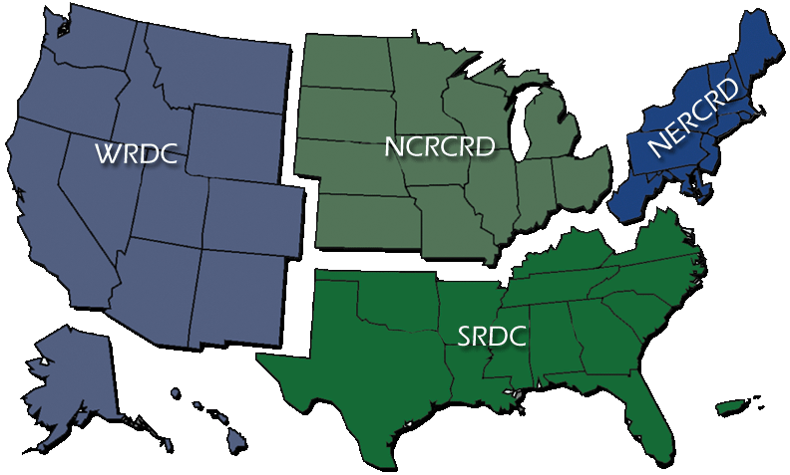
Regional Rural Development Centers
Facilitate network development Provide expertise to stakeholder groups (such as state commodities groups about agricultural clusters) Help faculty secure funding Promote development of working groups Support eXtension Communities of Practice Connect to multi-state regions; knit the country together

Slide 21
Don Albrecht, WRDC
don.albrecht@usu.edu
435-797-9732
Stephan Goetz, NERCRD
sgoetz@psu.edu
814-863-4656
Scott Loveridge, NCRCRD
loverid2@msu.edu
517-432-9969
Steve Turner & Rachel Welborn, SRDC
srdc@ext.msstate.edu
662-325-3207

Slide 22
Stay Connected
Aida Balsano
National Program Leader for the AgrAbility Program
abalsano@nifa.usda.gov
202-720-4436

Slide 23


Slide 24

Thank You!

