Slide 1
Farmer Veteran Coalition

Slide 2
Basic Webinar Instructions
Need speakers or headphones to hear the presentation. No phone connection.
Meeting > Manage My Settings > My Connection Speed
Dial-up not recommended
Questions about presentation
Type into chat window and hit return.
During the Q & A period, if you have a web cam/microphone, click the “Raise Hand” icon to indicate that you have a question
We will activate your microphone

Slide 3
Basic Webinar Instructions
4 quick survey questions
Session recorded and archived with PowerPoint files at
http://agrability.org/Online-Training/virtualntw along with resource materials
Problems: use chat window or email agrability@agrability.org

Slide 4
Known Webinar Issues
Echo
Check to see if you are logged in twice
Disconnection with presenters
Hang on – we’ll reconnect as soon as possible
Disconnection with participants
Log in again

Slide 5
AgrAbility: USDA-sponsored program that assists farmers, ranchers, and other agricultural workers with disabilities.
Partners land grant universities with disability services organizations
Currently 20 projects covering 22 states
National AgrAbility Project: Led by Purdue’s Breaking New Ground Resource Center. Partners include:
Goodwill of the Finger Lakes
The Arthritis Foundation, Heartland Region
The University of Illinois at Urbana-Champaign
Colorado State University
More information available at www.agrability.org

Slide 6
FVC Mission

Slide 7
The mission of the Farmer Veteran Coalition is to Mobilize Veterans to Feed America.

Slide 8
What We Believe
We believe that veterans possess the unique skills and character needed to strengthen rural communities
We believe that food production offers purpose, opportunity, and physical and psychological benefits.

Slide 9
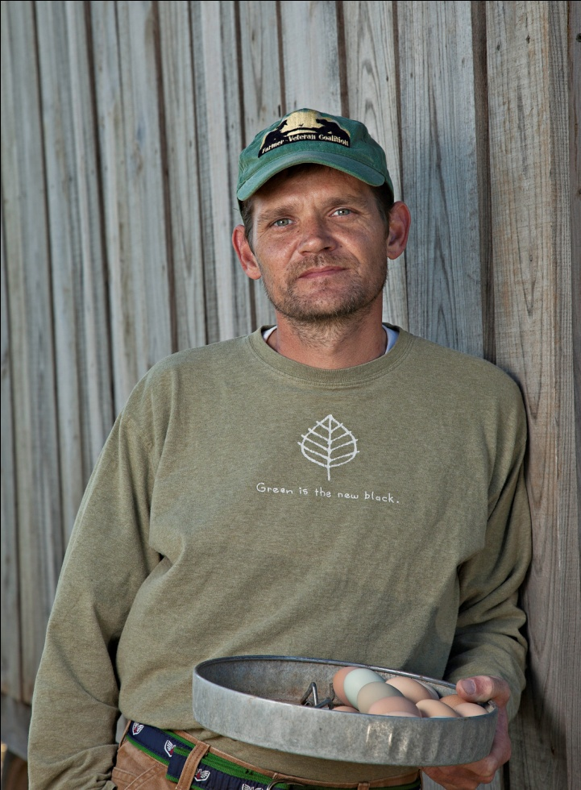
Why Vets and Farming?
The average age of a U.S. Farmer is 57 yrs old. For every 2 retiring, 1 begins
Rural America makes up 1/6 of the population of the United States; those who serve us in uniform, 45%...”
Vilsack February 18, 2010

Slide 10
Our Founder
Michael O’Gorman has over 40 years in large-scale organic production agriculture
He started FVC to help rebuild the US small farm population by training veterans to be the next generation of American farmers.

Slide 11
FVC Principles

Slide 12
One
We guide the passion of our veterans so that they may earn for themselves a meaningful and financially sustainable place in the agricultural community.
We provide training, mentorship, and financial assistance to veterans in agriculture.

Slide 13
One Continued
We recognize the tremendous range of opportunities that exist for employment throughout the agricultural economy.
We value the contributions made by all members of the agricultural industry.

Slide 14
Two
We acknowledge the plurality of agricultural practices available to our veterans. We honor, guide, and support the practical farming path chosen by each veteran.

Slide 15
Three
We are committed to leveraging our work through a network of partnerships.
We support all valid national, regional, or crop-specific efforts to connect veterans with agriculture and encourage collaboration instead of competition with other groups providing services to our nation’s veterans.

Slide 16
Four
We support and treat the whole veteran. We are aware of the high number of veterans that return with both visible and invisible wounds. We also recognize the geographic and psychological isolation common to both farmers and veterans.

Slide 17
Four Continued
Creating a network of Farmer Veterans and with that, sense of community is an important part of our mission.

Slide 18
FVC Programs

Slide 19
What does FVC do?
Informational resources on beginning farming operations
Provides information on federal programs
Apprenticeships and Internships
Assessment tools

Slide 20
What FVC does continued…
Mentorships
Educational retreats
Small grants
We cater our services to each vet individually as different areas and types of agriculture have different needs and resources.

Slide 21
The Fellowship Fund
The FVC Fellowship Fund allows us to provide small grants ($5000) on a case by case basis to assist veterans with start up costs associated with beginning operations or receive technical training in the Ag field.

Slide 22
The Fellowship Fund Cont.
To date we have re-granted almost $350,000 since April 2011
Many of our grantees are severely disabled
Some of our Fellows are now employing several of their peers

Slide 23
Homegrown by Heroes

Slide 24
FVC’s HBH National Launch
FVC has been selected by the Kentucky Department of Agriculture to take their visionary program nationwide
FVC received funding from Farm Credit to launch HBH and to provide marketing support to Farmer Veterans
Interested Veterans can contact FVC to be registered early 2014

Slide 25
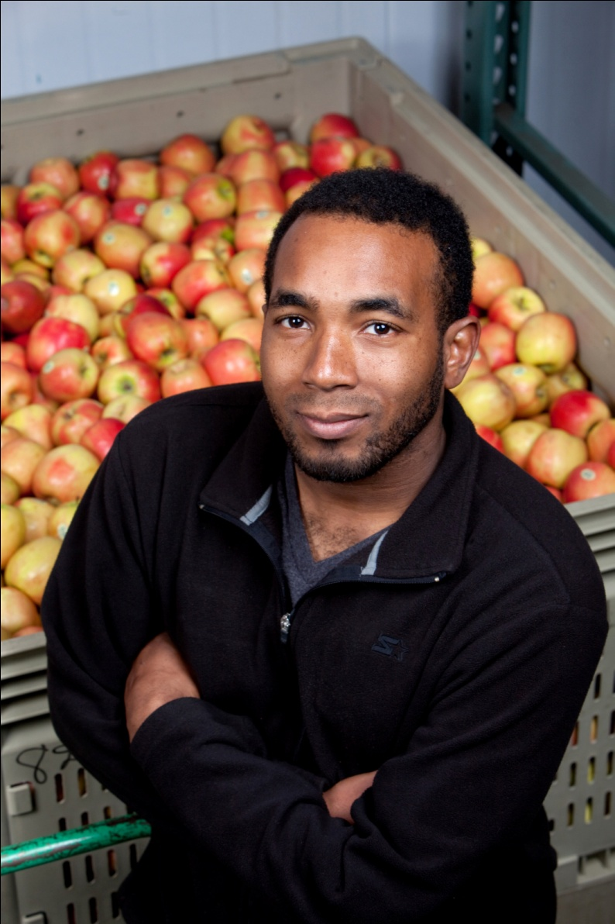
FVC Vital Stats
FVC currently has a network of over 1700 veterans in 49 states
We are working with partner agencies including Farm Credit, Farm Bureau and the NFU
FVC is set to launch as an independent 501c3 in early 2014

Slide 26
Our National Network

Slide 27
More Vital Stats
FVC believes in the value of financial mentors and literacy
The number of women veterans we work with has tripled in 2 years
We have chapters in Iowa and Maine and will be adding NY and NE

Slide 28
FVC & AgrAbility
Modern body armor and advanced battlefield medicine in Iraq and Afghanistan have made war more survivable for American service members than ever before. As a result, the wars’ severely wounded—those who in previous generations would have likely died from their wounds—are flooding the military’s hospitals and outpatient facilities.
(IAVA Issue Report, February 2010)

Slide 29
FVC & AgrAbility
We at FVC believe that AgrAbility is in a unique position to assist this growing number of disabled veterans as many of them wish to start or return to careers in the Agriculture sector.
FVC believes that along with being a source of viable employment, farming and ranching also has the ability to help veterans heal from the wounds of war.

Slide 30
Our Vets
Our vets are involved in a wide variety of Agricultural fields:
Fruit and Vegetables
Poultry
Maple Syrup production
Vineyards/ wine production
Ranching and mixed livestock
Aquaponics

Slide 31
Meet the Beyers

Slide 32
Meet Mickey Clayton

Slide 33
Meet Terrell Spencer

Slide 34
Meet Kelly Carlisle

Slide 35
Contact Us
Contact us: info@farmvetco.org
www.farmvetco.org
Ph.530-756-1395 Fax.530-756-1612

