Slide 1
FSA Farm Loan Programs Norman Cummins USDA/FSA AgrAbility Virtual National Training Workshop Thursday, February 23, 2017 11:00 a.m. ET

Slide 2
Basic Webinar Instructions
Audio available through computer or phone.
Check sound via Communicate menu at top left
Closed captions: use arrow to expand or contact the Media Viewer window.
Expand/contract any of the windows in the right-hand column with the arrows. May need to do this to see video of presenter.
Expand/contract the size of the right-hand column.

Slide 3
Basic Webinar Instructions
Questions and comments
Click Chat icon at top right of screen (it should turn blue). Enter message in box, choose who to send it to, and click send. You may enter questions about the presentation at any time. Please send to “All Panelists”.
In addition, during the Q & A period, if you have a web microphone, click the “Raise Hand” icon to indicate that you have a question. We will enable your microphone or phone connection.

Slide 4
Basic Webinar Instructions
4 quick survey questions + opportunity to share comments
Session recorded and archived with PowerPoint files at www.agrability.org/Online-Training
Problems: use chat window or email jonesp@purdue.edu

Slide 5
AgrAbility: USDA-sponsored program that assists farmers, ranchers, and other agricultural workers with disabilities.
Partners land grant universities with disability services organizations. Currently 20 state projects
National AgrAbility Project: Led by Purdue’s Breaking New Ground Resource Center.
Partners include:
Goodwill of the Finger Lakes
APRIL (Association of Programs for Rural Independent Living
Colorado State University
More information available at www.agrability.org

Slide 6
FSA Farm Loan Programs

Slide 7
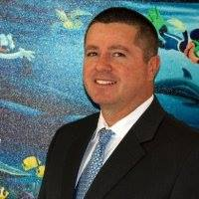
Introduction
Norman Cummins
Senior Loan Officer
United States Department of Agriculture – Farm Service Agency
Farm Loan Programs Loan Making Division
Direct Loans/Fund Management Branch
Washington, DC

Slide 8
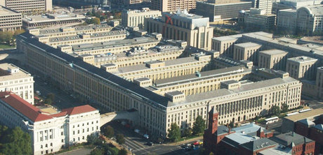
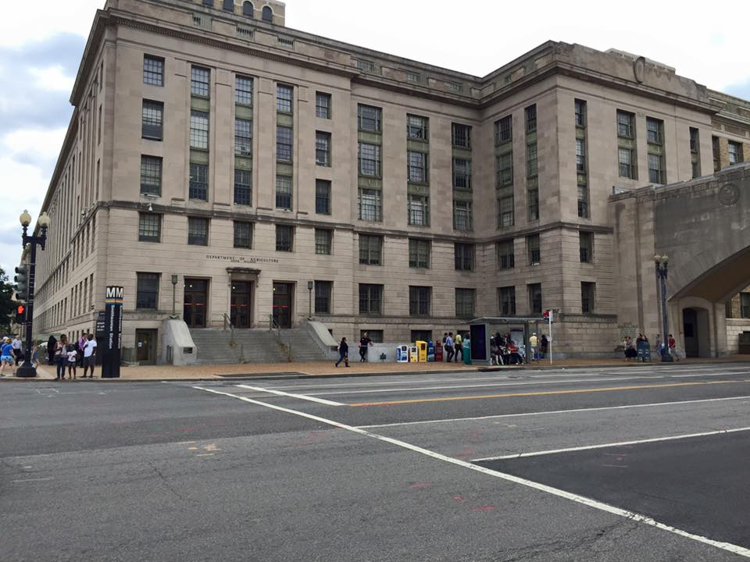
Introduction
USDA/FSA Headquarters

Slide 9
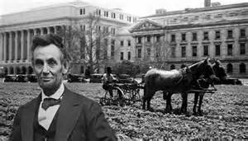
What is the Farm Service Agency?
The U.S Department of Agriculture’s (USDA), Farm Service Agency (FSA) provides services to farmers through loans, payment programs, commodity price support, conservation efforts and disaster recovery assistance.
These programs are administered through 51 state offices and over 2,124 county offices, including offices in U.S. territories.

Slide 10
Loan Programs
FSA is a lender of first opportunity and provides credit to agricultural producers who are unable to receive private, commercial credit.
If you are a farmer or rancher who is unable to obtain credit from another lender to start, purchase, sustain or expand your family farm you may be able to get a loan through FSA’s Farm Loan Programs.
FSA has different types of loans depending on your current situation and what you need the loan for. FSA loan officers are available to answer your questions and to help with the application process.

Slide 11
Types of Loans
Farm Operating
Farm Ownership
Emergency Farm Loans
Guaranteed Farm Loans
Minority & Women Farmers & Ranchers
Beginning Farmers & Ranchers
Rural Youth Loans

Slide 12
FSA Guaranteed Farm Loans
FSA guaranteed loans provide lenders (e.g., banks, Farm Credit System Institutions, credit unions) with a guarantee of up to 95 percent of the loss and interest on a loan. Farmers and ranchers apply to an agriculture lender, which then arranges for the guarantee. The FSA guarantee permits lenders to make agricultural credit available to farmers who do not meet the lender’s normal underwriting criteria.
Maximum loan amount up to $1,399,000 for FY17 (Amount adjusted annually for inflation).
Maximum term up to 40 years depending on loan type.

Slide 13
FSA Direct Farm Loans
General Eligibility Requirements:
No Controlled Substance Convictions.
Applicant and anyone signing promissory note must possess the legal capacity to incur the obligation of the loan.
Applicant and anyone who will sign the promissory must be a citizen of the United States, United States non-citizen national, or a qualified alien under applicable Federal immigration laws.
Applicant must have acceptable credit history demonstrated by debt repayment.

Slide 14
FSA Direct Farm Loans
General Eligibility Requirements:
Applicant and all entity members in the case of an entity must be unable to obtain sufficient credit elsewhere to finance actual needs at reasonable rates and terms.
Applicant and anyone who will sign the Promissory Note must not be in delinquent status on any Federal debt, other than a debt under the Internal Revenue Code of 1986 at the time of closing.
Applicant and anyone who will sign the promissory note must have no outstanding unpaid judgments obtained by the United States in any court. Such judgements do not include those filed as a result of action in the United States Tax Courts.

Slide 15
FSA Direct Farm Loans
General Eligibility Requirements:
Applicant and all entity members in the case of an entity must not be ineligible due to disqualification resulting from Federal Crop Insurance violation, according to 7 CFR Part 718.
Applicant must have sufficient managerial ability to assure reasonable prospect of loan repayment, as determined by Agency.
Borrower must agree to meet the training requirements if required by Loan Officer.
Applicant must be the operator of a family farm after the loan is closed.

Slide 16
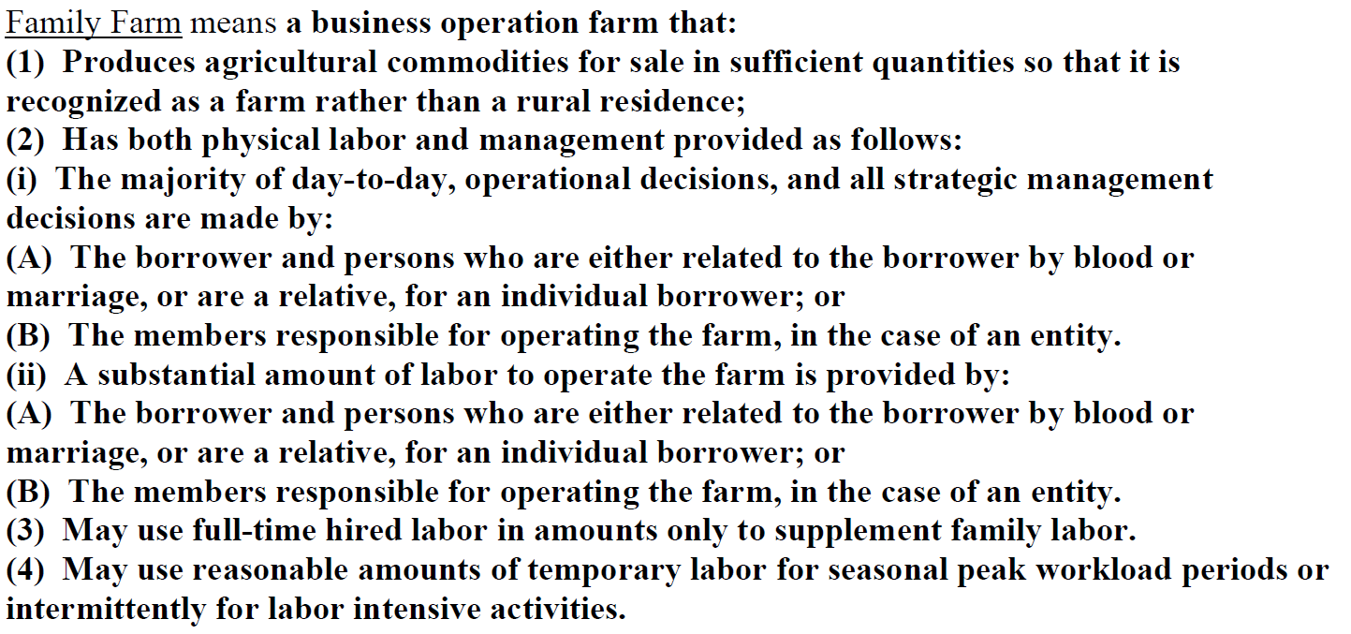
FSA Direct Farm Loans

Slide 17
FSA Direct Farm Loans
Farm Ownership (FO) Program
FO funds may only be used to:
Acquire or enlarge a farm or make a down payment on a farm.
Make capitol improvements to a farm by the applicant, for construction, purchase or improvement of farm dwellings, service building or other facilities and improvements essential to the farming operation.
Soil and Water Conservation and Protection.
Loan Closing Costs.
Refinance Bridge Loans if conditions are met.

Slide 18
FSA Direct Farm Loans
Farm Ownership (FO) Program
FO Funds Eligibility:
Must comply with the general eligibility requirements discussed earlier.
No prior debt Forgiveness.
Must be the owner-operator of the farm financed with Agency funds the loan is closed. Ownership of the farm operation and farm real estate may be held either directly in the individual’s name or indirectly through interest in a legal entity.
Applicant must have participated in the business operations of a farm for at least 3 years out of the 10 years prior to the date of the application submitted.

Slide 19
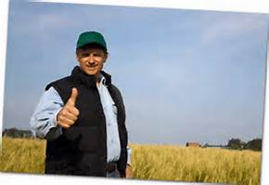
FSA Direct Farm Loans
Farm Ownership (FO) Program
FO Funds Eligibility:
Anyone who will sign the promissory note must at least one of the following conditions:
Meet the definition of a beginning farmer.
Have not had a direct FO loan outstanding for more than a total of 10 years prior to the date the new loan closed.

Slide 20
FSA Direct Farm Loans
Farm Ownership (FO) Program
FO Loan Limit:
The outstanding principal balances for a farm loan applicant or anyone who will sign the promissory note cannot exceed $300,000 for a Direct FO. In the case of an entity, the outstanding balance is considered separately for each individual member, it is not considered as a total of all members’ outstanding Direct FO principal balances.

Slide 21
FSA Direct Farm Loans
Farm Ownership (FO) Program
Refinancing of real estate debt is prohibited except for bridge loans.
Applicants will be required to comply with applicable Federal, State, and local laws and regulations governing building construction; diverting, appropriating, and using water including use for domestic purposes; installing facilities for draining land; and making changes in the use of the land affected by zoning regulations.

Slide 22
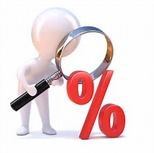
FSA Direct Farm Loans
Farm Ownership (FO) Program
Interest:
The interest rate is the Agency’s Direct Farm Ownership rate, available in each agency office.

Slide 23
FSA Direct Farm Loans
Farm Ownership (FO) Program
Terms:
Except for Microloans' made for FO purposes, the agency schedules repayment for an FO loan based on the applicant’s ability to repay and the useful life of the security. In no event will the term be more than 40 years from the note.

Slide 24
FSA Direct Farm Loans
Farm Ownership (FO) Program
Terms:
For Microloans'’ made for FO purposes, the Agency schedules repayment of an FO based on the applicant’s ability to repay and the useful life of the security. In no event will the term be more than 25 years from date of the note.

Slide 25
FSA Direct Farm Loans
Farm Ownership (FO) Loans
All notes are scheduled with annual payments.

Slide 26
FSA Direct Farm Loans
Operating Loan (OL) Program
Uses:
Costs associated with reorganizing a farm to improve its profitability.
Purchase of livestock, including poultry, farm equipment, quotas and bases, and cooperative stock for credit, production, processing or marketing purposes.
Farm operating expense, including but not limited to: feed, seed, fertilizer, pesticides, farm supplies, repairs and improvements which are to be expensed, cash rent and family living expenses.

Slide 27
FSA Direct Farm Loans
Operating Loan (OL) Program
Uses:
Scheduled principal and interest payments on term debt provided the debt is for authorized FO or OL purposes.
*The payment must be current year’s installment and cannot be delinquent.*
Funds can be used to finance the initial processing of agricultural commodities provided that a majority of the agricultural commodities processed are produced by the applicant’s farm.

Slide 28
FSA Direct Farm Loans
Operating Loan (OL) Program
Uses:
Costs associated with land and water development, use, or conservation.
Loan closing costs that are reasonable and customary.
Costs associated with Federal or State-approved standards under the Occupational Safety and Health Act of 1970 if the applicant can show that compliance or non-compliance with standards will cause substantial economic injury.

Slide 29
FSA Direct Farm Loans
Operating Loan (OL) Program
Uses:
Borrower training costs when required or recommended by the Agency.
Refinancing farm-related debts other than real estate to improve farm’s profitability, provided the applicant has refinanced direct or guaranteed OL loans four times or fewer and one of the following conditions is met –
(1) A designated or declared disaster caused the need for refinancing
(2) The debts to be refinanced are owed to a creditor other than the USDA.

Slide 30
FSA Direct Farm Loans
Operating Loan (OL) Program
Uses:
Costs for minor real estate repairs or improvements, provided the loan can be repaid within 7 years.

Slide 31
FSA Direct Farm Loans
Operating Loan (OL) Program
Eligibility:
The applicant must comply with the general eligibility.
The applicant and anyone who signs the promissory note must not have received debt forgiveness from the Agency on any direct or guaranteed loan.

Slide 32
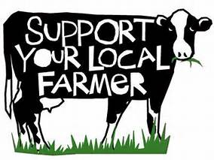
FSA Direct Farm Loans
Operating Loan (OL) Program
Eligibility:
Operator of the Farm (Authorized to operate the farm in the State in which the farm is located.)

Slide 33
FSA Direct Farm Loans
Operating Loan (OL) Program
Eligibility:
OL Term Limits – The applicant and anyone who will sign the promissory not, may close an OL in no more than seven calendar years, either as an individual or as a member of an entity. The years may be consecutive or non-consecutive, and there is no limit on the number of OL’s closed in a year. Microloans made to a beginning farmer or a veteran farmer are not counted toward this limitation. Youth loans are not counted toward this limitation.

Slide 34
FSA Direct Farm Loans
Operating Loan (OL) Program
Eligibility:
OL Term Limits – The maximum number of years a beginning farmer may receive OL assistance is 10 years.

Slide 35
FSA Direct Farm Loans
Operating Loan (OL) Program
Loan Limits:
The outstanding principal balances for a farm loan applicant or anyone who will sign the promissory note cannot exceed $300,000 for a Direct OL. In the case of an entity, the outstanding balance is considered separately for each individual member, it is not considered as a total of all members’ outstanding loan principal balances.

Slide 36
FSA Direct Farm Loans
Operating Loan (OL) Program:
All notes are scheduled with annual payments.

Slide 37
FSA Direct Farm Loans
Operating Loan (OL) Program
Loan Terms:
Annual OL Term – May not exceed 18 months from the date of the note.
Other OL Terms – The Agency schedule the repayment of all other OL loans based on the applicant’s ability to repay and the useful life of the security. In no event will the term of the loan exceed 7 years from the date of the note.
*Repayment schedules may include equal, unequal, or balloon installments if needed to establish a new enterprise, develop a farm, or recover from a disaster or economic reversal*

Slide 38
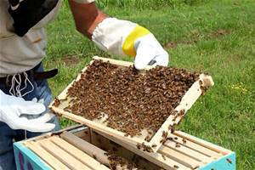
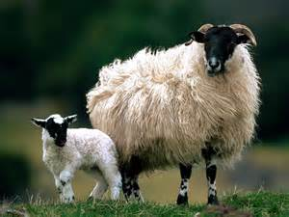
FSA Direct Farm Loans
Microloan
Overview
The Farm Service Agency (FSA) developed the Microloan program to better serve the unique financial operating needs of beginning, niche and the smallest of family farm operations such as, but not limited to:
Organic production
Community Supported Agriculture (CSAs)
Small scale livestock
Shellfish operations such as clams or oysters
Honey cheese producers

Slide 39
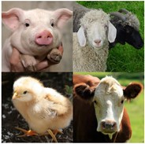
FSA Direct Farm Loans
Microloan
Direct Operating Microloan
Maximum Loan Amount - $50,000
Loan Terms – 1 to 7 years
Direct Farm Ownership Microloan
Maximum Loan Amount - $50,000
Loan Terms – Up to 25 years

Slide 40
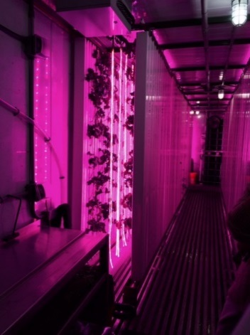
Use of FSA Microloan Microloans can be used for all approved operating expenses as authorized by the FSA Operating Loan Program, including but not limited to:
Initial start up expenses
Annual expenses such as seed, fertilizer, utilities, land rents
Marketing and distribution expenses
Family living expenses
Purchase of livestock, equipment, and other materials essential to farm operations
Minor farm improvements such as wells and coolers
Hoop houses to extend the growing season
Essential tools
Irrigation
Delivery vehicles

Slide 41
FSA Direct Farm Loans
Security
All loans must be secured by assets having a security value of at least 100% of the loan amount.
An additional amount of security up to 150% of the loan amount will be taken when available, except for down payment loans, Microloans made for purposes other than annual operation and youth loans.
The Agency will choose the best security available when there are several alternatives that meet the Agency’s security requirement.

Slide 42
FSA Direct Farm Loans
Security
The Agency will take a lien on all assets that are not essential to the farming operation and are not being converted to cash to reduce the loan amount when each such asset, or aggregate value of like assets (Such as stocks), has a value in excess of $5,000. This requirement does not apply to down payment loans, conservation loans, microloans, or youth loans.

Slide 43
FSA Direct Farm Loans
Security
The same real estate may be pledged as security for more than one direct or guaranteed loan.
The same chattel may be pledged as security for more than one direct or guaranteed loan.

Slide 44
FSA Direct Farm Loans
Security
If real estate is pledged as security for loan, the Agency must obtain a first lien, if available. When a first lien is not available, the Agency may take a junior lien under the following conditions:
The prior lien does not contain any provisions that may jeopardize the Agency’s interest or the applicant’s ability to repay the FLP loan.
Prior lienholders agree to notify the Agency prior to foreclosure.
The applicant must agree not to increase an existing prior lien without the written consent of the Agency and equity in the collateral exists.

Slide 45
FSA Direct Farm Loans
Loan Decision
Timeframe:
Within 60 calendar days after a FSA loan officer receives a complete loan application, the Agency will complete the processing of the loan request and notify the applicant of the decision reached, and the reason for any disapproval.

Slide 46
FSA Direct Farm Loans
Loan Decision
Eligibility:
Does the applicant meet the general eligibility and specific eligibility requirements for the type of loan?

Slide 47
FSA Direct Farm Loans
Loan Decision
Feasibility
Security
Environmental

Slide 48
FSA Direct Farm Loans
Borrower Training Requirements
The purpose of production and financial management training is to help an applicant develop and improve skills necessary to:
Successfully operate a farm.
Build equity in the operation.
Become financially successful and prepared to graduate from Agency financing to commercial sources of credit.

Slide 49
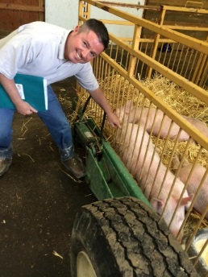
FSA Direct Farm Loans
Borrower Training Requirements
The applicant must agree to complete production and financial management training, unless the Agency provides a waiver in accordance with CFR 764.453, or the applicant has previously satisfied the training requirements.

Slide 50
FSA Direct Farm Loans
Borrower Training Requirements
An applicant who applies for a loan to finance a new enterprise, such as a new crop or a new type of livestock, must agree to complete production training with regard enterprise, even if production training requirements were waived or satisfied under a previous loan requests, unless the Agency provides a waver in accordance with CFR 764.453.

Slide 51
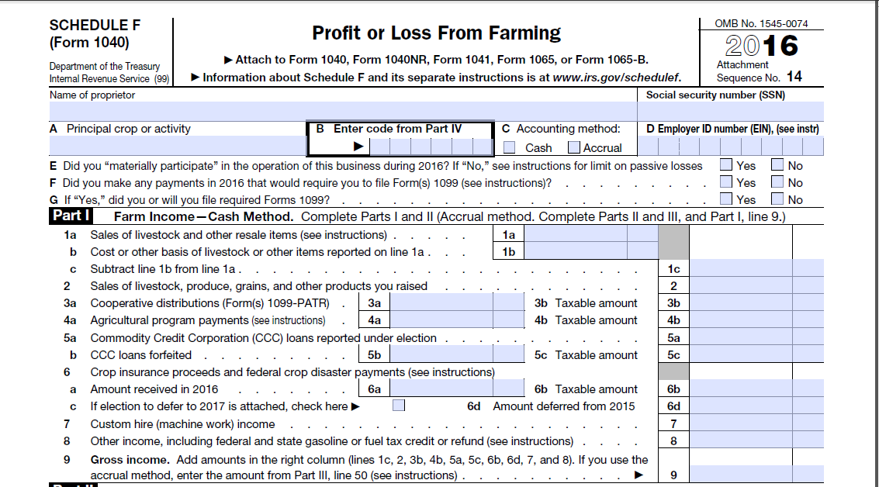
FSA Direct Farm Loans
LO Tips

Slide 52
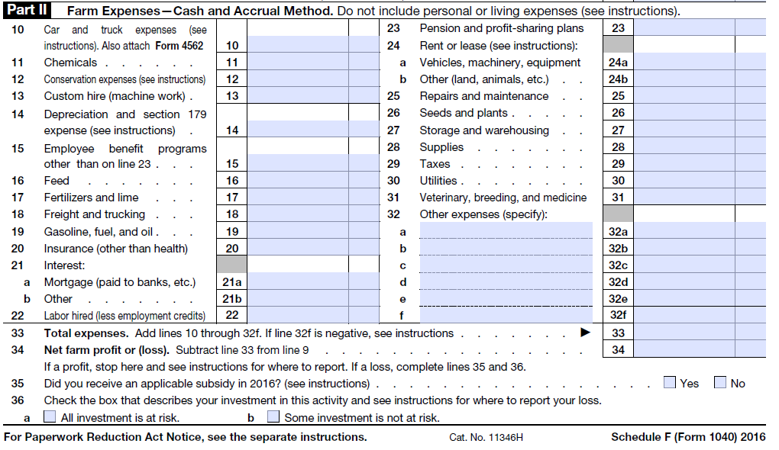
FSA Direct Farm Loans

Slide 53
FSA Direct Farm Loans
Obtaining a Loan Application
Any FSA Office
FSA’s website at www.fsa.usda.gov
eGov’s website at www.sc.egov.usda.gov

Slide 54
FSA Direct Farm Loans
An Agency Official Will:
Not refuse to provide a requested application to an any person.
Not discourage the prospective applicant to apply for a direct loan even when funds are limited or unavailable.
Not make oral or written statements that would discourage any individual from applying for assistance based on any ECOA prohibited basis (race, color, religion, national origin, sex, marital status, age, applicant’s income deriving from public assistance, or because the applicant has in good faith exercised any rights under the Consumer Protection Act).
Will provide assistance as necessary to help applicants complete the application.

Slide 55
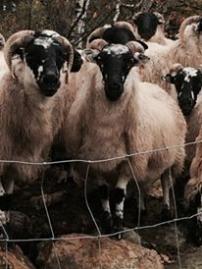
FSA Direct Farm Loans
Contact Information:
Norman Cummins
Senior Loan Officer
(202) 720-3168
Norman.Cummins@wdc.usda.gov

Slide 56
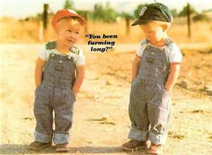
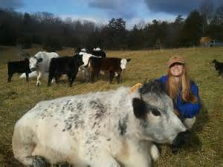
Q & A

