Slide 1
Secondary Injury: A Conversation with Farmer Ed Bell
Thursday, December 3, 2015

Slide 2
Basic Webinar Instructions
Check sound via Audio>Computer Audio Settings.
Please don’t activate camera.
Closed captions: use arrow to expand the Closed Captions window to view.
Expand/contract any of the windows in the right-hand column with the arrows.
Expand/contract the size of the right-hand column.

Slide 3
Basic Webinar Instructions
Questions and comments
Click Chat icon at top right of screen (it should turn blue). Enter message in box, choose who to send it to, and click send. You may enter questions at any time
In addition, if you have a web microphone, click the “Raise Hand” icon to indicate that you have a question. We will enable your microphone

Slide 4
Basic Webinar Instructions
5 quick survey questions + opportunity to share comments
Session recorded and archived with PowerPoint files at www.agrability.org/Online-Training/archived
Problems: please use chat window

Slide 5
Potential Webinar Issues
Audio continues, but slides don’t advance
Move your mouse or hit Enter
Disconnection with presenters
Hang on – we’ll reconnect as soon as possible
Disconnection with participants
Log in again

Slide 6
AgrAbility: USDA-sponsored program that assists farmers, ranchers, and other agricultural workers with disabilities.
Partners land grant universities with disability services organizations. Currently 20 state projects
National AgrAbility Project: Led by Purdue’s Breaking New Ground Resource Center. Partners include:
Goodwill of the Finger Lakes
The Arthritis Foundation, Heartland Region
University of Illinois at Urbana-Champaign
Colorado State University
More information available at www.agrability.org

Slide 7
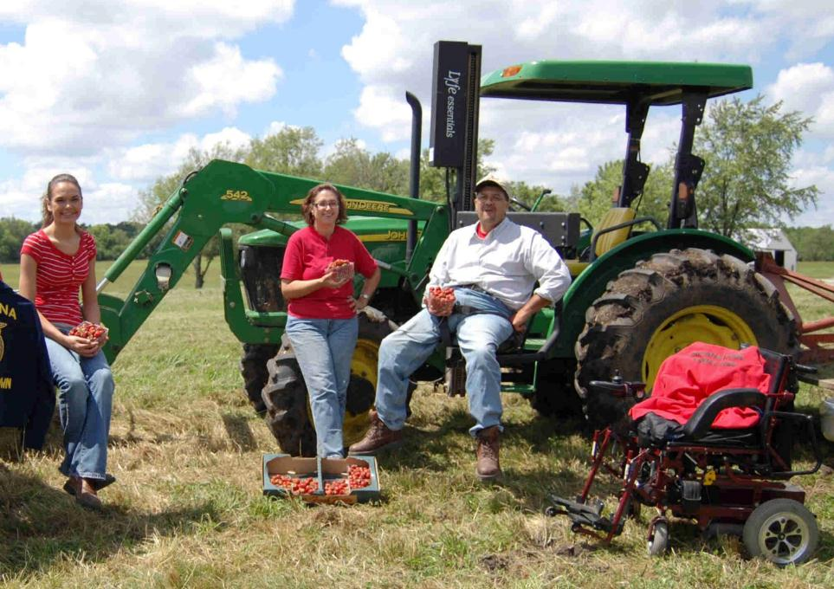
Ed Bell
Hagerstown, Indiana

Slide 8
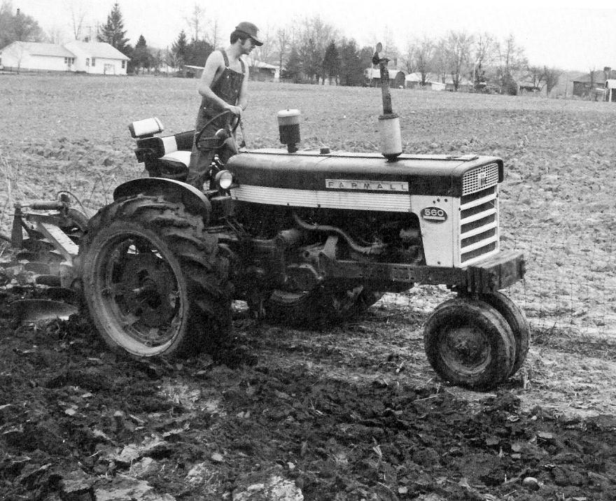

Slide 9
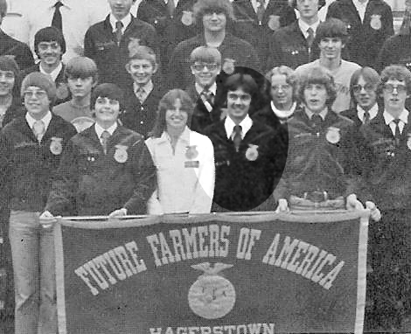

Slide 10
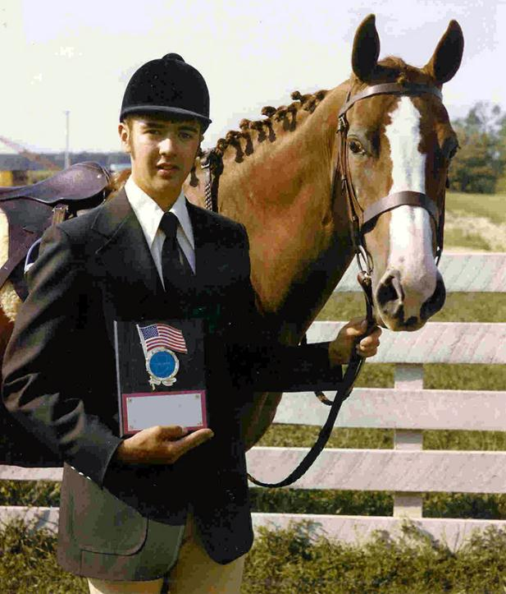

Slide 11
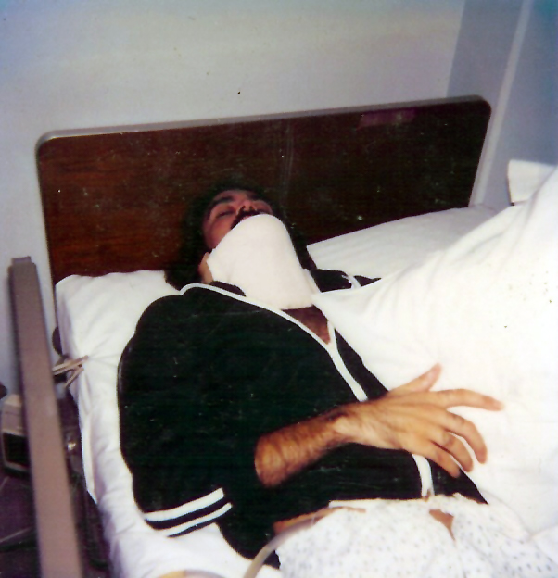

Slide 12
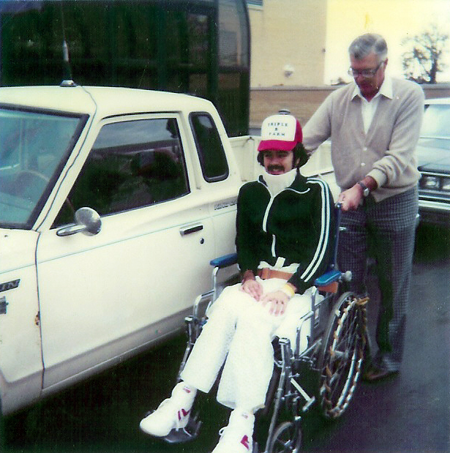

Slide 13
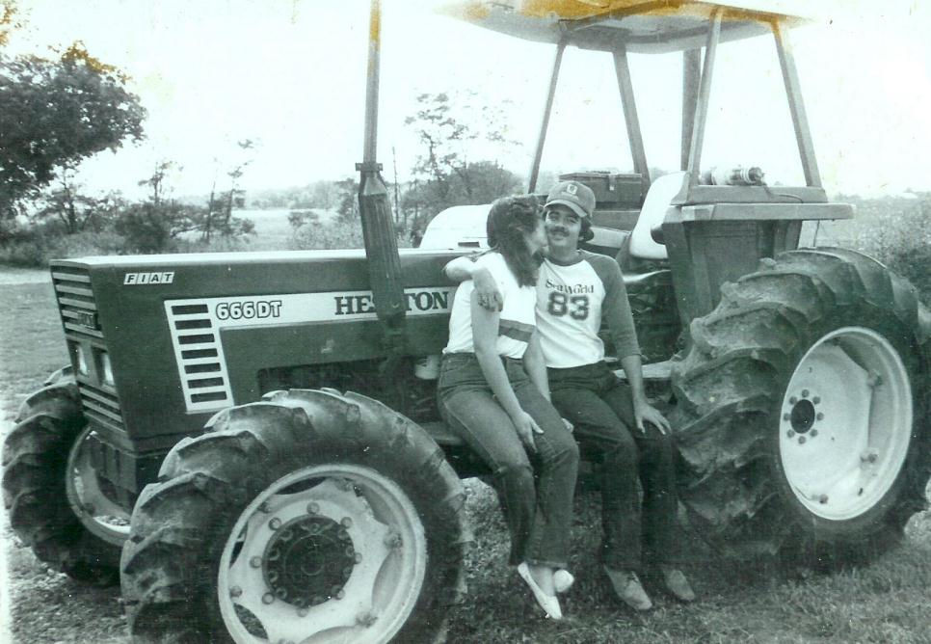

Slide 14
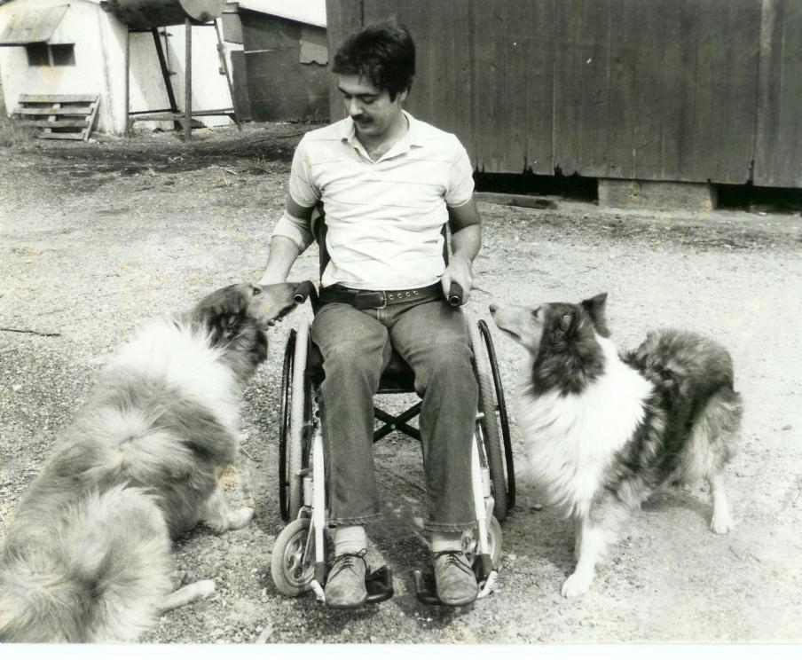

Slide 15
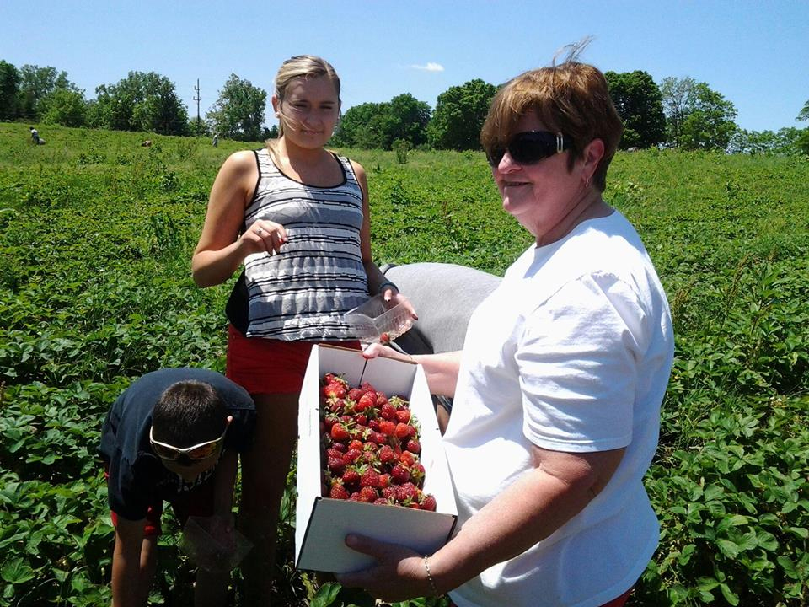

Slide 16
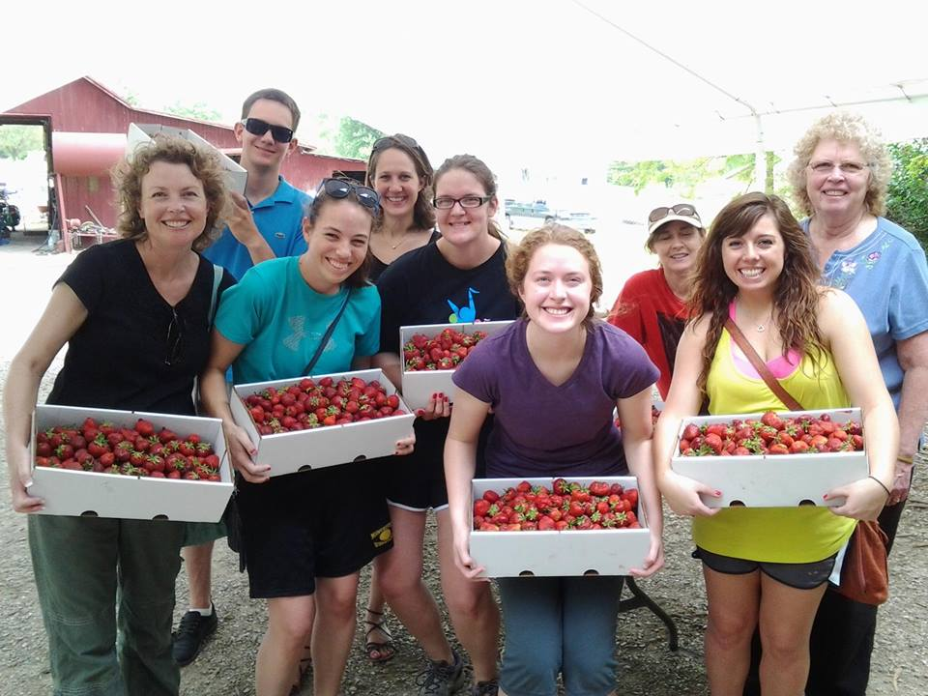

Slide 17
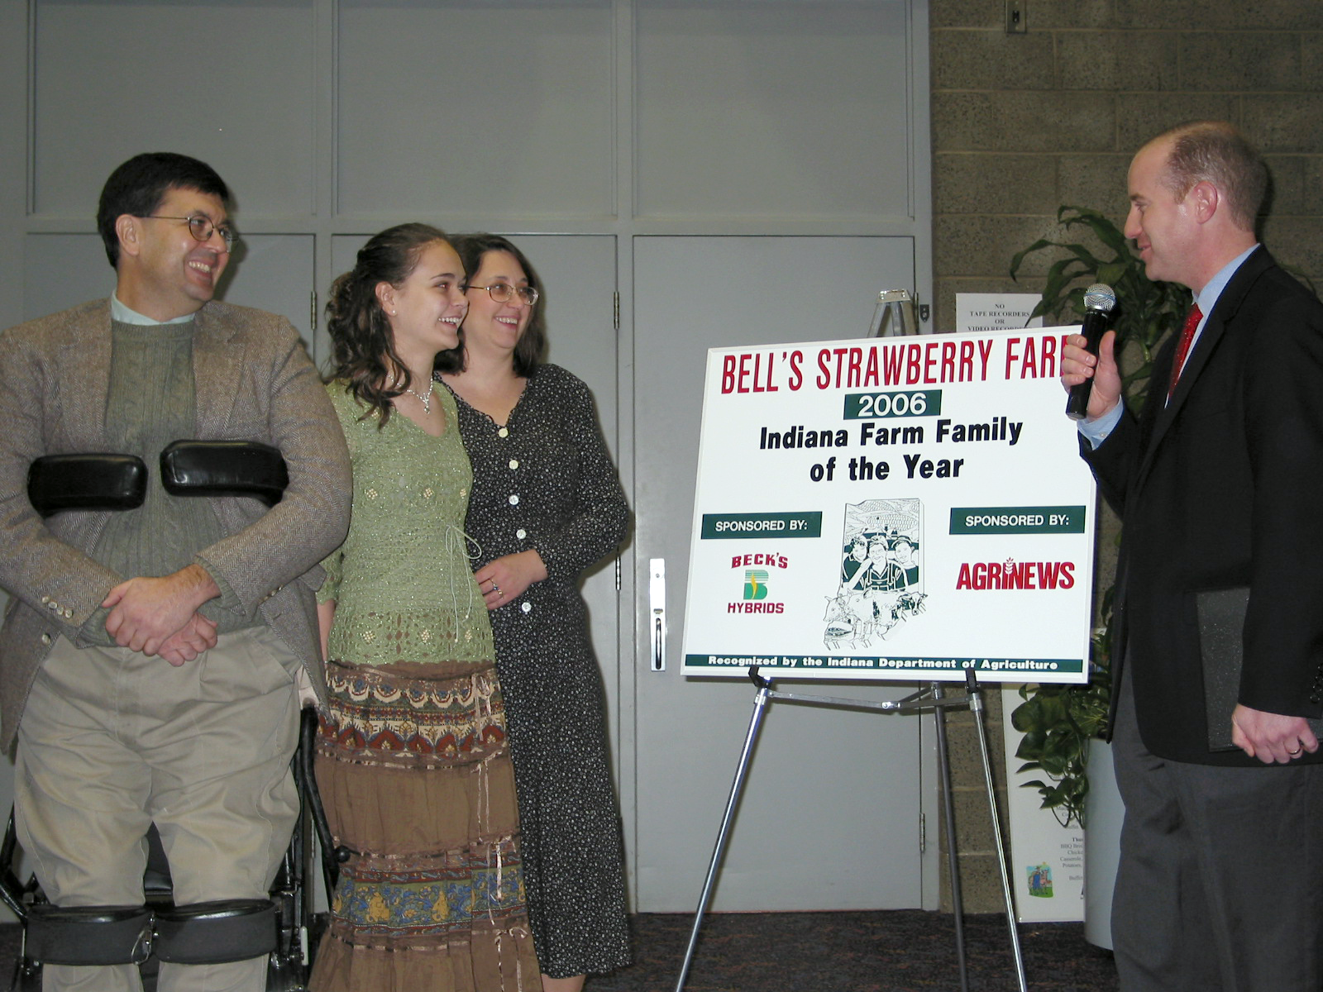

Slide 18
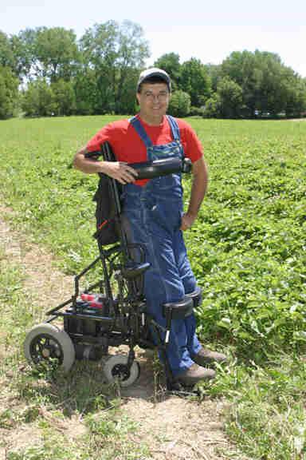

Slide 19
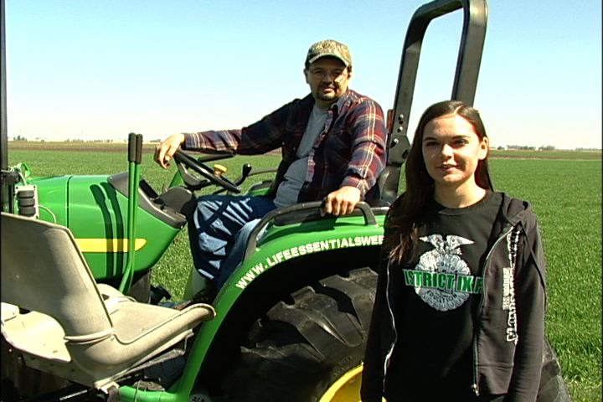

Slide 20
www.agrability.org/Resources/at

Slide 21
Definition of Secondary Injury
Secondary injury can be defined as injury caused by limitations associated with disabling conditions and/or resulting from the use of modified practices or AT to compensate for disabling conditions.

Slide 22
Examples of Secondary Injury
Burns
Fractures
Pressure sores
Amputation
Loss of hearing

Slide 23
The Need
Physical and mental disabling conditions can increase the potential of injuries for farmers who continue to perform tasks
Studies indicate that > 72% of farmers with disabilities fabricate their own AT to continue to perform tasks
Both commercial and home-fabricated AT can cause injuries
(Allen et al., 1995; Willkomm, 2004)
Notes:
Severe disability of an individual in a farm family significantly impacts spouse, children, parents and others closely related. Sometimes, farmers who decide to continue farming do this despite discouragement from medical and other professionals, family members and friends. They are taking the risk hoping that further injuries will not happen as they find out methods to overcome their disabilities. One estimate puts about 72% of farmers fabricate some kind of AT to overcome their inability to perform tasks they used to do. However disabling conditions, either physical or mental, can increase the potential for injuries for farmers who continue to perform farm tasks.

Slide 24
Assessment Tool - Objectives
Provide an evaluation method for funding agencies to reasonably estimate the safety of home-fabricated AT
Training tool for rehabilitation professionals to assess AT used by farmers with disabilities
Prevention of secondary injuries

Slide 25
Assessment Tool - Objectives
Help the assessor to identify potential for injury to the user
The assessor can provide suggestions for preventive /corrective measures to avoid or minimize risk of injury

Slide 26
Home-fabricated AT – Lifts

Slide 27
Home-fabricated AT – Added Steps

Slide 28
Home-fabricated AT – Cultivating Cart

Slide 29
Home-fabricated AT – Utility Vehicle

Slide 30
Home-fabricated AT – Lift

Slide 31
Home fabricated AT –- Home Access Lift

Slide 32
Home-fabricated AT – Lift

Slide 33
Home-fabricated AT – Added Steps

Slide 34
Home-fabricated AT – Added Spring Loaded Steps

Slide 35
Home-fabricated AT – Lift

Slide 36
Contents of Assessment Tool
Section I – Introduction
Section II – Steps in Assessment Process
Section III - Reference sheets
w/Descriptions and Pictures
Section IV – Assessment Example with all Worksheets filled
Section V Copy ready assessment sheets (Worksheets A to F)

Slide 37
Contents (…contd)
Worksheet A Client & Disability Information
Worksheet B AT Information
Worksheet C Quick Reference sheet
Worksheet D Assessment Questions
Worksheet E Problems Observed/Solutions
Worksheet F Results & Recommendations

Slide 38
Suggested Toolkit for Assessment
Clipboard
Digital Camera
Measuring tape
Angle finder
Calculator
Wire brush
Magnifying glass
Screwdriver
Pliers
Fish scale
Voltage tester
Level

Slide 39
Sample Home-fabricated AT - Lift
Frail construction (1)
No emergency exit (5)
Winch mechanism not certified for human lifting (6)
Dangling wires (18)
Sharp edges and corners (25)
Projections on moving parts (26)
No proper seat belts (38)
No stabilizing supports (41)
No back-up power source (47)
No back-up control switches (48)
No operating instructions (49)
And many more …..

Slide 40
Home-fabricated AT – Cultivating Cart
No brakes (12)
Pinch points (22)
Sharp edges and corners (25)
Unshielded moving parts (27)
Weather related restrictions (37)

Slide 41
Home-fabricated AT -Skid Loader Platform
Overall weight (8)
Sharp edges or corners (25)
Slippery surfaces (30)
Handrails and handholds (42)

