Slide 1

Cold Work Injuries in Agriculture - Strategies for Prevention and Rehabilitation
Qiuqing Geng, Ph.D.
JTI-Swedish Institute of Agricultural and Environmental Engineering
Robert Stuthridge, Ph.D.
Purdue University
Department of Agricultural and Biological Engineering

Slide 2
Basic Webinar Instructions
Need speakers or headphones to hear the presentation
Meeting > Manage My Settings > My Connection Speed
  Dial-up not recommended
Questions about presentation – type into chat window and hit arrow, and they’ll be addressed at the end.
To hide captions, click CC icon>Display>None
Problems: use chat window or email cookke@purdue.edu
4 quick survey questions
Session recorded and archived with PowerPoint file at www.agrability.org Online Training link

Slide 3

AgrAbility: USDA-sponsored program that assists farmers, ranchers, and other agricultural workers with disabilities.
  Partners land grant universities with disability services organizations
  Currently 23 projects covering 25 states
  National AgrAbility Project: Purdue’s Breaking New Ground Resource Center, Goodwill Industries International, the Arthritis Foundation-Indiana Chapter, University of Illinois at Urbana-Champaign
  More information available at www.agrability.org

Slide 4

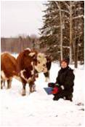

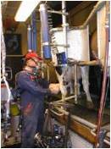
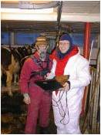
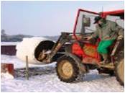

Agricultural work in cold weather
Changing environment
Outdoor cold exposure
Indoor cold exposure
32-50 °F; Wind speed < 0,4 m/s
Notes:
Outdoor cold exposure:
Climate is changing - unpredictable temperature, wind, snowfall or rain. Ground may be covered by dry or wet snow or ice.
Physical activity during outdoor cold exposure is often too low to produce enough heat to counteract environmental cooling.
Changing environment is typical problem in agricultural working environment:
Different length of cold exposures are interrupted by periods spent indoors. Together with the change in environment, physical activity may also change. Periods of sweating and subsequent cooling thereafter are also common.
This makes it difficult to dress appropriately and leads easily to both excessive and insufficient thermal clothing insulation.
Changing environment and activity require continuous thermoregulatory adjustments which may cause a special type of stress.
Indoor cold exposure:
When working in the animal barns, milking parlors and in the cabins of farming machinery.
Most common is exposure to air temperatures between 32-50 °F; Wind speed < 0,4 m/s.

Slide 5
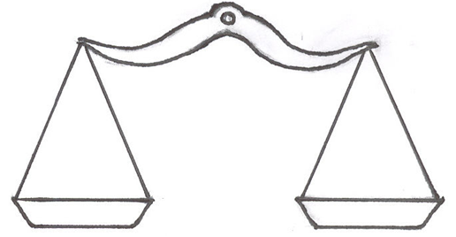

Cold effect on human thermal balance
convection
food , rest & muscular work
Heat
production
Heat
loss
conduction
radiation
evaporation
  Thermal Balance: Heat production = heat loss
The body (core) temperature should be maintained at 98.6 °F
Notes:
The effects of cold on human thermal balance
A human is in a state of thermal balance when:
heat production = heat loss
Efficient and optimal function of the human body requires body and tissue temperatures to be kept within a narrow range. This is most pronounced for the deep tissue (core) temperature, which is maintained at about 98,6 °F.
The main factors affecting the body’s thermal balance are climate, clothing, food intake and activity.
Heat production: an individual produces body heat via food (warm, sweet, caffeine-free & non-alcoholic drinks, soup) rest in a warm condition and muscular work.
Heat loss: by convection, conduction, radiation, and sweating to maintain a constant body temperature of approximately 98.6°F.

Slide 6
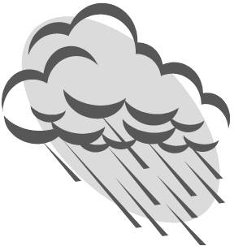

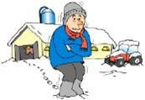
Cold Environment
  Cold environment = Conditions that cause greater than normal body heat losses:
  Low air temperature
  Radiant temperature
  High cool wind speed
  Air humidity
The body responds to cold by:
Constricting dermal blood vessels
Shivering
Notes:
A cold environment is defined by conditions that cause greater than normal body heat losses.
In the cold environment the large temperature gradient between the body surface and the environmental facilitates heat losses
The body responds to cold by:
Constricting the blood vessels of the skin; reduces heat loss from the surface of the skin by decreasing peripheral blood flow, and
Shivering, which generates heat by increasing the body’s metabolic rate.
Wind chill (temperature and wind velocity) is an important factor to evaluate cold exposure. For example, when the actual air temperature of the wind is 40°F and its velocity is 35 mph, the exposed skin would perceive these conditions as if the equivalent still air temperature were 11°F.
A dangerous situation of rapid heat loss may arise for any individual exposed to high winds and cold temperatures.

Slide 7
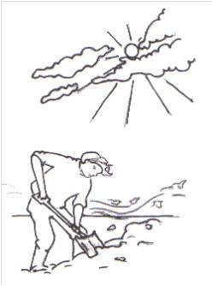
How do we lose heat in the cold?
Mode of heat loss | Climatic factor | Other factors
Convection | Air temp Wind speed | Activities Clothing isolation
Radiation | Radiant temp | Clothing Color of surface
Conduction | Surface temp | Clothing Properties of contact material
Evaporation | Humidity Air temp Wind speed | Activities Clothing
Evaporation
Radiation
Convection
Conduction
Convection increases with higher wind speed,
conduction occurs from hands to the cold spade and from feet to the ground
Notes:
Different types of heat loss :
Convection: transfer heat from the body surface to the cold. Wind accelerates this kind of heat loss. About 50-80 % of all heat can be lost by this mode that depending on wind and activity.
Radiation: heat is radiated from the surface of the body to the colder environment.
With adequate protection the radiant heat loss is 20 % or less, because of the low temp gradient between the clothing surface and the environment. In sunshine the body may gain some heat by absorption of the solar radiation.
Conduction: heat is lost to colder surface by contact a cold object.
When parts of the body, for example a hand, contact a cold object, heat is lost by conduction. This form of heat loss can result in a hand cooling in manual work.
Evaporative cooling: a powerful means of losing heat when the body is warm
With many layers of clothing in the cold, evaporative cooling is not efficient. Moisture is trapped in clothing, resulting in a loss in insulation capacity that may endanger heat balance when heat production diminishes.

Slide 8


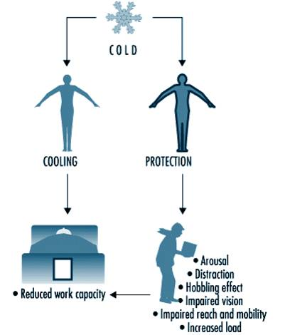
Cold stress
Cold stress - thermal load on the body when abnormal heat loss is anticipated and compensatory thermoregulatory actions are needed to maintain a thermally neutral state.
Cold and cold protection effects on work
Notes:
Cold stress is defined as a thermal load on the body under which abnormal heat losses are anticipated and compensatory thermoregulatory actions are required to maintain the body in a thermally neutral state.
Cold stress may be present in many different forms, affecting the whole-body heat balance as well as the local heat balance of extremities, skin and lungs.

Slide 9
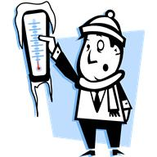
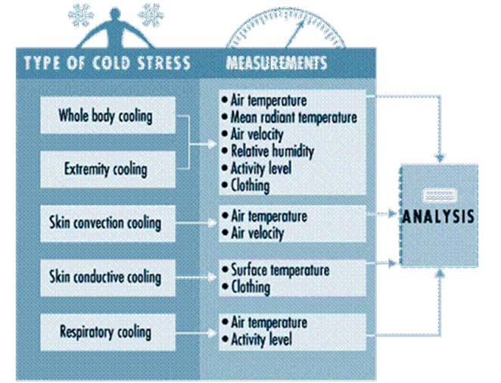
Notes:
Human performance is a combination of sensory, cognitive and motor functions. For optimal performance it is important that circulatory, respiratory and endocrine functions, as well as good energetic and fluid balance support the function of muscles and nerves.
Physical performance. Cooling affects endurance, force, power, velocity and co-ordination.
In conditions similar to normal outdoor work in winter dynamic performance decreases about 17 %. During heavy work, the upper respiratory tract may become constricted when ambient temperature falls below 5°F, but there are great individual differences in the sensitivity of the respiratory system.
Cold effects on cognitive performance may be masked by increased effort.
Exposure to moderately uncomfortable cold temperatures increases vigilance and may consequently improve performance. However, further increases in discomfort may lead to a decrease in vigilance, followed by an increased number of errors and a longer reaction time.
In addition to the immediate effects of cold exposure on cognitive performance, living in cold and dark environment may cause changes in mood (light-affective disorder, seasonal affective disorder), and further decrease cognitive and physical performance.

Slide 10

Cold effect on manual task performance
Hand temp. | Effects of hand temperature on manual function
°F
90 - 97 | Optimal hand and finger function
81 - 90 | Effects on finger dexterity, perception and speed
68 - 81 | Impaired performance in work with small details, reduced accuracy and endurance
59 - 68 | Decrement in manual dexterity of gross hand/finger work, occasional pain sensation
50 - 59 | Reduced gross muscle strength and coordination, pain sensation
< 50 | Numbness, manual performance reduced to simple gripping, pushing etc., spontaneous rhythmic re-warming (Lewis reaction)
43 - 46 | Loss of sensations and thermal receptors of superficial skin (nervous block)
≤ 32 | Frostbite can occur (freezing risk).
Notes:
This slide shows the effects on manual performance at different hand/finger skin temperatures.
When we speak of human performance, the final task is often done by hand, so manual performance is important.
Manual performance is a motor skill that is determined by the range of motion of the arm, hand and fingers, and the capacity to manipulate objects. Important components of manual performance are: Reaction time; sensitivity; nerve conduction velocity; grip strength; time to exhaustion, and mobility.
Skin temperature of the fingers and hands are crucial to manual performance. Finger dexterity decreases slightly at finger skin temperatures below 68°F, and decreases strongly at skin temperatures below 59°F.
Cooling decreases manual performance in several ways. Sensitivity is an important part of dexterity. Critical skin temperature for tactile sensitivity is between 43-46°F, where nerve conduction is impaired.
Severe cooling of other body parts may also influence manual performance, particularly in tasks which are sensitive to shivering. However, deep body temperature has only a minor effect on manual dexterity.

Slide 11



Cold injuries - Frostbite
  Skin tissue can freeze only if air temp ≤32°F)
  Wind-chill accelerates process.
  Contacting cold metal with bare skin can rapidly cause frostbite.
Ears, cheeks. nose, hands, feet main injury sites.
Frostbites in the ears are almost
twice as common as that of
the nose and cheek.
Frostbites of the hands and feet more often cause severe tissue damage and require medical treatment.
You should be familiar with signs & symptoms of frostbite - see http://www.cdc.gov/niosh/topics/coldstress/#_Frostbite
Notes:
Frostbite occurs when skin tissue is frozen.
Skin can only freeze when air temperature is below 32°F. Wind-chill is a significant factor in accelerating the process, but only if air temperature is below 32 degrees.
Touching cold metal with bare skin can rapidly cause a frostbite.
Frostbites affect generally the extremities - ears, cheeks. nose, hands and feet
Signs and symptoms of frostbite include:
Pain or prickling progressing to numbness;
Pale, hard, and cold skin with waxy look;
Flushing from blood rushing to area after it's rewarmed;
Burning sensation and swelling from collected fluid that may last for weeks;
Black scab-like crust, which may develop several weeks after exposure.
Victim is often unaware of frostbite due to numb tissues.
The most common late symptoms of frostbite are local
hypersensitivity to cold and pain in the injured area, sensations and disturbances in muscular function. These late symptoms may have negative impact on occupational activities in 13-43 % cases.

Slide 12
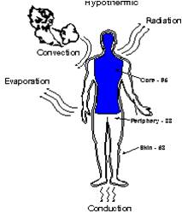
Cold injuries - Hypothermia
Core body temperature <95ºF due to prolonged exposure to cold and damp conditions.
Most cases: air temp. 30 to 50°F;
Can occur in air temp. to 65°F, particularly if clothing is wet;
Can occur in water temp. to 72°F.
Signs & symptoms of hypothermia see: http://www.cdc.gov/niosh/topics/coldstress/#_Hypothermia
Notes:
Most cases of hypothermia develop in air temperatures between 30 & 50°F, significant hypothermia can occur with air temp as high as 65°F, particularly when clothing is wet, or in the water at 72°F
Signs and symptoms of hypothermia:
Shivering and feeling of cold
Exhaustion, lethargy and apathy
Confusion and fumbling hands
Rapid heart rate, memory loss and delirium
Drowsiness
When body temperature < 82.4 °F:
Coma
Ventricular fibrillation
May appear deceased
First symptoms of hypothermia are uncontrollable shivering and feeling of cold. As the body’s temperature continues to drop, an individual can become confused, careless, and disoriented. At this point a person may make little or no effort to avoid further exposure to the cold. For those working around machinery or animals, accidental injury is an additional risk.
When the core body temperature falls below 83°F, the body’s adaptive mechanisms for reducing heat loss become ineffective and death can occur.

Slide 13

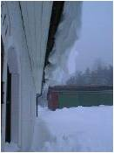
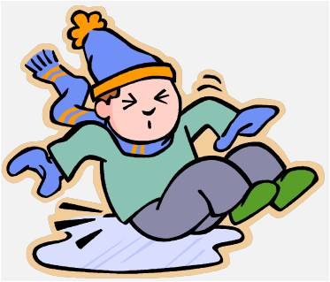
Cold injuries - Non-Freezing Cold Injuries (NFCI)
NFCI: cold & wet conditions above freezing (~32-39F) and immobilization causes venous stagnation. Legs/feet e.g. trench foot
Signs & symptoms of NFCI – see
http://www.cdc.gov/niosh/topics/coldstress/#_Trench_Foot
Other cold related injuries:
Slips and falls
Strains, sprains, etc.
Trench foot
Notes:
Prolonged exposure to cold & wet conditions above freezing point (~32-39F) combined with immobilization causing venous stagnation are the prerequisites for NFCI. It almost always affects legs and feet (trench foot).
These injuries are more likely if the limb is wet, and if the subject is dehydrated, malnourished, ill, or in poor physical condition, and often develop be a serious problem. NFCI is most often caused by an unawareness of the condition due to the slow and indistinct first appearance of symptoms.
Signs and symptoms of NFCI:
cold
swollen
blotchy pink-purple
blanched feet that feel heavy, woody and numb
There is no satisfactory treatment for the long-term effects of NFCI. These may include chronic damage to muscles, nerves, cartilage and bone.
First aid treatment for trench foot is similar to the treatment for frostbite, and includes: moving the victim to a warm area; treating the affected part with warm water (102°-110°F) or warm packs; arranging bed rested in a warm environment; and obtaining medical assistance as soon as possible.

Slide 14
Cold-related diseases
Cold -related diseases are either caused by cold or their symptoms are aggravated by exposure to cold .
Cardiovascular diseases;
Respiratory diseases;
Diseases in peripheral circulation;
Musculoskeletal diseases.
Male death rates due to cold are greater than the rates for females.
Notes:
Cold -related diseases are either caused by cold or their fate and symptoms are affected by cold exposure
Cardiovascular diseases - Older workers, or those with other disease, such as diabetes and atherosclerosis, may increase risk. Increased blood pressure occurs more often in colder regions than in warmer regions.
Respiratory diseases - It may represent a risk factor at very low temperatures (<-4°F), in particular in combination with high activity to operate heavy work. Inhaling cold, dry air may cause problems for sensitive and older workers at 50°F.
Diseases in peripheral circulation - A reversible episodic constriction of the blood vessels in fingers and toes. Constriction of the blood vessels the blood flow in fingers and toes is markedly reduced
Musculoskeletal diseases - Hand extensor tenosynovitis can be caused by windy exposure in cold temperatures 32-25°F. Local cold exposure in a frozen food factory caused 10 times higher incidence of carpal tunnel syndrome than in warm environments.
Male death rates due to cold exposure are greater than the rates for females, because of inherent risk-taking activities, body fat composition, or other physiological differences.

Slide 15
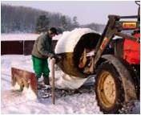
REDUCING COLD INJURY RISK
Organizational measures
Technical measures
Protective clothing
Protection of extremities
Other measures
Notes:
Organizational measures
Technical measures
Protective clothing against cold
Thermal insulation and principles of multilayer clothing
Protection of the extremities (head, hand and foot)
Other measures
Information and training
Health care/control.

Slide 16
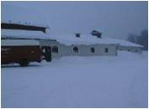
REDUCING COLD INJURY RISK
Organizational measures
Check weather conditions;
Work indoors;
Protective clothing;
Extra help - complete jobs faster;
Allow more time per task - work-rest regimens must reflect task, workload, & protection levels;
Reliable communication system;
Flexibility re: intensity/duration of work;
Frequent breaks (hot drinks/food in heated shelter);
Sufficient time for recovery after severe exposures;
Notes:
Check climatic conditions for outdoor work;
Wherever practicable, work on tasks indoors;
Provide adequate protective clothing;
Use extra manpower to shorten and reduce exposure to cold;
Tasks may take longer in the cold - suitable work-rest regimens should reflect task, workload and protection levels;
Organize a reliable communication system;
Be flexible regarding intensity/duration of work;
Provide frequent breaks for hot drinks/food in a heated shelter;
Allow sufficient recovery time in a heated environment after severe exposures;
Before every work shift and during the actual work shift a number of observations and controls allow safe management of working conditions, i.e. schedule adequate work-rest regimens.

Slide 17
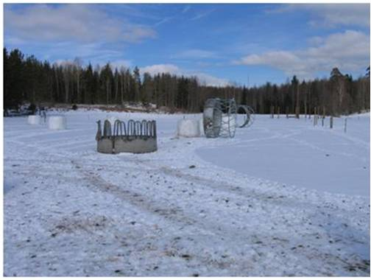
REDUCING COLD INJURY RISK
Technical measures
Choose equipment intended for cold conditions;
Store equipment in protected, preferably heated space, or pre-warm before use;
Insulate metallic handles/controls (rubber, plastic, wood);
Allow operation by gloved hands;
Slip resistant handles;
Repair/maintain indoors or prepare for easy repair/maintenance in adverse conditions
Notes:
Select tools, machinery and equipment intended and tested for cold conditions;
Store tools, machinery and equipment in protected, preferably heated space, or pre-warm tools, machinery and equipment;
Insulate metallic handles and controls (rubber, plastic, wood);
Choose design that allows operation by gloved hands;
Select tools with slip resistant handles;
Conduct the repair and maintenance work indoors or prepare for easy repair and maintenance under adverse conditions.

Slide 18
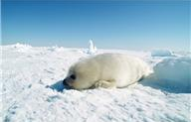
REDUCING COLD INJURY RISK
Technical measures
Avoid slippery materials and materials with different friction qualities in the same space;
Inclination of ground - water to drain away
Remove ice and snow from entries, passages, working floors and machinery steps;
Sand or salt walkways regularly;
Openings in floor covered up or guarded;
Warning signs, if surfaces are slippery;
Shoes - anti-slip soles, anti-skid devices.
Notes:
In cold season slippery surfaces increase the risk for occupational accidents. The following actions should be made:
Avoid installing slippery materials and materials with different friction qualities in the same space
Ensure that the inclination of floor or ground is adequate for water to flow to drain pit
Prevent building up of snow at entries with open shelters
Remove ice and snow from entries, passages, working floors and planes, machinery
Sand and maintain passages regularly
Use warning signs if surfaces are slippery
Choose shoes with anti-slip soles, and equip shoes with anti-skid devices when working outdoors.
General and targeted lighting should be re-checked wintertime. Measure the lighting and compare to following recommendations:
Provide additional general lighting or spot lighting if needed;
Eliminate direct glare from unshielded lights, as well as reflections from bright surfaces.

Slide 19
REDUCING COLD INJURY RISK
Protective clothing
Multilayer clothing more flexible than fewer, thicker layers.
Underwear provides humidity & moisture control at skin surface;
Intermediate layers mostly deliver thermal insulation. 1 to 3 garment layers, depending on environmental conditions, physical activity and thermal properties of each layer;
Outerwear protects against wind, water, dust and other factors.
Important! Friction between layers.
Textile materials with high internal friction may restrict movement.
Notes:
Besides protection against cold climate (i.e. temperature, wind, rain) there are usually a number of additional requirements for protective clothing, which represent a challenge to clothing manufacturers. Clothing should allow sufficient unrestricted body movement to perform work tasks at a reasonable level of efficiency.
A multi-layer clothing system provides flexible solutions to match thermal and task demands.
Wear at least three layers!
When selecting the multi-layer composition of cold protective clothing, consider the material surface of each layer, and the resulting internal friction between layers. Textile materials with high internal friction may reduce the wearer’s freedom of movement.
The change to multi-layer systems for cold protective garments simplifies drying.
As sweat condensation affects cold weather clothing, it is necessary to dry clothing between uses. Drying is faster for the whole clothing system is garment elements can be separated.

Slide 20
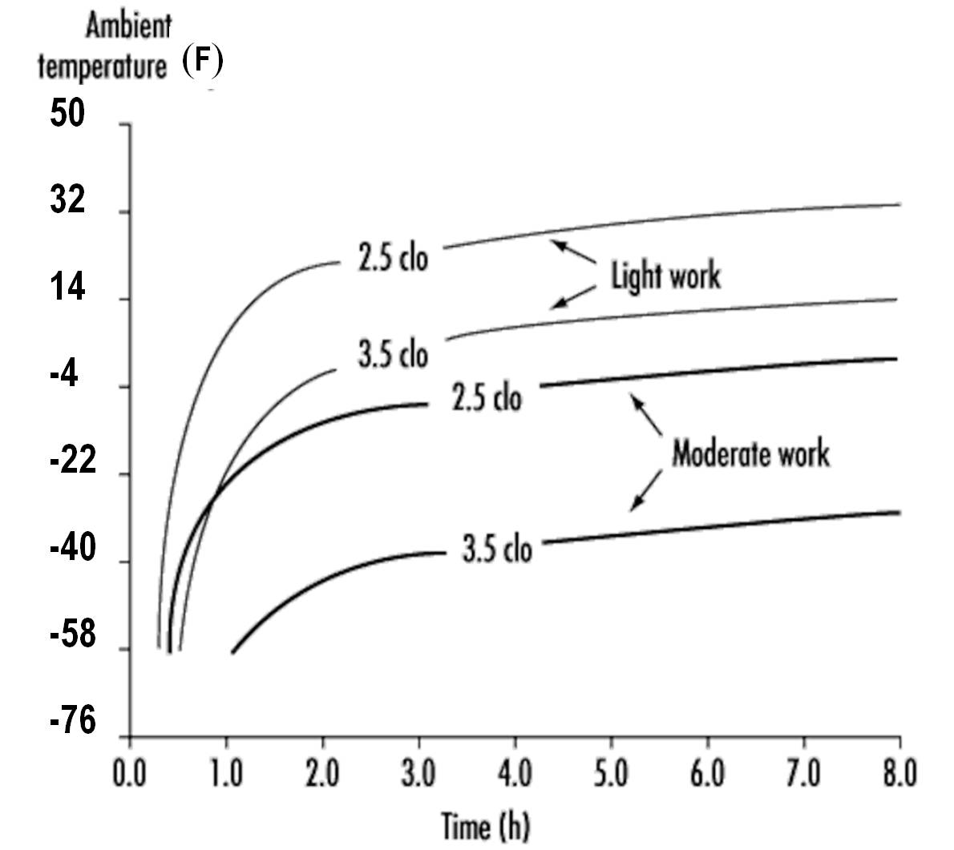
(F)
50
32
14
-4 -22 -40 -58 -76
Time limits for light and moderate work with two insulation levels of clothing
Notes:
This graph shows examples of time limits for light and moderate work with two insulation levels of clothing. When the available clothing system does not provide sufficient insulation, a time limit is calculated for the actual conditions. The time limit depends on the difference between required clothing insulation and that of the available clothing. Since, full protection against cooling is no longer achieved, the time limit is calculated on the basis of an anticipated reduction of body heat content.

Slide 21
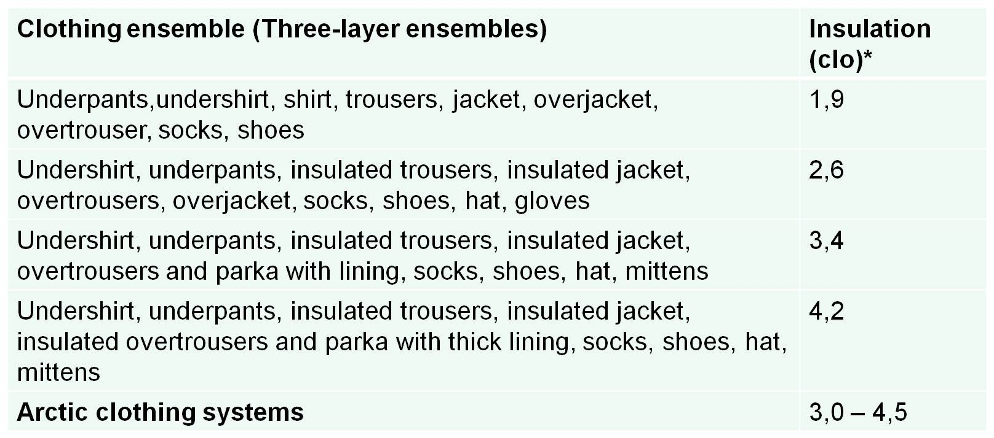
Basic insulation value of clothing. Data only applies to static (resting), wind-still conditions.
[After ISO-TR 11079]
*: 1 clo = 1/0.155 (°C*m²/W)
Notes:
This Table shows the basic insulation value of clothing. Data only applies to static (resting), wind-still conditions. (See ISO-TR 11079).
*: 1 clo = 1/0.155 (°C*m²/W)

Slide 22

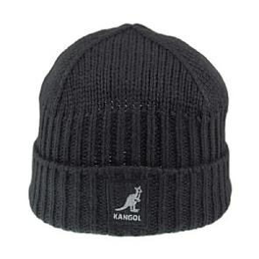
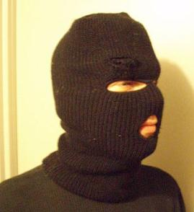
REDUCING COLD INJURY RISK
Protecting extremities: Head
Up to 40% of body heat can be lost if head exposed
Headgear adjustable to cover forehead, ears, cheeks, chin; Adjust for warmer weather or heavy tasks;
Allow sweat to evaporate from the head - important in winter;
A hood is helpful in cold, snowy, windy, or rainy weather:
  Adjustable;
  Big enough to fit over a helmet,
  Protect the face from wind (at sides) and rain;
  Good field of view, including sideways
In extreme cold and wind – a balaclava or facemask is recommended.
Notes:
Up to 40% of body heat can be lost if head exposed
Headgear adjustable to cover forehead, ears, cheeks, chin; Adjust for warmer weather or heavy tasks;
Allow sweat to evaporate from the head - important in winter;
A hood is helpful in cold, snowy, windy, or rainy weather:
Adjustable;
Big enough to fit over a helmet,
Protect the face from wind (at sides) and rain;
Good field of view, including sideways
In extreme cold and wind – a balaclava or facemask is recommended.

Slide 23
REDUCING COLD INJURY RISK
Protecting extremities: Hands
Consider dexterity and tactile sensitivity.
Gloves - slip-resistant palms and finger pads. Additional grip force is otherwise applied to prevent object from slipping;
Mittens – greater protection than gloves in very cold temperatures. Consider if dexterity not a major issue;
Double gloving - thin inner glove (PES, PP, WO) under work gloves/mittens recommended if precision tasks must be carried out in the cold.
Rough/injurious material e.g. logs, building materials, chemicals etc. – wear safety gloves.
Replace Wet gloves with dry ones during work shift
Notes:
The selection of gloves or mittens should not be taken lightly, since both forms of handwear can reduce the wearer’s ability to perform tasks requiring dexterity and tactile sensitivity.
Gloves may be equipped with slip-resistant palms and finger pads to provide a better grip on smooth objects. This will help if additional grip force would otherwise be required to prevent the object from moving in the hand;
Mittens provide greater protection than gloves in very cold temperatures, and should be considered when dexterity is not a major consideration;
Double gloving use of a thin inner glove (PES, PP, WO) under work gloves/mittens is recommended if precision tasks have to be carried out in the cold.
For handling rough or injurious material e.g. logging operations, building construction and handling chemicals etc., safety gloves are used.

Slide 24
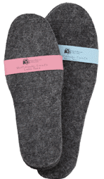
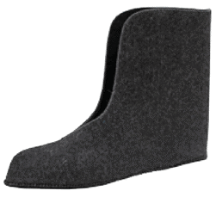
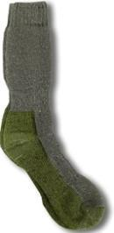
REDUCING COLD INJURY RISK
Protecting extremities: Feet
Foot cooling occurs esp. if standing still, & when footwear is damp or wet.
Outerwear (e.g., boots, shoes):
Adequate traction for walking/climbing surfaces/conditions;
Innerwear (socks, liners, and insoles)
Soles should be thick;
Loose insoles increase thermal insulation - can be removed and dried.
Keep footwear/feet dry; moisture reduces insulation, can cause sores.
Remove footwear during breaks to let footwear dry and feet “breathe,” if possible. Change damp socks for dry ones;
Optimize Innerwear and outerwear are as a unified footwear system.
Notes:
Foot cooling occurs mostly when people stand still, especially when footwear has become moist
Outerwear (typically boots or shoes) Provide adequate traction on walking and climbing surfaces encountered.
Innerwear (socks, liners, and insoles) The soles of the winter footwear should be thick, loose insoles increase the thermal insulation of the sole and can be removed and dried easily. Moist socks should be replaced with dry ones.
The footwear and feet should be kept dry, as moisture reduces thermal insulation and can cause sores. Workers should take off the footwear during breaks and let footwear dry and feet to “breath” if possible.
Greatest performance and comfort is achieved where both innerwear and outerwear are optimized as a unified footwear system.
The insulated footwear system should:
Provide adequate traction on walking and climbing surfaces;
Be light in weight and not bulky;
Be flexible (not excessively restricting ankle, toe, and foot
movements), support the foot adequately on uneven surfaces;
Be balanced and fit the user correctly;
Provide good traction on ice;
Not represent a hazard (e.g. cause blisters or skin irritations);
Protect against falling objects or other sources of crush injuries (e.g. animals);
Protect against corrosive and caustic chemicals;
Resist punctures and cuts through the sole and through the uppers;
Be waterproof and resistant to wind;
Be permeable to water vapor (sweat vapor) to minimize wetness inside the boot; and dry and drain quickly.

Slide 25
REDUCING COLD RISK
Occupational Health Care
Seek warm shelter if:
  Heavy shivering,
  Uncomfortable sensation of coldness,
  Severe fatigue, drowsiness, or euphoria.
Energy – warm, sweet, (e.g. jello dissolved in warm water rehydrates and provides protein); Soup; caffeine-free non-alcoholic drinks.
Lotions to prevent chapped skin.
Never rub potentially frozen tissue.
Notes:
Seek warm shelter immediately following these symptoms: heavy shivering, an uncomfortable sensation of coldness, severe fatigue, drowsiness, or euphoria
Keep energy levels up and prevent dehydration by consuming warm, sweet, caffeine-free, nonalcoholic drinks and soup.
Prevent chapped skin by the frequent application of protective lotions.

Slide 26
HEALTH CONDITIONS REDUCED COLD TOLERANCE
Older workers, people with health problems at higher risk.
Hypothermia associated with alcohol/drug use – impaired judgment.
Alcohol (vasodilator).
Tobacco (vasoconstrictor).
Hashimoto’s disease thyroiditis (hypothyroidism).
Lupus.
Raynaud’s phenomenon.
Livedo reticularis and palmar erythema.
Poor physical condition.
Notes:
Older workers, or those with certain medical problems, need to be extra alert about the effects of cold stress. Check with a doctor about special needs and precautions.
Avoid using alcohol or drugs which may impair judgment while working in a cold environment.
Hypothermia commonly occurs in association with alcohol abuse. In addition to its effects on judgment, alcohol increases heat loss through vasodilatation and may impair shivering.
Important to stay in good physical condition.

Slide 27
REDUCING COLD RISK
Information and training
Through training, employees take responsibility for cold management.
Training to include:
Identifying personal warning signs of over-exposure to cold;
Hazards of cold air, moisture, and contact with cold materials.
Protective clothing – especially for the extremities (hands, feet and head)
Using PPE (e.g. safety helmets) with cold protective clothing
Train key personnel - update knowledge of cold related hazards
Train new workers on cold work risks.
Notes:
By improving their cold related knowledge employees are able to recognize their own responsibilities in cold management, This should include:
Identifying personal warning signals of cold exposure
Exposure to cold air
Exposure to wettness
Contact with cold materials
Need for overall cold protective clothing
Need for protecting the extremities (hands, feet and head)
Need for using personal protective equipment (e.g. safety helmets) together with cold protective clothing
Other problems related to cold
The selection of appropriate clothing according to the climatic conditions and working activities.
It is important to train key persons who should constantly update their knowledge of cold related hazards
It is important that new workers receive training on the risks of cold work

Slide 28
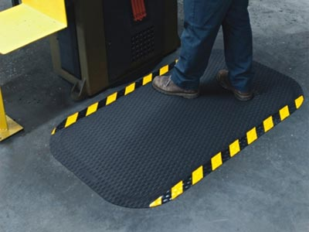
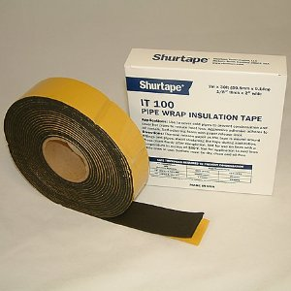
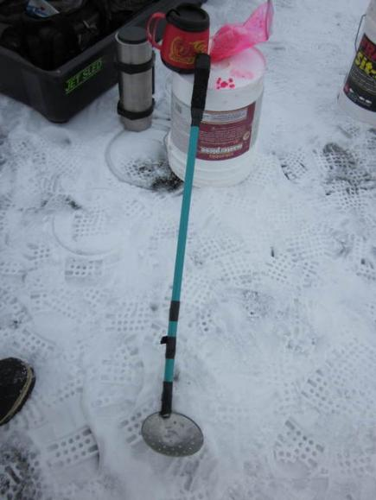
REDUCING COLD RISK
Thermal (Insulating) Barriers
Reduce conductive heat loss:
thermal mats on cold floors;
pipe insulation tubing or tape on cold skin-contact points.
Notes:
Thermal barriers such as floor mats, foam tapes, pipe insulation, etc., isolate the person from a source of cionductive heat loss.
Wrapping metal handles and grip points with securely fastened insulation material will enable the operator to grip the object using bare hands. This is particularly important where wearing gloves is difficult, due to their bulk or impact on grip force.
Barriers should be installed ahead of cold conditions. A quick survey of grip points around the farm or ranch will allow cold weather precautions to be made.
It will be more difficult to apply adhesive-backed tapes after the weather has turned cold, when metal surfaces will become damp during handling, due to condensation.

Slide 29
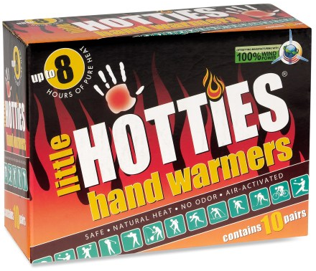
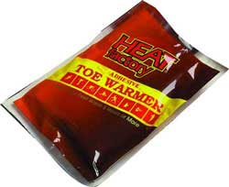
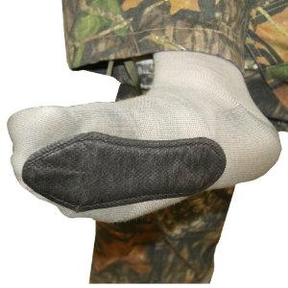
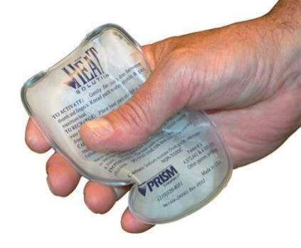
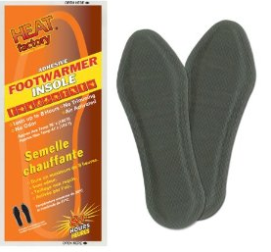
REDUCING COLD RISK
Heat Generation
Ready to use. 105°F
Toe Warmers. to 6 hrs.
Adhesive Insole Foot Warmer - 8+ Hours
ProHeat reusable. 130º F
Notes:
Thermal gel-filled pads are useful in providing relief for the extremities. Hand warmers will interfere with grip tasks, but may be used to provide heat to re-warm the hands if kept in coat pockets, or inside flip-back mittens.
Foot warming: additional insoles and adhesive gel pads should be used as an accessory to an effective foot protection system, in which case they would rarely be needed.
People with circulatory disorders, such as lupus, or sensory disorders that impair awareness of cold feet, may find these useful in reducing risk of cold injury.

Slide 30
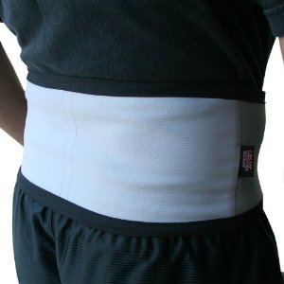
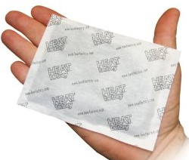
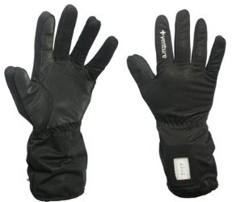
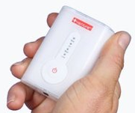
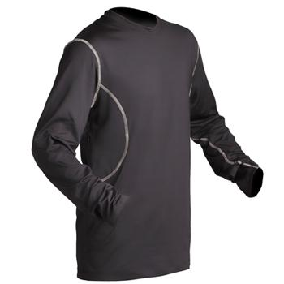
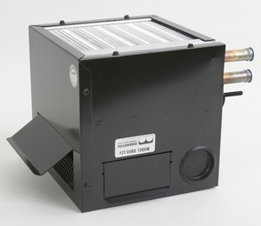
REDUCING COLD RISK
Heat Generation
Heat Factory Heated Back Wrap for use with Heat Factory Hand & Body Warmers
Venture Heated Glove Liner
Men’s Battery Heated Base Layer
Maradyne 5030
12 Volt Cab Heater 12,500 BTU. 7” square.
Hose connectors.
Notes:
Warming pads can also be fitted to the body, and may be useful for people with back problems, in particular, helping to maintain relaxed muscles in the trunk.
Efficient cab heaters may be fitted retrospectively to vehicles with water-cooled engines. Eliminating drafts is going to be important if attempting to heat a tractor cab or similar. The environment should allow controlled air flow to reduce condensation and to maintain air quality, but ensuring at least that the vehicle maker’s door and window seals are in place and effective will be essential.
Many of the cheaper 12v cab heaters available at low cost tend to receive negative reviews from users, and it is unlikely that they would be effective in very cold conditions or in a large cab.
Rechargeable battery-powered clothing is available. These vary considerably in performance, battery life, extent of heated area, and reliability. There are extensive video reviews available on sites such as YouTube, and by reading the feedback from purchasers on sites such as Amazon.com.

Slide 31

Additional Resources
The Toolbox has many useful aids for reducing cold injury risk: http://www.agrability.org/toolbox/browse.cfm
“Cold Stress.” NIOSH http://www.cdc.gov/niosh/topics/coldstress/
“Outdoor Action Guide to Hypothermia and Cold Weather Injuries.” R. Curtis: http://www.princeton.edu/~oa/safety/hypocold.shtml
“Prevention and Management of Cold-weather Injuries.” US Military Technical Bulletin TB MED 508 (2005) http://armypubs.army.mil/med/dr_pubs/dr_a/pdf/tbmed508.pdf

Slide 32
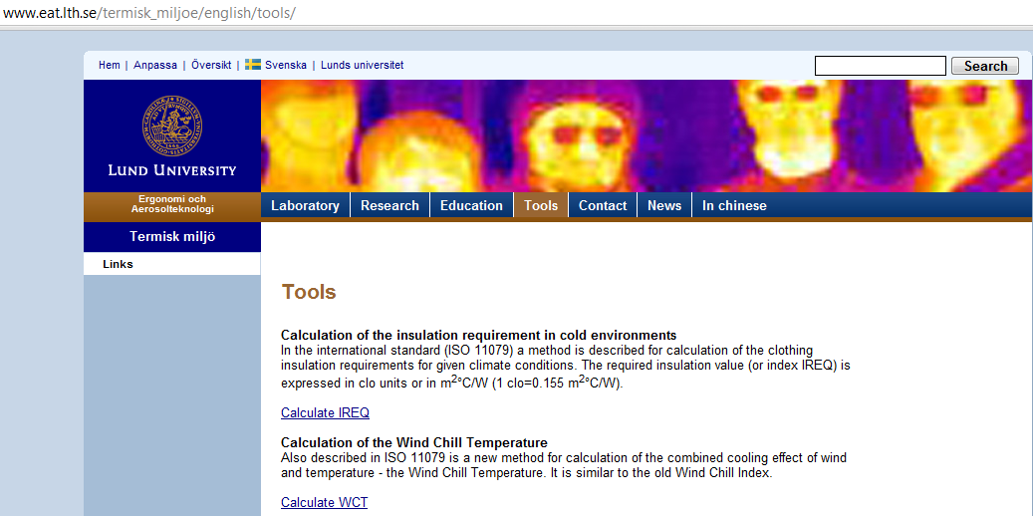
Notes:
Tools :
http://www.eat.lth.se/termisk_miljoe/english/tools/
Calculation of the insulation requirement in cold environments
In the international standard (ISO 11079) a method is described for calculation of the clothing insulation requirements for given climate conditions. The required insulation value (or index IREQ) is expressed in clo units or in m²°C/W (1 clo=0.155 m²°C/W).
Calculate IREQ
Calculation of the Wind Chill Temperature
Also described in ISO 11079 is a new method for calculation of the combined cooling effect of wind and temperature - the Wind Chill Temperature. It is similar to the old Wind Chill Index.
Calculate WCT

Slide 33
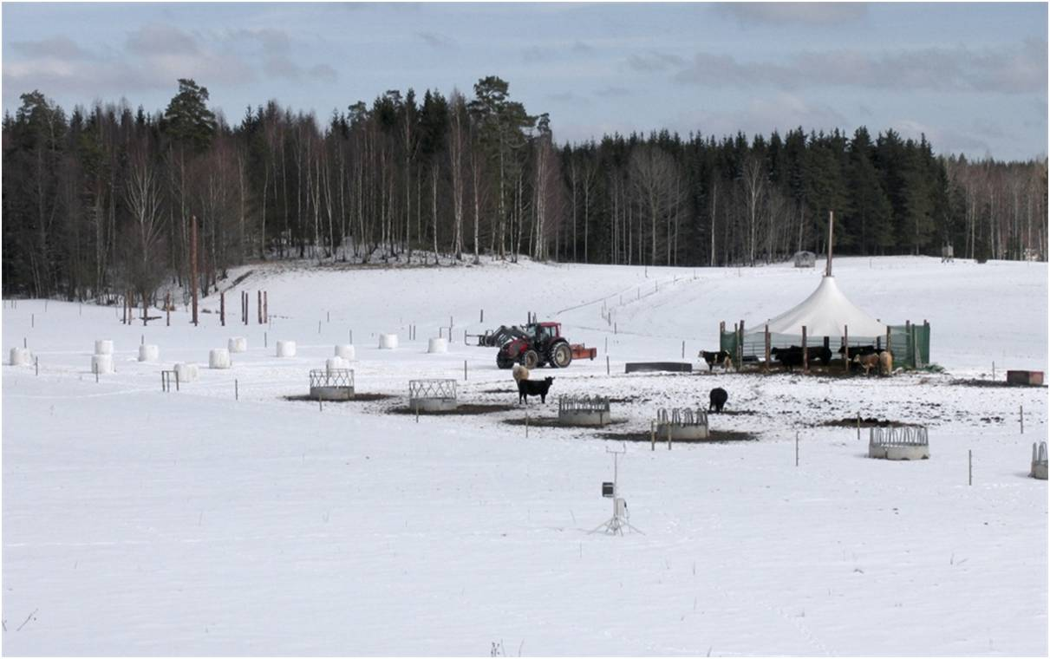
Thank You!

