Slide 1


Changes in Marketing
Integration of messages across all channels of communication to assure success

Slide 2

Basic Webinar Instructions
Need speakers or headphones to hear the presentation. No phone connection.
Check sound via Meeting > Audio Setup Wizard
Questions about presentation
  Type into chat window and hit return.
  During the Q & A period, if you have a web cam/ microphone, click the “Raise Hand” icon to indicate that you have a question. We will enable your microphone

Slide 3
Basic Webinar Instructions
4 quick survey questions
Session recorded and archived with PowerPoint files at www.agrability.org/Online-Training/virtualntw along with resource materials
Problems: use chat window or email agrability@agrability.org

Slide 4
Known Webinar Issues
Echo
  Check to see if you are logged in twice
Disconnection with presenters
  Hang on – we’ll reconnect as soon as possible
Disconnection with participants
  Log in again

Slide 5

AgrAbility: USDA-sponsored program that assists farmers, ranchers, and other agricultural workers with disabilities.
  Partners land grant universities with disability services
  Organizations. Currently 20 state projects
  National AgrAbility Project: Led by Purdue’s Breaking New Ground Resource Center. Partners include:
    Goodwill of the Finger Lakes
    The Arthritis Foundation, Heartland Region
    University of Illinois at Urbana-Champaign
    Colorado State University
  More information available at www.agrability.org

Slide 6
Changes in Marketing
Integration of messages across all channels of communication to assure success

Slide 7

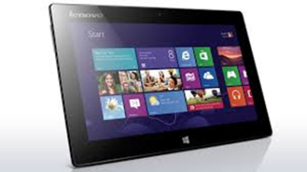
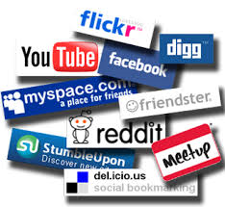
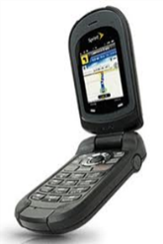
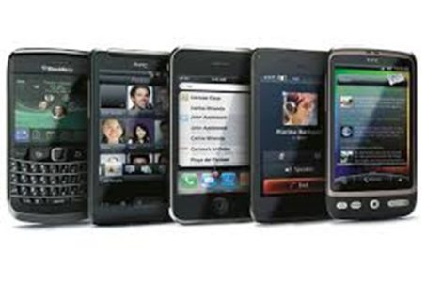
Digital Technology is changing communications…to targeting!
RAPIDLY
“because of smartphones, tablets, social media sites, e-mail and other forms of digital communications, the world creates 2.5 quintillion bytes of new data daily, according to IBM.
The Company estimates that 90% of the data that now exists in the world has been created in just the last two years. From now until 2020, the digital universe is expected to double every two years.”
June 2013, International Data Corporation

Slide 8
Changes in Communicating
Old: Learning as a Transaction-
  Learners receive knowledge
  Knowledge is organized in stable, hierarchical structures that can be treated
  independently of one another
  We learn best passively, by listening and watching
  Our “intelligence” is based on our individual abilities
New: Learning as a process-
  Learners create knowledge
  Knowledge is organized “ecologically”- disciplines are integrated and interactive
  We learn best actively doing and managing our own learning
  Our “intelligence” is based on our learning communities

Slide 9
Who is your Target Audience?
You cannot be everything to all audiences
Build your database
  Demographics- age/ gender/where they live
  Lifestyle- Organizations/Businesses/Community they associate
  Income Level
What is most cost effective to reach?
  Do free stuff 1st!
  What delivers the most reach/ frequency to people you are targeting?
  What is easiest to do, and you can manage?
  Who can you leverage to multiply your message with reach and frequency?

Slide 10
Age= Source of News
Brown: All Ages
Orange: 25-44
Tan: 45-64
Green: 65+

Slide 11
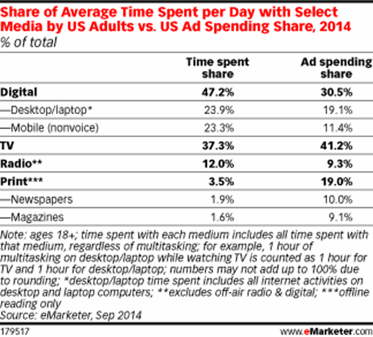
Age= Source of News
Subscribe to Local Paper-by Age
65+ | 60%
55-64 | 42%
45-54 | 28%
35-44 | 22%
25-34 | 12%
18-24 | 14%

Slide 12
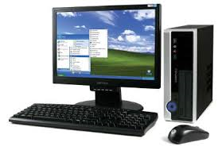
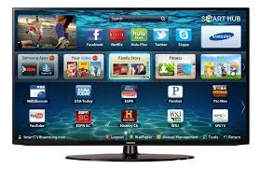
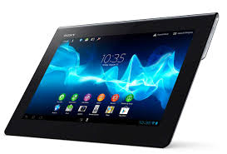
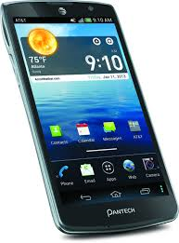
Where is time spent in media: digital… versus television?
Emarketer 14
2 hours 12 minutes, or 18% of daily media time spent on desktops/laptops
2 hours 51 minutes, or 23% of daily media time spent on mobile devices
4 hours 28 minutes, or 37% of daily media time spent with television

Slide 13
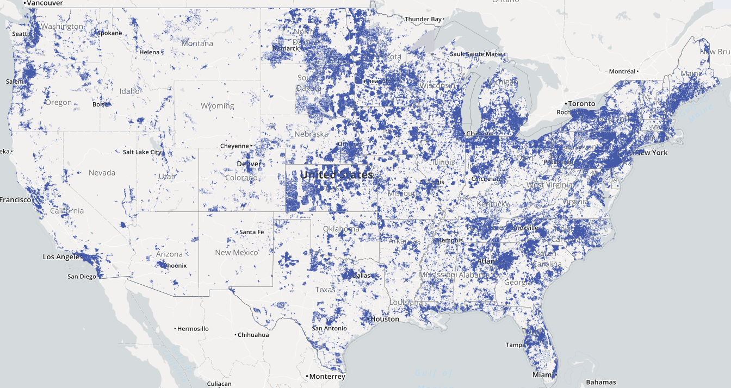
National Broadband Coverage
www.broadbandmap.gov

Slide 14
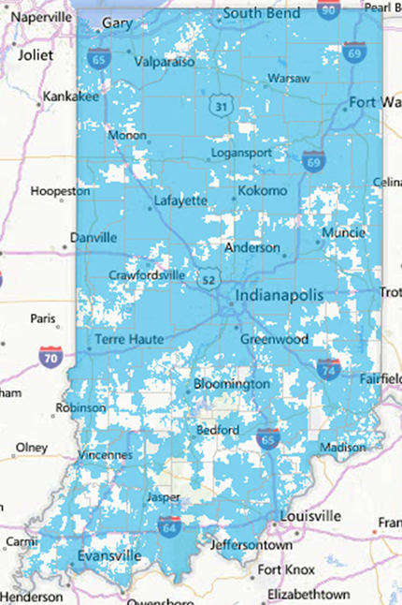
Key Factors for New Communications
Location, Location, Location:
Access to Basic Broadband
3 Mbps/758 kbps
98% Urban Households have access
71% Rural Households have access
65% Very Rural Households have access
63% Farm Households have access
  29% -37% Rural without broadband
  access
  17% - 28% HHDs will NOT use internet
  Indiana Office of Technology Mapping Project 2013

Slide 15
Farmer use of Internet: USDA ’13 USDA/August

Slide 16
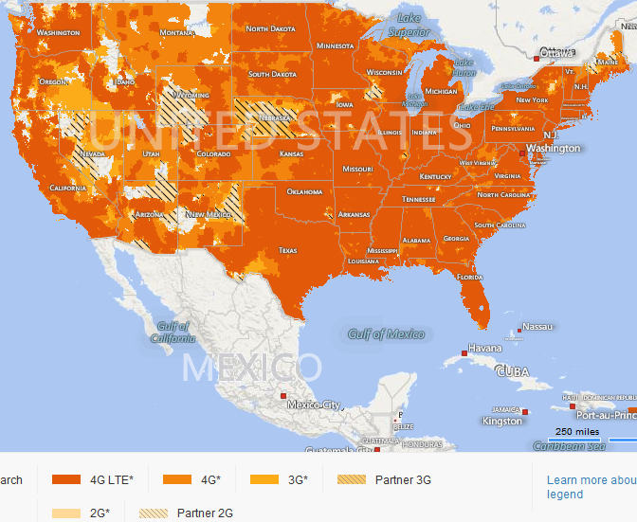
National Wireless Coverage

Slide 17
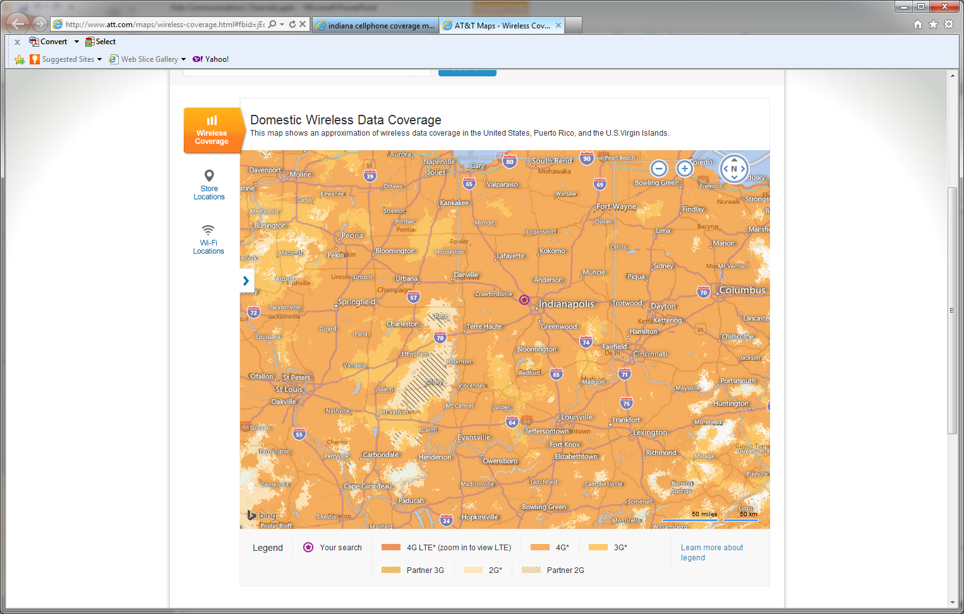
Key Factors for New Communications
Location, Location, Location:
High speed Cell phone
Coverage across Indiana
AT& T Coverage Map
Dark Gold: 4G
Medium Gold: 3G
Light Gold: Partners-Local

Slide 18
The ways farmers get information digitally AgWeb 2014

Slide 19
Mobile Devices Farmers Use: AgWeb Research 14
82% farmers send/receive text messages
65% use smartphone (16% increase since 2013)
45% use a tablet (17% increase since 2013)
95% take it to do farm work
92% use it hourly or multiple times a day
52% US Population have smartphone
46% US Population have tablet

Slide 20
How Farmers use their Smartphones
AgWeb Research 14

Slide 21
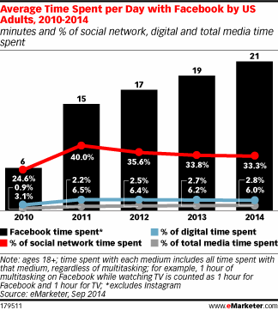
Social Networks-Critical Mass-Fast
% who use social, over time
Notes:
Source: The Pew Research Center Internet & American Life Project Teen & Parent surveys. Source: Teen data taken from surveys of teens age 12-17 conducted October-November 2006, September-November 2007, November 2007-February 2008, June-September 2009, April-July 2011, and July-September 2012 (n=802). Adult data taken from surveys of adults ages 18+ conducted August 2006, April-May 2009, August-September 2009, July-August 2011, and November-December 2012 (n=2,261). Methodological information for each survey is available from http://pewrsr.ch/ZLGBUL

Slide 22
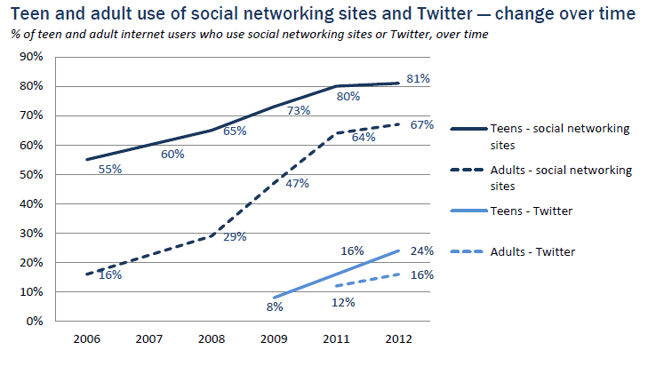
Social Networks-Critical Mass-Fast
% who use social, over time
Notes:
Source: The Pew Research Center Internet & American Life Project Teen & Parent surveys. Source: Teen data taken from surveys of teens age 12-17 conducted October-November 2006, September-November 2007, November 2007-February 2008, June-September 2009, April-July 2011, and July-September 2012 (n=802). Adult data taken from surveys of adults ages 18+ conducted August 2006, April-May 2009, August-September 2009, July-August 2011, and November-December 2012 (n=2,261). Methodological information for each survey is available from http://pewrsr.ch/ZLGBUL

Slide 23
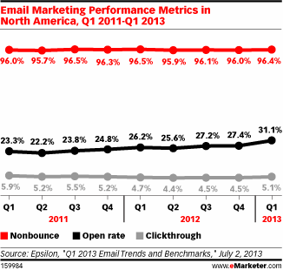
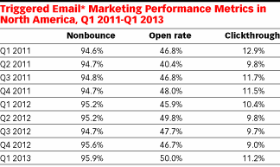
Make email a part of your communications mix…
Immediate Response Measurement

Slide 24
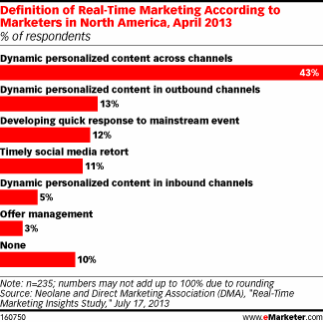
Communications Trends:
Dynamic, Real Time, and Personal
.
.
.

Slide 25
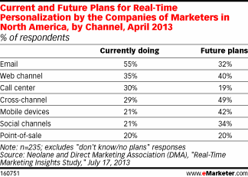
Communications Trends:
Dynamic, Real Time, and Personal
.
.
.

Slide 26

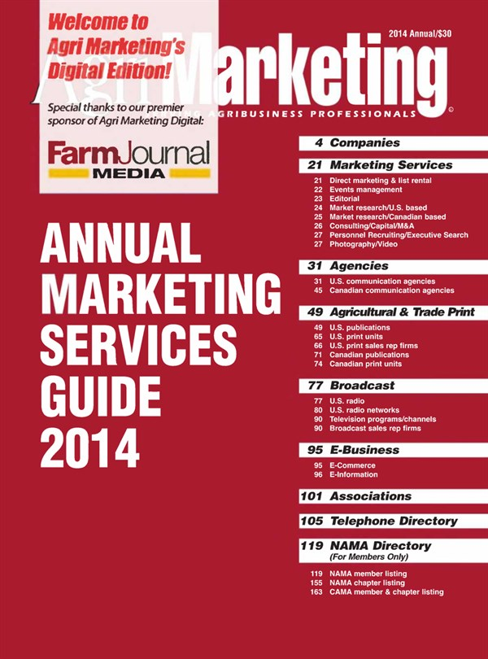
Ag Resources for your Marketing Communications
www.agrimarketing.com
Agrimarketing Annual Marketing Services Guide:
Detailed contact information
http://www.agrimarketingdigital.com/?iid=86575
  Agricultural Print Media
  Agricultural Radio Stations/ Networks
  Agricultural Television Programs/Channels
  Agricultural E Information
  Agricultural Direct Marketing & List rental
  Agricultural Events- All Farm Show Events
http://www.agrimarketing.com/arsg.php

Slide 27
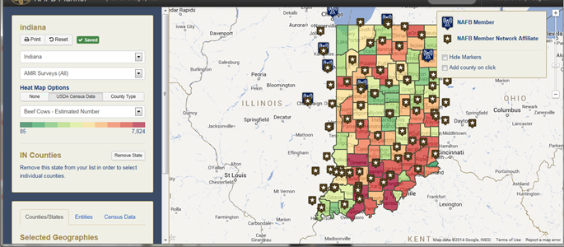

Ag Resources for Your Marketing Communications: Farm Radio
http://www.nafbplanner.com

Slide 28
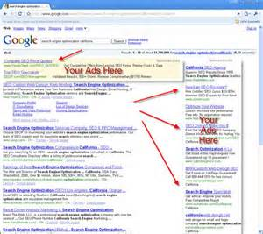

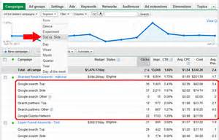
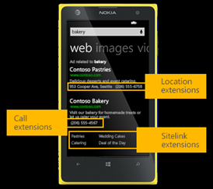
Frequency, Impact, Cost: Effective Internet Advertising Resources
Pay per click…you only pay if people respond

Slide 29

Native advertising/ Infomercials/Paid Content
New to the Web: Major news sites and aggregators placing paid/sponsored content in editorial sections of website
Broadcast: Long format messages- up to 2 minutes-are placed within program- on radio it may be read by announcer. Local stations/Cable Channels will accept long format paid programs- up to one hour. This can be very cost effective when other media drives audience
Print: Featured/Sponsored Sections or Cover Wraps can be more cost effective than direct mail as you select your target audience to receive message
All the above can be purchased as non-profit organization, and pre-emptible rate - usually heavily discounted - make sure programming matches your audience

Slide 30





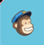
Extend, multiply, and build relationships with social media and email
Post to Facebook 5 – 10 times a week- 75% Audience/5 hours = 90 minutes median
Post to Twitter at least 5 times a day- 75% Audience/3 hours= 24 minutes median
Utilize You Tube in
All messaging and increase impact 10X
Post to Linked in Daily
Utilize 3rd party email services to assure maximum delivery with measured responses & feeds to social media

Slide 31







Leverage your message with state commodity/trade organizations

Slide 32
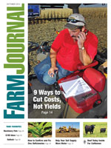
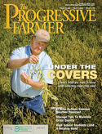









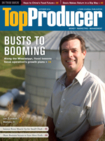



Utilize traditional print media for reach, and add internet for frequency:
It can be local and cost effective

Slide 33
Why is Multi-channel Marketing important?
Makes it easy for Clients to complete desired action on whatever channel they are most comfortable…the user decides.
Multi-channel Clients respond three to four times more than single channel Clients.
72% of Clients prefer integrated marketing approach- avoid silo mentality- channel campaigns MUST be integrated together.
  Popular Multi-Channel Programs
    Computer & Mobile (9 am – 5 pm) Lowest on weekend evenings
    TV & Mobile (5 pm- 11 pm)
    Google Pay per click programs w/coupon offer
    Direct Mail offer w/ website coupon
    1/3 active Twitter users tweet about TV program they are watching

Slide 34
Example: National Training Workshop (NTW) Promotion
Current NTW Marketing Channels
  Direct Mail → Save the Date/Register Now Cards
  Email → Save the Date, Register Now, NTW Updates
  Social Media → Facebook and Twitter
  Web → Link to NTW site from National AgrAbility site
  Events → Pass out NTW information at events
  Magazine → Purchased ad space in relevant publication in the region where the NTW is being held in addition to ad space on their website and e-newsletter

Slide 35
Example: National Training Workshop (NTW) Promotion
  Other Marketing Channels to Consider
    Texting → Send texts when registration is open and when it’s closing and updates/reminders
    Radio → Utilize free PSA options to drive people to the website
    Newspapers/Magazines → Utilize the need for “filler” content or ad space to get low/no cost space. Also use press releases and feature stories to help promote the NTW

Slide 36
Summary:
Identify/build database of your target audience(s)
Identify Communications Channels that match your audience
Leverage 3rd parties with the same audiences as yours- to deliver your message at low costs or free
Utilize multiple channels to maximize effectiveness
Integrate new e-communications with traditional communications options
What strategy delivers most reach and frequency at lowest cost?
Only do what you can easily manage with your resources- you can’t do everything.

Slide 37
Contact Info:
Jerry Shafer
Marketing Specialist
Purdue University Ag Communications
Ag Administration Building
615 W State Street
West Lafayette, IN 47907
JWShafer@purdue.edu
765-494-7817

