Slide 1
Assistive Technology to Prevent Secondary Injury in Aging Farmers Ned Stoller Michigan AgrAbility AgrAbility Virtual National Training Workshop Wednesday, February 22, 2017 11:00 a.m. ET

Slide 2
Basic Webinar Instructions
Audio available through computer or phone.
Check sound via Communicate menu at top left
Closed captions: use arrow to expand or contact the Media Viewer window.
Expand/contract any of the windows in the right-hand column with the arrows. May need to do this to see video of presenter.
Expand/contract the size of the right-hand column.

Slide 3
Basic Webinar Instructions
Questions and comments
Click Chat icon at top right of screen (it should turn blue). Enter message in box, choose who to send it to, and click send. You may enter questions about the presentation at any time. Please send to “All Panelists”.
In addition, during the Q & A period, if you have a web microphone, click the “Raise Hand” icon to indicate that you have a question. We will enable your microphone or phone connection.

Slide 4
Basic Webinar Instructions
4 quick survey questions + opportunity to share comments
Session recorded and archived with PowerPoint files at www.agrability.org/Online-Training/archived
Problems: use chat window or email jonesp@purdue.edu

Slide 5
AgrAbility: USDA-sponsored program that assists farmers, ranchers, and other agricultural workers with disabilities.
Partners land grant universities with disability services organizations. Currently 20 state projects
National AgrAbility Project: Led by Purdue’s Breaking New Ground Resource Center.
Partners include:
Goodwill of the Finger Lakes
APRIL (Association of Programs for Rural Independent Living
Colorado State University
More information available at www.agrability.org

Slide 6
Save Time and Money:
Assistive Technology to Prevent Secondary Injury in Aging Farmers
Ned Stoller
Agricultural Engineer
Easterseals Michigan AgrAbility

Slide 7
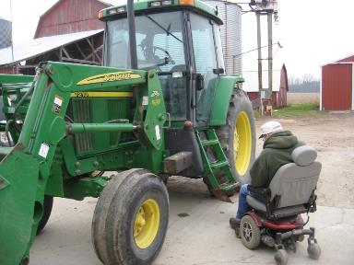
The average age of a farmer is 17
We are all prone to accidents, but aging increases the risk
Arthritis, hearing, vision, reaction time, fatigue

Slide 8
$15,000 cost estimate of a common broken leg injury
Lose 2 full weeks of business opportunity just going to appointments (8 appointments, 5 hours each x 2 people)
$6800 to $10,000 medical cost (ER $1700, Orthopedic $1700, Therapy $3000, medicine & crutches $400)
$4800 Hired labor (2 hired people to do what you did) because you can only do 25%

Slide 9
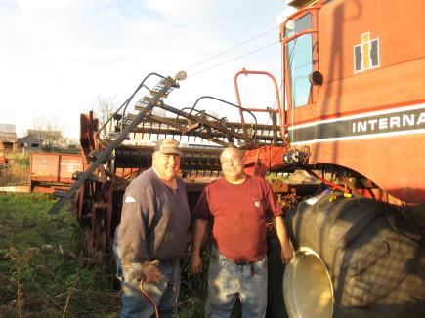
Slipped & trampled

Slide 10
You are most likely to have injury or illness caused by an existing condition
Fatigue and arthritis cause tripping and falling
Knocked down by livestock from slower motion
Running over people and property because it hurts to twist and look back while operating equipment
Injured by equipment because of unawareness due to hearing loss

Slide 11
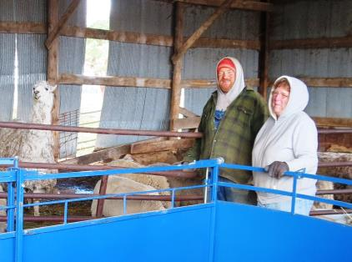
Rely on more help to get the work done.

Slide 12
Use your wisdom of years, know your limits
Educate your doctors about your work, and then follow their medical advice
Accommodate your limitations
Being wise is not the same as lazy, it is efficient, smart and productive

Slide 13
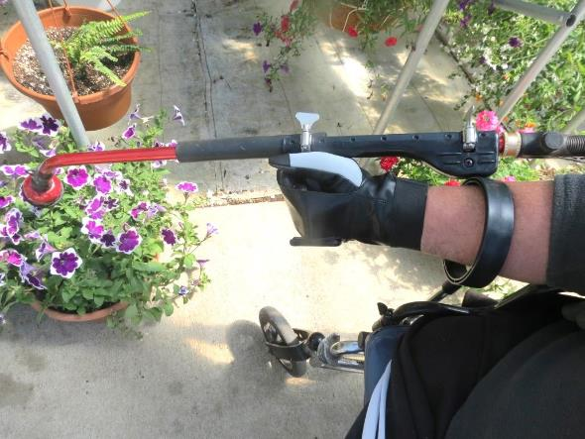
Grip aids

Slide 14
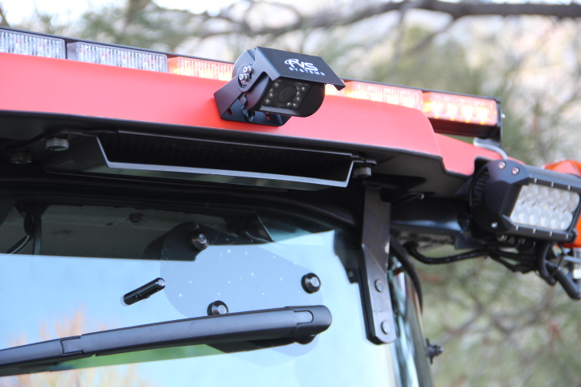
Simple accommodations
Mirrors and CabCam monitors

Slide 15
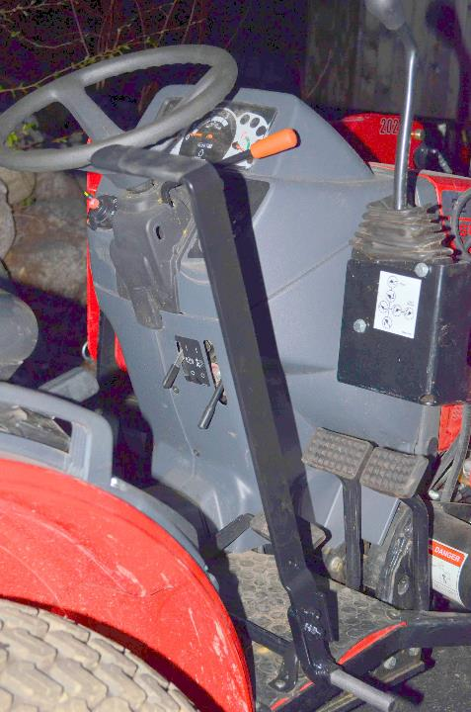

Slide 16
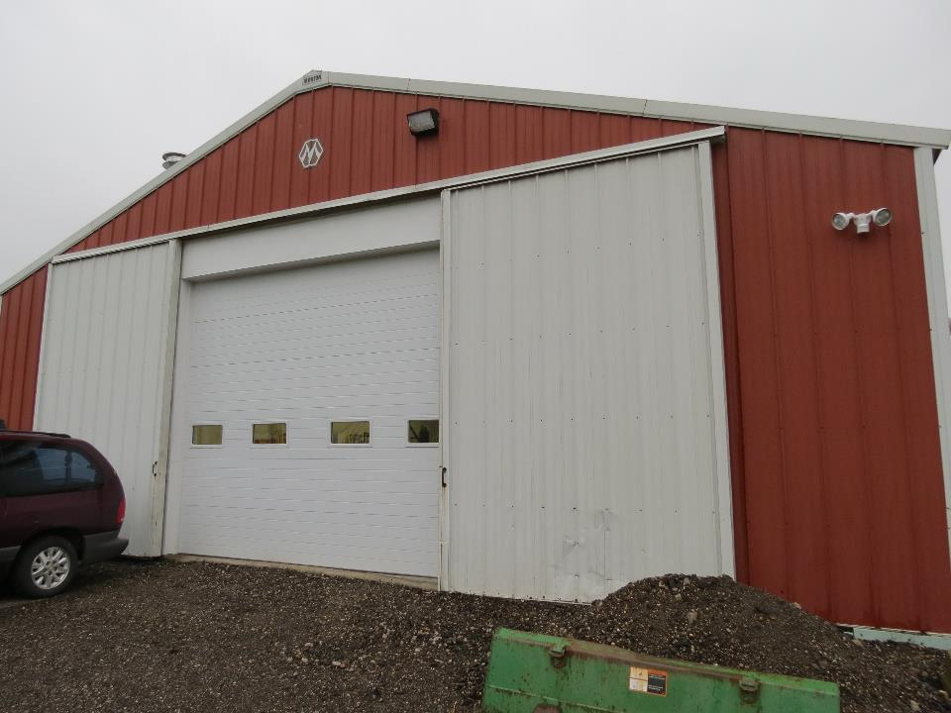
Simple accommodations
Power doors and gates reduce climbing

Slide 17
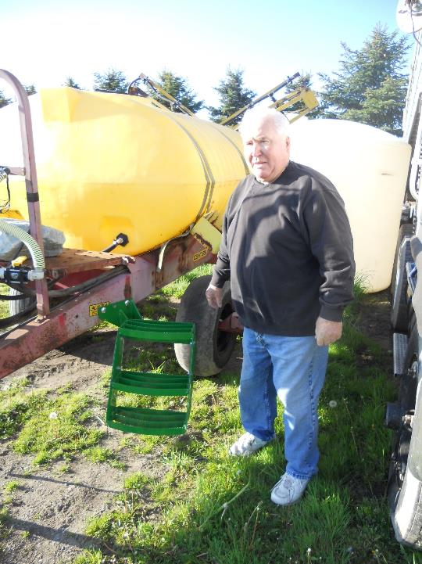

Slide 18
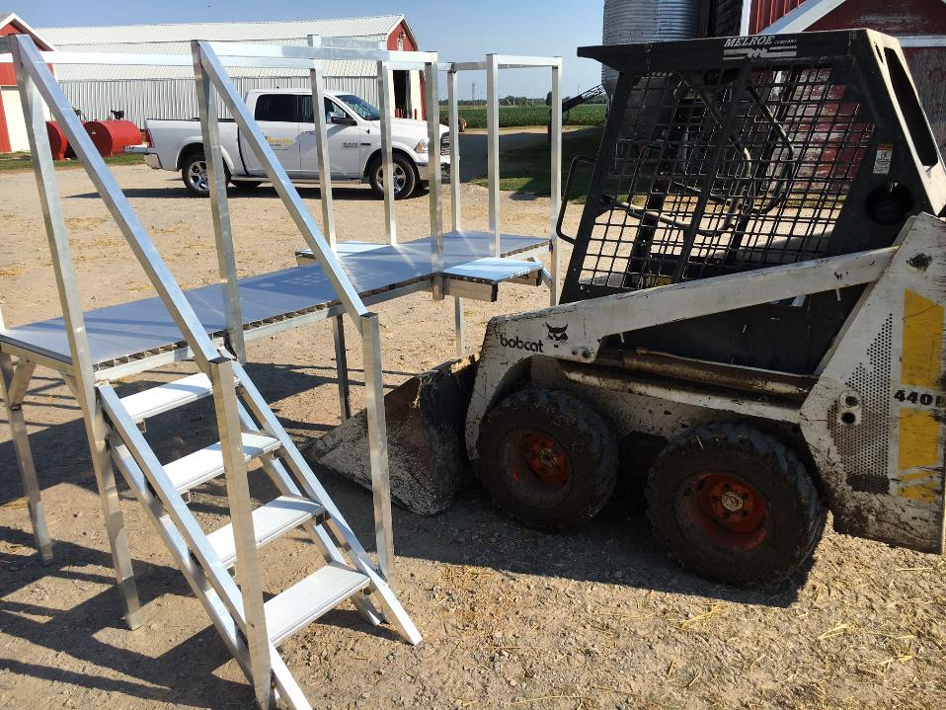
Simple accommodations
Crowding tubs for livestock handling

Slide 19
Fenceline feeders - the safe side of the gate

Slide 20
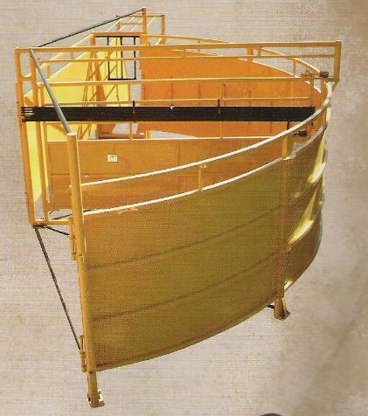
Simple accommodations
Cattle handling

Slide 21
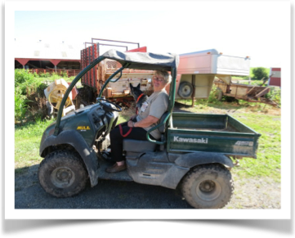
Simple accommodations
Save your steps

Slide 22
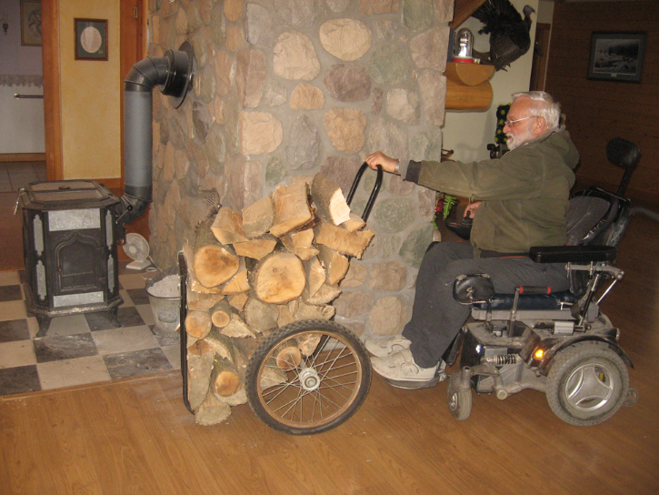

Slide 23
Count the cost
Cattle handling equipment $12,000 vs. internal injuries or permanent impairment?
Added tractor steps $400 vs. broken leg $12,000
CabCam or mirror $300 vs. tractor rolled over into manure pit and you paralyzed $1,000,000

Slide 24
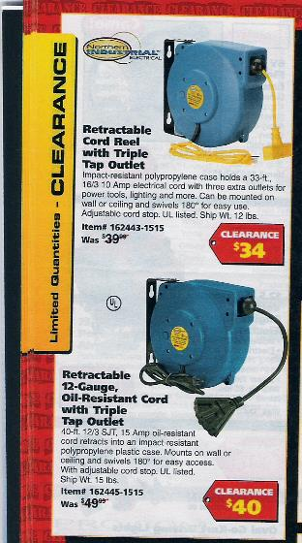

Slide 25
Save Time & Money
Medical cost – hospital, ambulance, ER, wheelchairs, xrays, doctors, therapy
Business cost – time spent at medical appointments instead of working, time recovering/resting, time doing therapy, vehicle cost driving to appointments, time for another person from family or farm to drive you around

