Slide 1
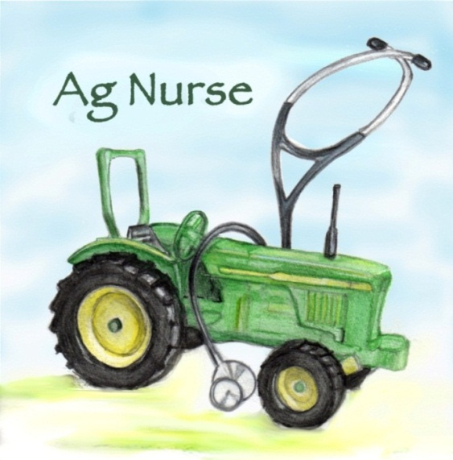

Aging and farmers:
Understanding “Normal” and Adapting to Changes
Deborah B. Reed, PhD
College of Nursing – University of Kentucky
dbreed01@uky.edu
http://www.facebook.com/Agriculture.nurse
Notes:
Thank you for coming to this session on aging and farm work. I can personally identify with the information we are about to explore. Much of this insight has been gathered not only over my 22 years in research but over the course of my lifetime as a member of a farm household. I am officially an occupational health nurse , but more closely identified as an ag nurse.

Slide 2

Basic Webinar Instructions
Need speakers or headphones to hear the presentation. No phone connection.
Check sound via Meeting > Audio Setup Wizard
Questions about presentation
  Type into chat window and hit return.
  During the Q & A period, if you have a web cam/ microphone, click the “Raise Hand” icon to indicate that you have a question. We will enable your microphone

Slide 3
Basic Webinar Instructions
4 quick survey questions
Session recorded and archived with PowerPoint files at www.agrability.org/Online-Training/archived along with resource materials
Problems: use chat window or email agrability@agrability.org

Slide 4
Known Webinar Issues
Echo
  Check to see if you are logged in twice
Disconnection with presenters
  Hang on – we’ll reconnect as soon as possible
Disconnection with participants
  Log in again

Slide 5

AgrAbility: USDA-sponsored program that assists farmers, ranchers, and other agricultural workers with disabilities.
  Partners land grant universities with disability services
  Organizations. Currently 20 state projects
  National AgrAbility Project: Led by Purdue’s Breaking New Ground Resource Center. Partners include:
    Goodwill of the Finger Lakes
    The Arthritis Foundation, Heartland Region
    University of Illinois at Urbana-Champaign
    Colorado State University
  More information available at www.agrability.org

Slide 6
Aging and farmers:
Understanding “Normal” and Adapting to Changes
Deborah B. Reed, PhD
College of Nursing – University of Kentucky
dbreed01@uky.edu
http://www.facebook.com/Agriculture.nurse
Notes:
Thank you for coming to this session on aging and farm work. I can personally identify with the information we are about to explore. Much of this insight has been gathered not only over my 22 years in research but over the course of my lifetime as a member of a farm household. I am officially an occupational health nurse , but more closely identified as an ag nurse.

Slide 7
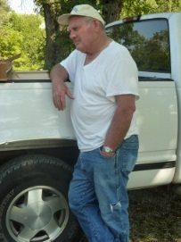
Session Objectives
Provide information on the health and work environment of aging farmers (> 50)
Discuss the interface between aging and work
Discuss strategies to assess risk
Discuss strategies to restructure behavior and work
Notes:
During our time together I hope to equip you with new knowledge about aging, farm work and risk, and best practices to assist farmers to remain in the workplace.

Slide 8
Studies and Funding Sources
Sustained Work Indicators of Older Farmers
NIOSH grant R01 OH 04157
Strategies for Safety of Older Adult Farmers
NIOSH grant R21 OH 009494
Nurses Utilizing Research, Service, Education and Practice (NURSE-AP)
NIOSH grant 2 U54 OH 007547-11
Primary goal: to develop new resources to safeguard the right of aging farmers to work and to safeguard the health of older farmers so they can continue to work.
DISCLAIMER
The views here are the responsibility of the author and do not reflect endorsement by the funding agency
Notes:
My work has involved various agencies and research projects as noted on this slide.

Slide 9
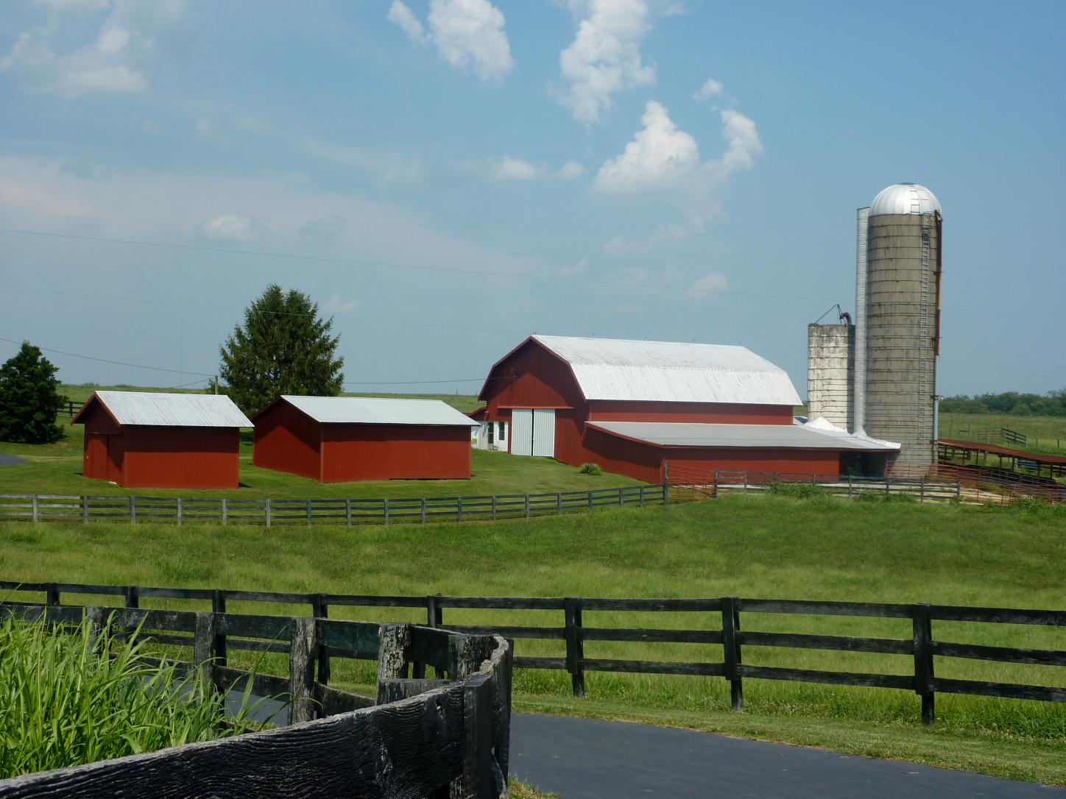
The Farm Workforce
most rapidly aging workforce in U.S.
average age of all U.S. principal farm operators 58 (average age of the U.S. workforce is 42)
not constrained by constructs typical to the labor force (no standard retirement age, performance evaluation criteria, or years of service)
over half of all farmers hold an off-farm job
Notes:
A variety of reasons makes farmers the oldest work group in the US. This trend is expected to continue for over another decade. More importantly, farmers rarely retire and many also hold a second job.

Slide 10
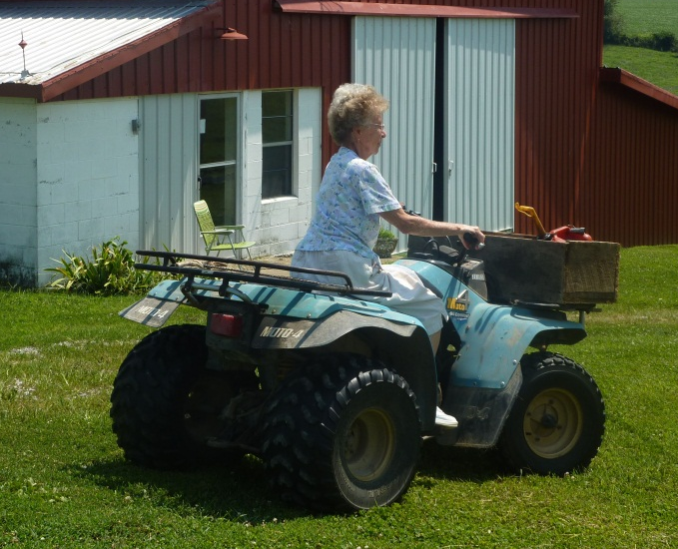
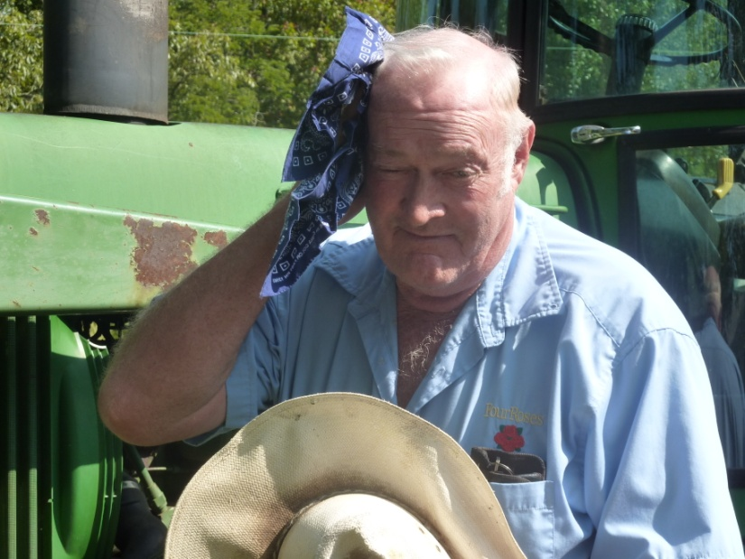
Recent trends (2012 Census)
2012 Census:
Women-Now almost 14% of all farms
2nd operators – 67%
Percent of operators age 65 and older- 33.25 (7% increase, 20 increase previous round)

Slide 11
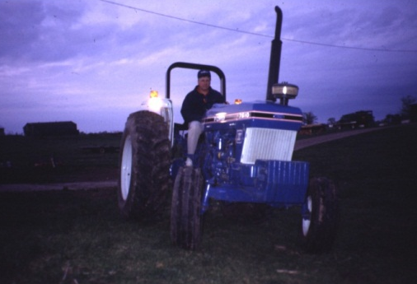
Off-farm Jobs
In our study of KY and SC older farmers, 44% also held an off–farm job
    34 hrs/wk
    Essential for supporting farm operation
    Felt farm work reduced their overall stress and relaxed them from their off-farm job strain
    Retired from off farm jobs; increased farm work
Study: Sustained Work Indicators of Older Farmers
Notes:
The reason for off-farm includes financial, health insurance coverage. However, the farm job is seen as less stressful than the off farm work.
Quotes: My public job supports my “habit” (farming).
“On the farm you can look back and see what you’ve accomplished at the end of the day.”

Slide 12

Farmers and Retirement
When an older farmer claims to be retired, don’t assume the dictionary meaning applies
In 2003, principal farm operators who were “retired” still averaged 913 hours of work on the farm per year
Departure from farm life may be equated with separation from the very essence of their being
Notes:
Dictionary meaning = “to withdraw from one's position or occupation: conclude one's working or professional career”.

Slide 13
Average hours worked by farmers over age 55 (focus group)
Age Group | # in Study | Self-Reported Farmer Status |  |  |  | Avg. Hrs/Week
 |  | FT | PT | Retired | Not Answered
56-59 | 3 | 3 |  |  |  | 67
60-69 | 18 | 14 | 3 | 1 |  | 51
70-79 | 16 | 7 | 7 | 1 | 1 | 38
80-83 | 6 | 1 | 1 | 4 |  | 12
Totals | 43 | 25 | 11 | 6 | 1
Study: Safety Strategies for Older Adult Farmers
Notes:
Our current study includes 43 farmers who share their views via focus groups. Six of those self-reported as retired from farming. Notice the continued but declining hours of farm work by age increase. Farmers call this “Cutting back”.

Slide 14
Average hours worked by “retired” farmer
Age of “retired” farmer | Average hours worked per week
65 | 40
72 | 30
72 | none
80 | 15
80 | didn’t answer
83 | full-time
“If you enjoy it, it’s not work.”
Study: Safety Strategies for Older Adult Farmers
Notes:
Farm work hours reported by the six who said they were retired from farming “If you enjoy it, it’s not work.”

Slide 15
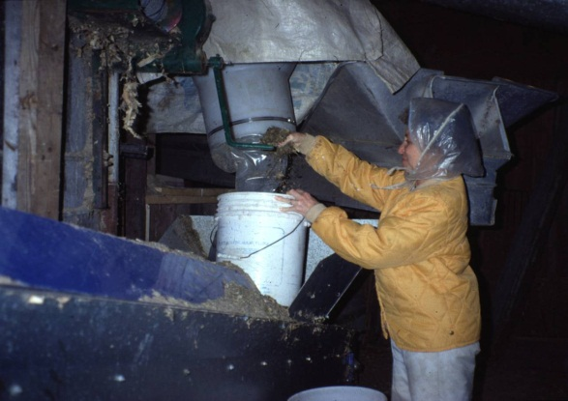
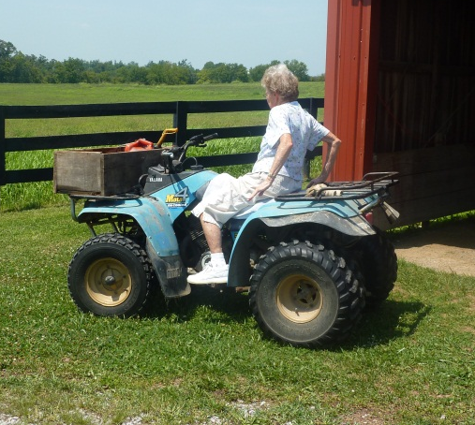
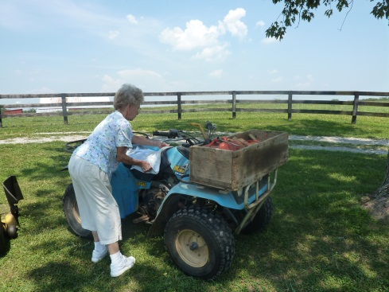
Persistence
“My Doctor, after I cut my leg off, he said just to sell the farm and retire. I was so mad, I’m not going to sell what we worked so hard for! This is what I do. This is who I am, I’ll find a way to do it. I have to.”
- DB, age 70, amputation at age 64
(now 78, still farming)
“It’s in the blood. We’ve always liked it. It’s part of who we are.”
Notes:
Are they hardy, resilient, stubborn, or trapped? All these terms have been used in the literature about farmers. This lifelong farmer has been through 4 prosthetic devices already and continues her farm work despite multiple health impairments. She is 4 10 and weighs 78 lbs.

Slide 16
What happens as we age
AKA: “the groan”
Decreased respiratory capacity – 20’s
Presbyopia – 40’s
Compromised joints – 50’s
Skin changes – 60’s
Decreased distal sensation – 70’s
Decreased temperature tolerance – 80’s
Notes:
Aging starts at birth, the good news we get wiser as we age and can accommodate these deficits

Slide 17
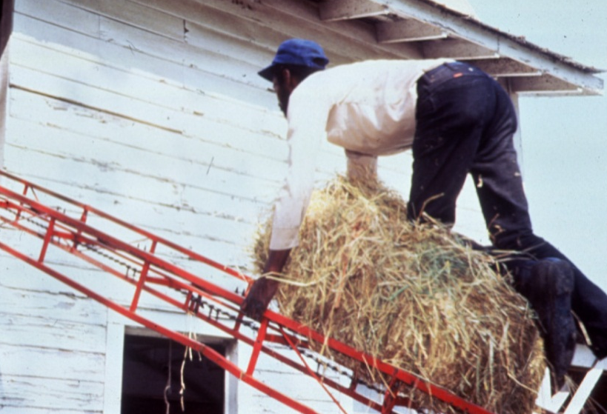
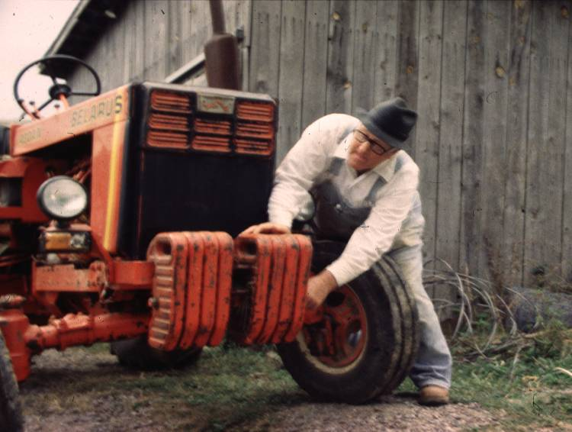
As age advances …
Prolonged recovery
Morbidity and mortality increases
Co-morbidities increase
Notes:
Have you noticed it takes longer to recover as you age, and with that, comes more illnesses. Because our systems are compromised it is more likely that we die from what we could have recovered from at an earlier stage in life. Thus, it becomes even more important to protect ourselves ( “ an ounce of prevention….)

Slide 18
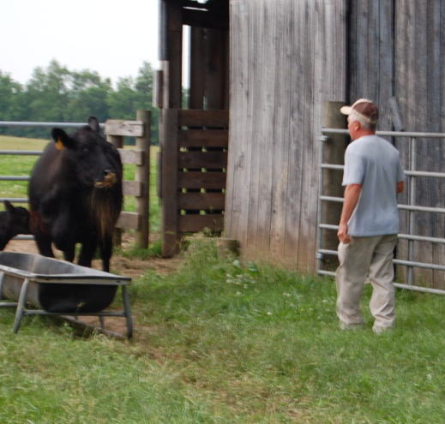
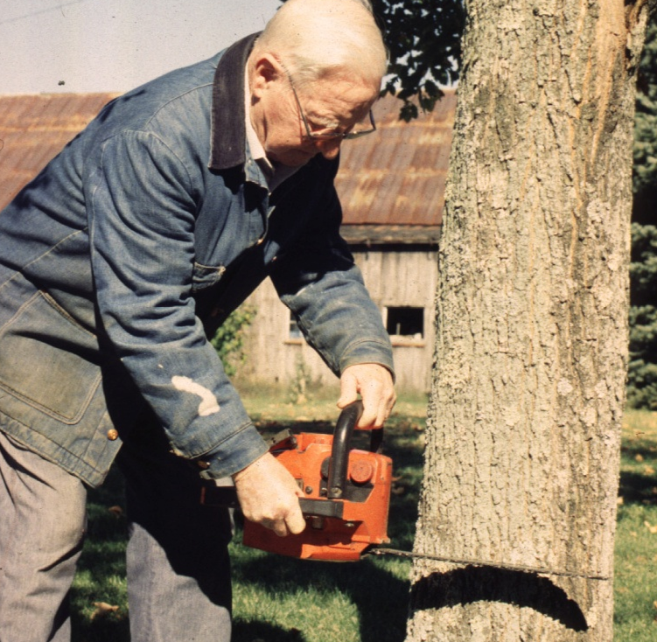
Older Farmers at risk
Slowing reflexes
Physical wasting
Arthritis
Accelerated hearing loss
Cataracts
Skin cancer
Notes:
Older farmers seem to suffer from more debilitating conditions than the general population. Farmers are second only to fisherman for cataracts. Predominant skin cancers are basal cell and malignant melanoma. Hearing loss has been documented in farm teens and is caused by prolonged exposure to loud noises. If you have to raise your voice to be heard 36” away you are damaging your hearing.

Slide 19
Leading Health Conditions
Reported by Older Farmers
Study: Sustained Work Indicators of Older Farmers
Notes:
Study: N = 1,423; Average age 65; Equal men, women
Think of the previous slides. Few persons have just one of these so they create a synergistic effect on the body. Hearing loss can actually increase blood pressure, for instance.

Slide 20
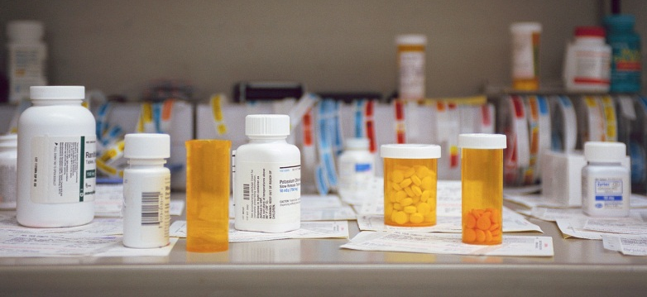
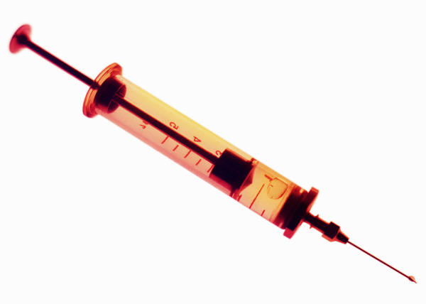
78% of aging farmers reported taking prescription medications on a daily basis
Nearly a third (31%) were not current on tetanus immunization or did not know if they were
Study: Sustained Work Indicators of Older Farmers
Notes:
Now think of the warnings that are included with common medications. Do not operate machinery while taking this medications; this medication may cause drowsiness (or dizziness), Take extra fluids when on this medication….. Now think of the usual day of farmers.
Tetanus is a rare event but a deadly one, with a 46% mortality rate. Soil is heavily contaminated with the tetanus spores, yet one of three farmers did not know their immunization status. Moreover, few health care providers ever ask.

Slide 21
Preventive Health Actions by Older Farmers
Study: Sustained Work Indicators of Older Farmers
Notes:
In past 12 months have you had….
On the other hand, older farmers and spouses are doing pretty good in getting their blood pressure checked at least yearly, but not so good in getting that important flu shot. Remember two things: if you get the flu no one else does your farm work for you, and the older you are the longer it takes to recover.

Slide 22
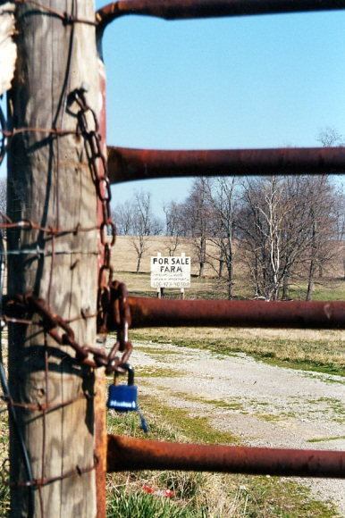
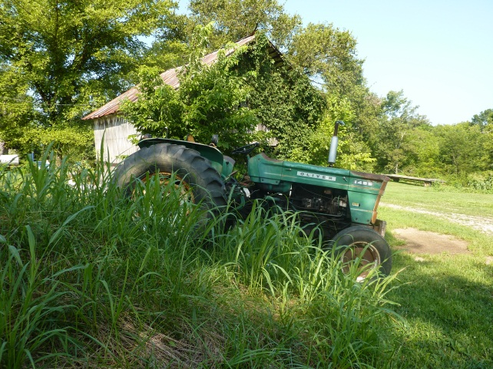
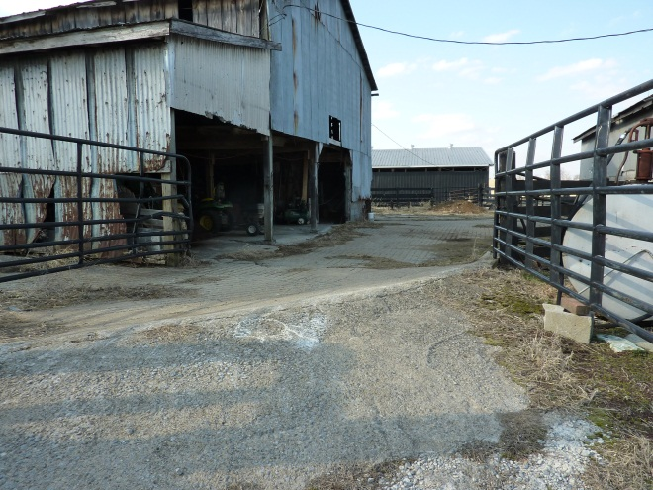
Farmers and Depression
Farmers have one of the highest suicide rates of any occupation
Peaks at oldest ages
Males are at higher risk than females
Browning, S.R., Westneat, S.C., & McKnight, R.H. (2008). Suicides among farmers in three southeastern states, 1990‐1998. Journal of Agricultural Safety and Health, 14(4): 461-472.
Notes:
This slide is usually a shocker. But think about watching your farm go downhill and you no longer able to keep it pristine. Older farmers tend to remain in the farm homestead, even after passing the work along to someone else. Sitting at the window can take a tremendous emotional toll. “This is what I’ve worked for, this is who I am .”

Slide 23
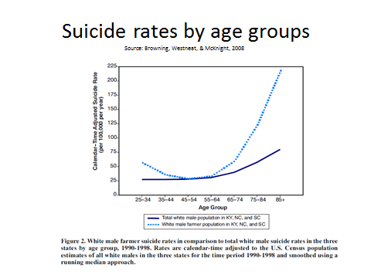

Slide 24
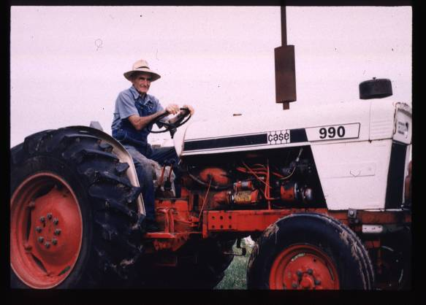
Meaning of Work
Defines health
  “I can’t think of a time I wouldn’t be raising cows unless I was dead or disabled.”
  “As long as I can climb onto a tractor I will. If you stop, you set still and die.”
Defines self
  “Farming is a habit, a way of life. We don’t know anything else to do.”
Notes:
Farming and farm work is a part of the self-identity ?tractor overturns as “unintentional suicides”

Slide 25
Perspectives on Health Status
How would you best define good health? | Under 65 N=749 | 65 - 69 N=267 | 70+ N=407 | Total Sample N=1,423
Absence of pain | 14.5 | 15.3 | 10.9 | 13.7
Ability to work | 39.1 | 40.0 | 41.8 | 40.0
Absence of major disease | 25.4 | 25.5 | 23.4 | 24.9
Not having to take medications | 17.0 | 16.5 | 18.1 | 17.2
Some other definition | 3.9 | 2.8 | 5.9 | 4.2
Reed. D.B., Rayens, M.K., Conley, C., Westneat,S., Adkins, S.M. (2012) Farm elders define health as the ability to work. Workplace Health and Safety , 60(8), 345-351.
Notes:
Unlike the general population, farmers thought more of health as the ability to work, This is consistent with the limited literature from the 80’s that explored this concept. With the exception of “absence of pain” the definitions were fairly consistent across age groups.

Slide 26
Injuries and Aging
Injury rate of farmers 3 times higher than other occupations
Older farmers have less non-fatal injuries than younger
Fatality rate is 2.6 times greater than for younger farmers
Older farmers more likely to require hospitalization with a longer length of stay
Myers, J. R., Layne, L. A., & Marsh, S. M. (2009). Injuries and fatalities to US farmers and farm workers 55 years and older. American journal of industrial medicine, 52(3), 185-194.
Notes:
Tractors, trucks and animals led the mechanisms for most of these fatalities and falls are frequently involved in the injury events..
Reviews of injured farmer’s medical records note that older farmers are more likely to require hospitalization due to their injuries than younger farmers. A Canadian study confirmed that hospitalization costs for older injured famers were higher and length of stay longer than for younger farmers.
In the United States, the fatality rate for older farmers was 2.6 times greater than for younger farmers with a dramatic increase in fatalities beginning at age 65.(Myers)

Slide 27
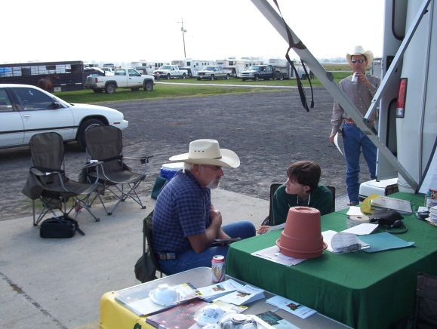
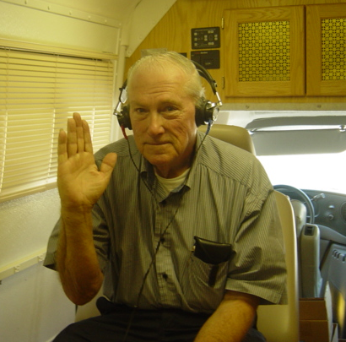
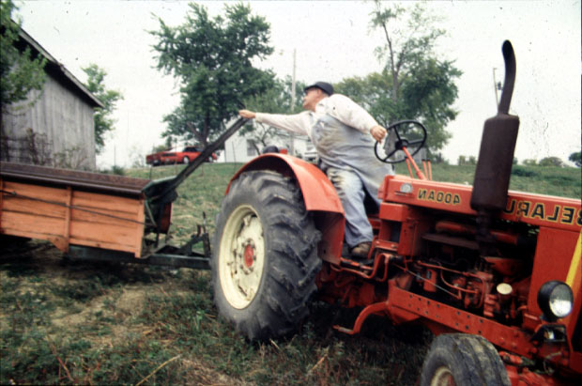
Assessing Physical Risk
Vision/hearing
Balance
Reaction time
Range of motion (neck)
Notes:
It is fairly easy to assess physical risk for farm work of the aging farmer, low or no cost, and as good as fancy tests. The challenge is not being objective about the potential consequences.

Slide 28
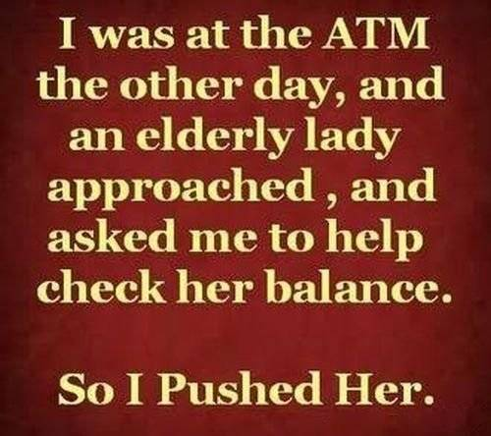
Notes:
You may even have to ask others to help with the assessment, Just be careful how you phrase it.

Slide 29
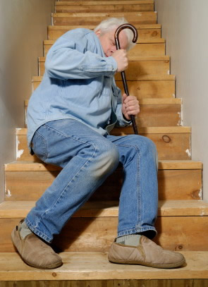

Balance Tests You Can Do at Home
http://www.fit-after-50-womens-health-magazine.com/balance-tests.html
http://www.realage.com/fitness/improve-your-balance

Slide 30
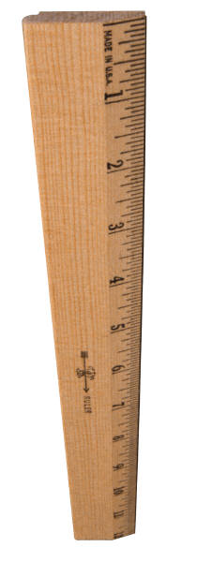
Reaction Time Tests
http://faculty.washington.edu/chudler/chreflex.html (How fast are you?)
http://www.driveractive.com/tips/reaction.html
Notes:
Get a ruler (or a yardstick or candy bar). Hold the ruler near the end (highest number) and let it hang down. Have another person put his or her hand at the bottom of the ruler and have them ready to grab the ruler (however, they should not be touching the ruler). Tell the other person that you will drop the ruler sometime within the next 5 seconds and that they are supposed to catch the ruler as fast as they can after it is dropped. Record the level (inches or centimeters) at which they catch the ruler (you can convert the distance into reaction time with the chart below). Test the same person 3 to 5 times (vary the time of dropping the ruler within the 5 second "drop-zone" so the other person cannot guess when you will drop the ruler). Here is a table to convert the distance on the ruler to reaction time. For example, if you caught the ruler at the 8 inch mark, then your reaction time is equal to 0.20 seconds (200 ms). Remember that there are 1,000 milliseconds (ms) in 1 second.
Distance – Time
2 in (~5 cm), 0.10 sec (100 ms)
4 in (~10 cm), 0.14 sec (140 ms)
6 in (~15 cm), 0.17 sec (170 ms)
8 in (~20 cm), 0.20 sec (200 ms)
10 in (~25.5 cm), 0.23 sec (230 ms)
12 in (~30.5 cm), 0.25 sec (250 ms)
17 in (~43 cm), 0.30 sec (300 ms)
24 in (~61 cm), 0.35 sec (350 ms)
31 in (~79 cm), 0.40 sec (400 ms)
39 in (~99 cm), 0.45 sec (450 ms)
48 in (~123 cm), 0.50 sec (500 ms)
69 in (~175 cm), 0.60 sec (600 ms)

Slide 31
Perceived Farm Work Hazards to the Older Farmer
per the Farmers
per Family Members
Balance, vision, arthritis, hearing
Long hours
Working alone
Driving equipment on highway
Stress
Equipment
Cattle
Chainsaws
Stress
Study: Safety Strategies for Older Adult Farmers
Notes:
The older farmers did not perceive the dangers associated with aging factors toward themselves, only toward their fathers. They realize their physical and mental capabilities aren’t what they once were but don’t see those factors as significant increases for injury risk right now. None of the farmers in this group really perceived their aging issues as hazards on the farm – when asked about the hazards it was always the equipment or the cattle. Finite things that served as the injury host, not anything related to them.
Even though they understand the risks increase as they develop aging symptoms, they still seem to think it won’t happen to them. Still seem to think they can control their circumstances and events. Or maybe they just think it’s worth the risk to do what they love to do.
Interesting that they all expressed how much easier farming is physically now than it was when they started but that the stress level is greater. In the long run, wonder which will place a greater toll on the farmer? I would guess the latter. Literature already supports how stress is a major factor contributing to injury. Aches and pains can be controlled to some extent to let you carry on your work. But mental issues (worry, stress) will affect everything you do. Prevents you from thinking clearly and paying attention, etc.

Slide 32
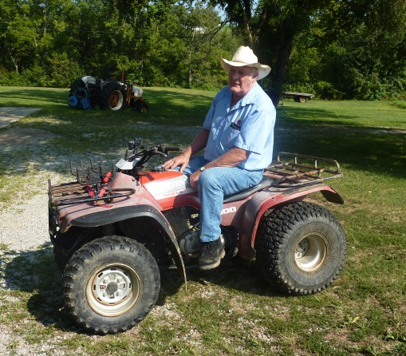
Types of Adaptations
(the farmers)
Use of ATVs and utility vehicles
Increased use of communication devices
physically demanding tasks
Maintain machinery and equipment
Plan your trips (walking) to conserve energy
“A 4-wheeler is better for chasing cows, but watch what you’re doing.”
“Be sure somebody knows where your are.”
Study: Safety Strategies for Older Adult Farmers

Slide 33
Types of Adaptations
(the farmers)
Ease up how much you do; pace yourself
  Don’t get in a hurry; stop and rest
Hire younger people to help do the more physically demanding tasks
Relax – do more away from farm (vacation)
Take nap breaks
“Now I go out to feed at 7, used to go at 5.”
“When I get tired, I quit.”
Study: Safety Strategies for Older Adult Farmers

Slide 34
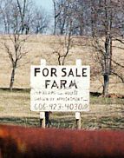
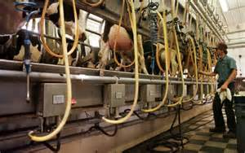
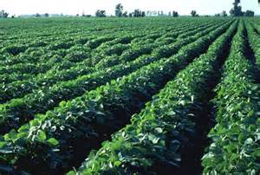
Types of Adaptations
(family members)
What they’ve done
  Selling part of farm to lessen work load
  Changing type of farm (e.g. from dairy to hay/beef cattle operation)
  Keep PTO shields on
  Planning task distribution ahead of time
Study: Safety Strategies for Older Adult Farmers

Slide 35
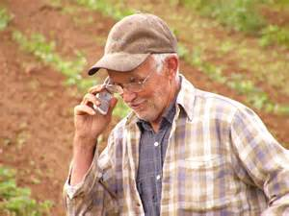
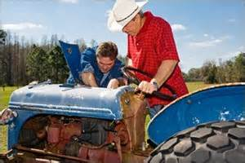
Types of Adaptations
(family members)
What they could do
  Find different tasks that aren’t as risky
  Fix/repair equipment so someone else can do the job instead of the older farmer
  Communication (keep him in sight; check-in)
  Plan A – Plan B

Slide 36
Feasibility of Guidelines (the Farmers)
Not overly enthused
Will realize on your own when it’s time to quit
Probably would not read it
Anything that makes you stop and think might be helpful
Taken more seriously if directed toward farmer’s risk of hurting others
“You don’t ever get anywhere making somebody think they’re dangerous to themselves; but I think if you make them feel like they’re dangerous to other people, then you accomplish something.”
Study: Safety Strategies for Older Adult Farmers
Notes:
Overwhelmingly, the farmers voiced the need to direct any type of guidance toward the fear of hurting others. Farmer will take it much more seriously if he thinks he might hurt a family member, neighbor, friend, or farmworker than if it’s directed at how he individually could get hurt.

Slide 37
Feasibility of Guidelines (the Family Members)
Older farmer’s response may be aggressive; upset about other people telling him what he can/can’t do
Older generation is more traditional – women don’t tell men what to do
Personality is a factor
Older farmer must come to realization that the job can get done without them
Farmers may have “mental block” for changes
Study: Safety Strategies for Older Adult Farmers

Slide 38
Preliminary Themes
Older Farmers
“Don’t tell us we can’t do this any more.”
Resistant to any type of assessment
More concerned about hurting someone else than hurting themselves
Use humor
Be realistic
Farmers’ Family
“They won’t listen.”
Find alternative tasks that aren’t as risky
Ensure older farmers use familiar equipment – not too technical or high speed
Study: Safety Strategies for Older Adult Farmers

Slide 39
So, how did the conversation go with your Dad about him giving up the keys to the tractor? “It was the hardest thing I ever had to do.”
Their Stories
“We have abused our bodies doing farm work. We had to prove ourselves when we were young. We need to learn to slack off a bit but that’s not how we were brought up.”
“These younger ones need to be careful what they tell us to do. Putting us on tractors to mow banks is probably the worst thing we can do. That’s how we get killed.”
“I think as you get older the more important it is to just be able to accomplish something.”
“That’s one thing, if you take their freedom away, you break an old farmer’s spirit just like that.”

Slide 40
Your Stories
Your Thoughts
Your Ideas

Slide 41
What has worked for yourself or for your farm family to adapt farm work for older people?
What are your concerns?
What adaptations has farmer made to make farm work easier/safer?
What would make an aging farmer think and act on these concerns?

Slide 42
Resources
AgNurse | http://www.facebook.com/Agriculture.nurse
National AgrAbility | http://agrability.org/
AgriSafe | http://www.agrisafe.org/
AgriWellness | http://agriwellness.org/
NIOSH Ag Centers | http://www.cdc.gov/niosh/agctrhom.html
NASD – National Agriculture Safety Database | http://www.cdc.gov/niosh/nasd.html http://www.nasdonline.org/

Slide 43
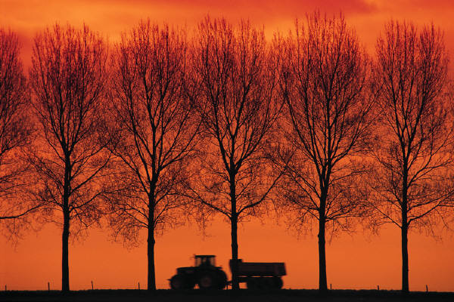
“I can’t imagine not farming.
I’d rather die than not farm…”
  “As long as I can climb onto a tractor I will. If you stop, you set still and die.”

