Slide 1

Improving Quality of Life for Rural People with Disabilities: the Collaboration between APRIL and AgrAbility
Sierra Royster: the Association of Programs for Rural Independent Living (APRIL)
AgrAbility Webinar Series
Tuesday, August 8, 2017
2:00 p.m. ET

Slide 2

Basic Webinar Instructions
Audio available through computer or phone.
Check sound via Communicate menu at top left
Closed captions: use arrow to expand or contact the Media Viewer window.
Expand/contract any of the windows in the right-hand column with the arrows. May need to do this to see video of presenter.
Expand/contract the size of the right-hand column.

Slide 3
Basic Webinar Instructions
Questions and comments
  Click Chat icon at top right of screen (it should turn blue). Enter message in box, choose who to send it to, and click send. You may enter questions about the presentation at any time. Please send to “All Panelists”.
  In addition, during the Q & A period, if you have a web microphone, click the “Raise Hand” icon to indicate that you have a question. We will enable your microphone or phone connection.

Slide 4
Basic Webinar Instructions
4 quick survey questions + opportunity to share comments
Session recorded and archived with PowerPoint files at www.agrability.org/Online-Training
Problems: use chat window or email jonesp@purdue.edu

Slide 5

AgrAbility: USDA-sponsored program that assists farmers, ranchers, and other agricultural workers with disabilities.
  Partners land grant universities with disability services organizations. Currently 20 state projects
  National AgrAbility Project: Led by Purdue’s Breaking New Ground Resource Center.
  Partners include:
    Goodwill of the Finger Lakes
    APRIL (Association of Programs for Rural Independent Living
    Colorado State University
  More information available at www.agrability.org

Slide 6


Improving Quality of Life for Rural People with Disabilities: the Collaboration between APRIL and AgrAbility
August 8th, 2017
Sierra Royster

Slide 7

Association of Programs for Rural Independent Living
(APRIL)
Who we are: APRIL is a national grassroots, nonprofit membership organization consisting of members from Centers for Independent Living, the satellites and branch offices, Statewide Independent Living Councils, other organizations and individuals concerned with the independent living issues of people with disabilities living in rural America.
Mission: “APRIL provides leadership and resources on rural independent living. As a national membership organization dedicated to advancing the rights and responsibilities of people with disabilities living in rural America by serving as a center of resources and by leading systems change.”
Vision: APRIL is the unified voice of independent living in rural America.
Notes:
Disability Rights-The state protection and advocacy organization
Easter Seals
National Council on Independent Living
Northwest Colorado Council of Governments-Veterans, Transportation
Putnam County Comp. Svs.-DD services
Kansas Youth Empowerment Academy-Youth
RTC: IL Kansas –Agriculture and Technology Universities.
Nonprofits, and certain issue groups. (Veterans, transportation, certain disability groups, youth, agriculture)

Slide 8

What we are:
We are a membership organization
We provide training and technical assistance.
  Through mentors at the CIL, SILC, and youth local levels
  Webinars, Teleconference
We hold an annual conference (APRIL in October)
  This includes a Youth conference embedded in.
Provide leadership opportunities
We have other partnerships including RTCs : IL in Kansas and Montana
Provide a national rural voices on every issue that relates to people with disabilities
  Transportation, housing, community accessibility, youth, veterans, policy, AgrAbility.
MORE THAN A MONTH
What we are NOT:
We do not provide direct service.
We do not have a location for trainings and meetings.
We do not oversee/supervise/manage the CILs and SILCs.
CILs are not residential facilities.
IL programs and Centers are not day treatment.
Notes:
What we are not:
ONLY CILs provide the direct services. Not even SILCs.
We have a small office in Little Rock, AR for our ED and Director of Operations and Conference Coordinator. We are spread out through the country in Montana and North Carolina.
Oversight:
Mission: “APRIL provides leadership and resources on rural independent living. As a national membership organization dedicated to advancing the rights and responsibilities of people with disabilities living in rural America by serving as a center of resources and by leading systems change.”
IL Conversations, Advocacy Trainings,
RTC: Research Training Centers both are connected to the local Universities.

Slide 9
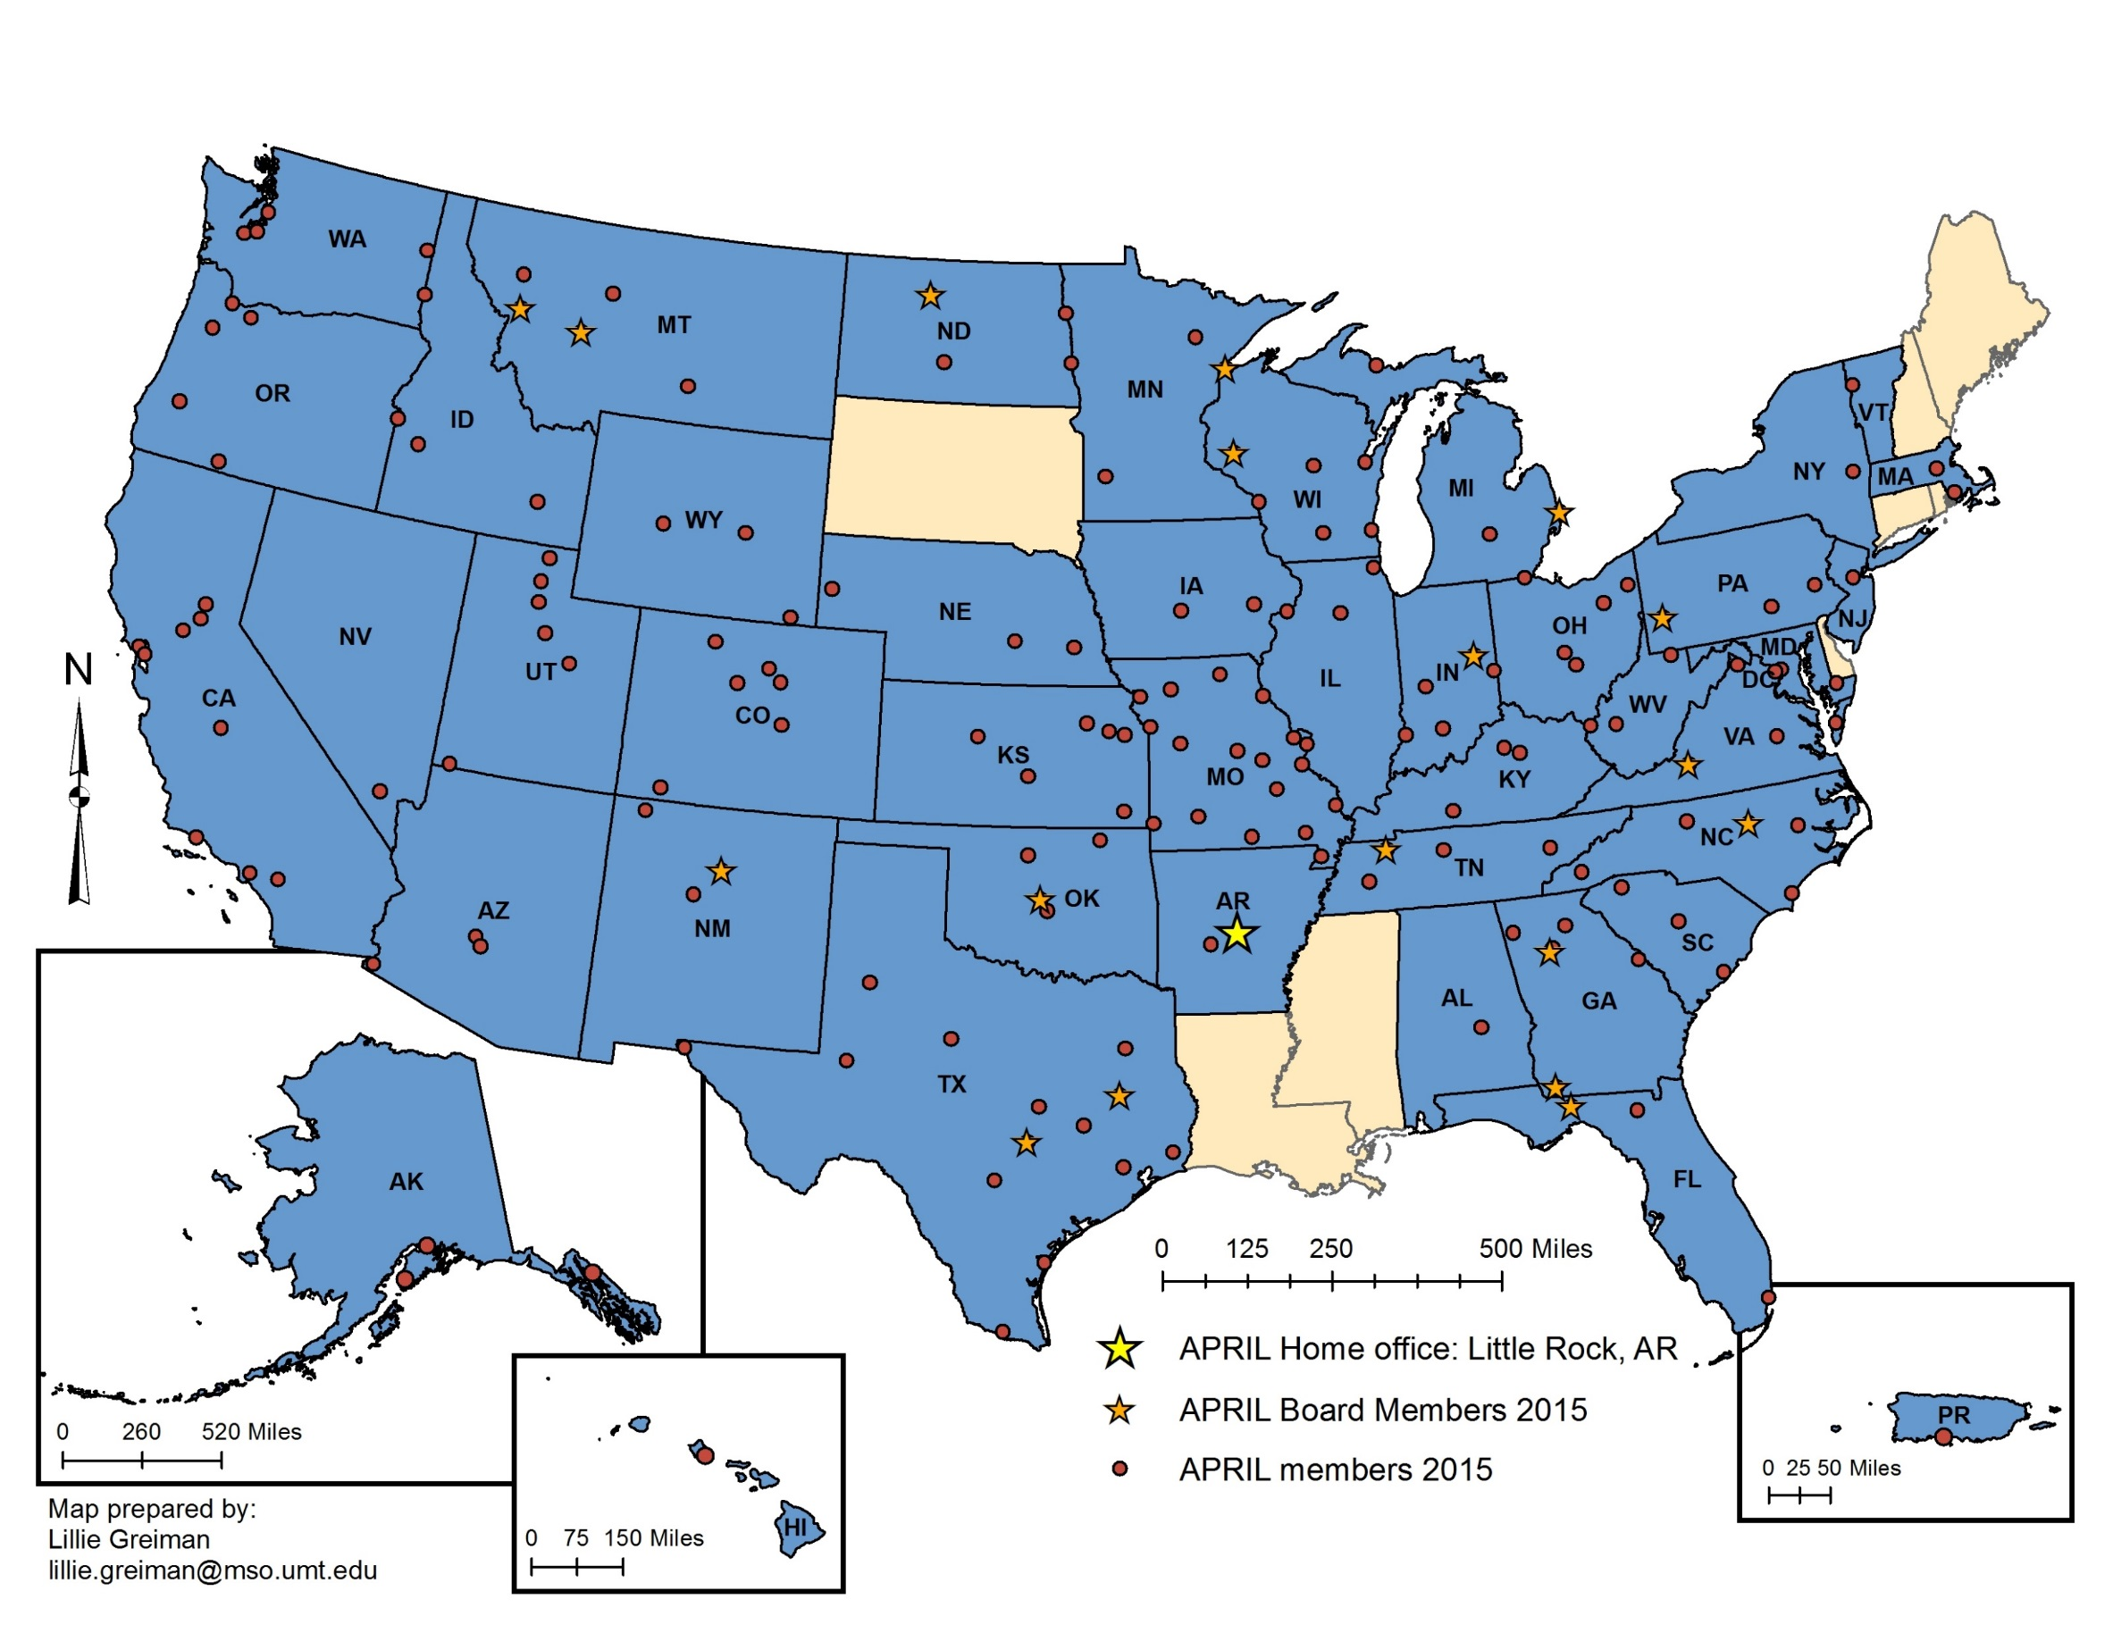
APRIL Membership
https://april-rural.org/index.php/about-us
Notes:
The star notes where our main office is.
You can find smaller orange stars for our board members
And the dots identify the members. This number does change annually. We do not have the latest numbers. If you are curious to see if your local CIL or SILC is a member the link is provided here so you can see.
If you do not see your local CIL or SILC listed…we can still talk with them, work with them, and provide resources to them. That just means they are not a member not that we have cut them off from APRIL.

Slide 10
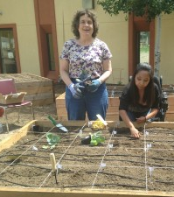
What is a CIL
Centers for Independent Living are community-based, cross-disability, non-profit organizations that are designed and operated by people with disabilities. CILs are unique in that they operate according to a strict philosophy of consumer control, wherein people with all types of disabilities directly govern and staff the organization. Centers for Independent Living provide:
  Peer Support
  Information and Referral
  Individual and Systems Advocacy
  Independent Living Skills Training
  Transition
    Diversion from Institutions
    Transitions from Institutions
    Youth Transitions
403 Centers for Independent Living (CILs)
330 branch offices
143ish are APRIL members

Slide 11
Which services have CILs been able to provide?
Notes:
I&R-any information they are able to give to a consumer. Are you able to make an AgrAbility referral…if they know about you.
ILS-This can be learning a new skill to assist them in living independently. Could be living well with a disability training, medication management, reading service, computer training classes
PM&S-Having another individual with a similar or exact same disability, barriers, and experience can really provide a lot of support and guidance. Allowing another person to feel comfortable and be able to relate. Learn inside tricks and tips from someone in their same shoes.
I&SA-This can be helpful is someone is turned away from services, or equipment they are in need of. An advocate from a CIL can assist in mediating that process. Access to businesses in the rural community that a farmer or rancher may need.
Transition-a young person wanting to transition to starting a farm, taking over the farm for the family.
Transitioning from an institution (hospital, long-term care facility, nursing home, prison or jail, etc.) after an injury.
Diversion from an institution-ensuring the family is safe on a farm to avoid any further injuries on the farm that may land someone in an institution. To ensure they can receive their home and community based programs at home rather than being sent to an nursing home, long-term care facility, long-term rehabilitation facility.

Slide 12
What is a SILC
Each state and US territory is required to maintain a statewide independent living council (SILC). The Council and the Centers for Independent Living (CILs) within the state develop a State Plan for Independent Living (SPIL). The SPIL is a document required by law that indicates how the IL Network is going to improve independent living services for individuals with disabilities over the next three years. It identifies the needs and priorities of consumers, providers, and other stakeholders and sets forth goals and objectives to respond to them.
Having a strong network for independent living in a state or territory is crucial. Collaborating on the SPIL development can help create a cohesive and unified vision among all stakeholders who have an interest in issues that impact citizens with disabilities.
56 Statewide Independent Living Councils (SILCs)
32ish are APRIL members

Slide 13
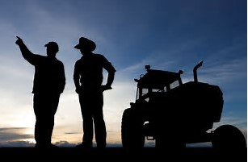
Same Culture Different Worlds…
Farm Culture
Solid family values
Hard working
Commitment to community
Self sufficient
Take care of each other
Everyone contributes
IL Culture
Independent Living (IL), as seen by its advocates, is a philosophy, a way of looking at disability and society, and a worldwide movement of people with disabilities working for self-determination, self-respect, and equal opportunities.
To work through the barriers that you may face with your disability.
Values community participation.
Many people with disabilities want to learn how to be in control and self sufficient.
Take care of each other.
Lifespan Model/Independent Living Model.

Slide 14
History
  AgrAbility began in 1991 as part of the USDA Cooperative State Research, Education, and Extension Service (now NIFA)
  Was included in 1990 Farm Bill, funded in 1991.
  In 1991, there were 8 funded state and regional AgrAbility projects (SRAPS); as of 2016 there are 20 SRAPs and several previously-funded affiliate projects.
  One National AgrAbility Project (NAP) supports the SRAPs.
Mission
  The vision of AgrAbility is to enhance quality of life for farmers, ranchers, and other agricultural workers with disabilities.
  Through education and assistance, AgrAbility helps to eliminate (or at least minimize) obstacles that block success in production agriculture or agriculture-related occupations.
Notes:
SRAPs-State and Regional AgrAbility Project.

Slide 15
AgrAbility Partnerships
AgrAbility Partnerships
National Project
State Project
Land Grant University
And at least one disability service program.
State Project
Land Grant University
.
Notes:
Many projects have more than one partner.
CILs can be, have been, and are currently partners (subcontractors) on AgrAbility Projects

Slide 16
AgrAbility Dos and Don’ts
Do
Provide support to the state and regional AgrAbility Projects
  Training
  Resources
  Consultations with NAP specialists
Provide direct services to customers in states without AgrAbility Projects
Don’ts
Funding
Equipment (though some Tech Act Project partners provide certain AT)
  Most funding for assistive technology comes through state vocational rehabilitation systems.
  Other resources of grants and loans are available.
Notes:
Some states partner with AT Act Projects, which usually have a lending “library” of AT or an AT re-use program.

Slide 17
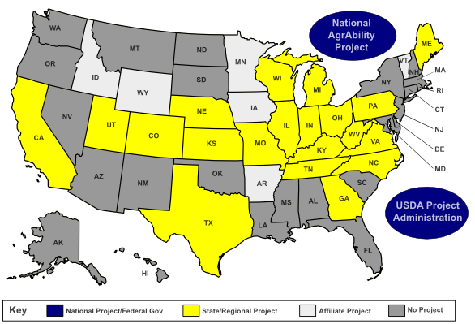
National AgrAbility Projects

Slide 18
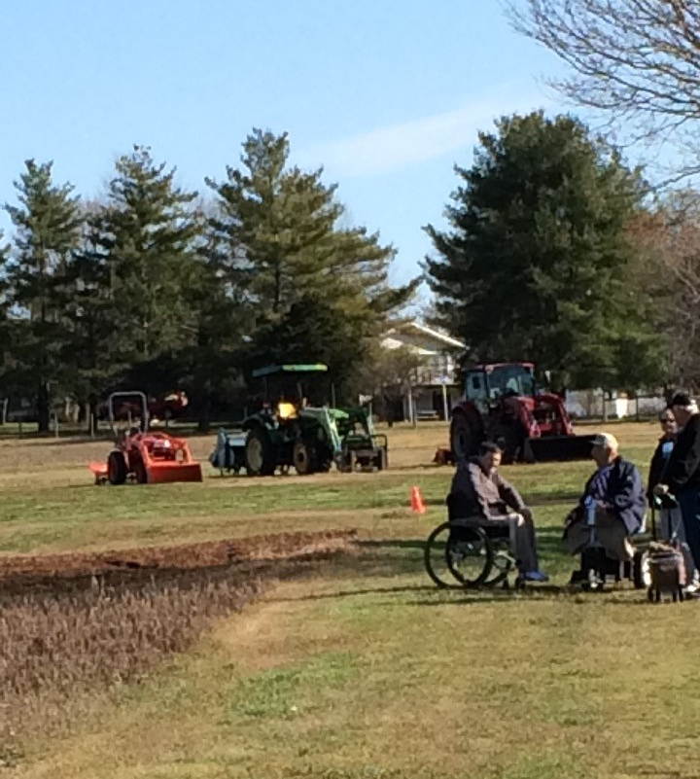
What will this partnership do?
Increase the awareness level of both the NAP and APRIL staff members regarding the respective services of both programs and how to access them.
Increase the resources available to each APRIL member Center for Independent Living and AgrAbility funded and affiliated states on CILs and SILCs as resources.
APRIL has conducted an assessment of their membership clientele to determine the level of services being provided to AgrAbility clientele.
Enhance the collaboration between State AgrAbility Projects and rural Centers for Independent Living.
Work together to increase collaboration with Youth in CILs and State AgrAbility Projects.

Slide 19
What did the people say?
Out of the states surveyed 48.6% were mostly rural. 40.5% were a mixture of urban/suburban and rural.
78% of those surveyed have heard of AgrAbility.
43% do not know if they have AgrAbility Project in their state.
50% serve only 1-10 consumers involved in agricultural with 22.2% only serving more than 26 consumers.
Notes:
It is important to know how our CILs/SILCs identify their areas. APRIL defines rural as not having access to services. NC example we do not define it as a certain population number. But, many define their area as mostly rural. So in those rural areas you have to ask are they working with the farmers and ranchers in those rural service areas?
Second, have they even heard about this?
Thirdly, 78% have heard about the project, but 48% do not know if they have a project. If they know the name, they need to know the people, contacts, resources.
Fourthly, Out of those CILs who serves farmers. As you see not a lot. Only 22.2% serve 26 or more. But most are just giving information and/or referral. The question here is are they being served or referred on. Are they being referred because the CIL is unsure of what they can do for the farmer. If so, How can we help with that knowledge?

Slide 20
Year 1
Cross-Connections-CILs and AgrAbility
Training for California CILs and others. Training will include intake form, resources, overview of programs, how to collaborate.
http://www.agrability.org/toolbox/
We are linking up with AgrAbility staff who know the language of agriculture and the language of VR to assist farmers in getting technology that works for them.
We are also reaching out to CILs that have accessible gardening programs.
Assist in the start of the conversations with youth program collaborations. (4H)
Accessed members of APRIL.

Slide 21
What to do now?
SILCs
Read your state SPIL. Does it include unserved or underserved?
Is the agricultural community represented on the council?
How can you do outreach?
Have you contacted your state AgrAbility person to see if they can represent as an Ex-Officio?
Do you have Agricultural University department?
HOW CAN APRIL HELP?
Notes:
Who can be a resource to assist farmers near you?

Slide 22
What to do now?
HOW CAN APRIL HELP?
CILs
Do some research
  County Extension agency
  AT Offices
  AGRABILITY –in your state or others.
How can you do outreach?
Who can provide agriculture training in your area?
Intake forms to assist in the process.
Identify your services that could improve or grow for famers and/or ranchers.

Slide 23
What to do now?
HOW CAN APRIL HELP?
AgrAbility
Reach out to your CILs/SILCs to provide training on agriculture community and businesses.
Assist in creating some language for intake forms to assist IL Specialist in working with farmers and/or ranchers.
What areas could you get in disability services from a CIL?
Could your client use some peer support? Could you or a client be a great mentor fit?
Read your State Plan for Independent Living.

Slide 24
Where are the gaps?

Slide 25
Sierra Royster
Youth Programs Coordinator, APRIL
11324 Arcade Drive, Suite 9
Little Rock, AR 72212
919-567-3602
www.april-rural.org
April-sierra@att.net
If you are not at the table, you are on the menu.

