Slide 1
Navigating the Information & Referral World
Leveraging Resources that Can Help You Help Those You Serve

Slide 2

Basic Webinar Instructions
Need speakers or headphones to hear the presentation. No phone connection.
Meeting > Manage My Settings > My Connection Speed
  Dial-up not recommended
Questions about presentation
  Type into chat window and hit return.
  During the Q & A period, if you have a web cam/microphone, click the “Raise Hand” icon to indicate that you have a question
    We will activate your microphone

Slide 3
Basic Webinar Instructions
4 quick survey questions
Session recorded and archived with PowerPoint files at http://agrability.org/Online-Training/archived along with resource materials
Problems: use chat window or email agrability@agrability.org

Slide 4
Known Webinar Issues
Disconnection with presenters
  Hang on – we’ll reconnect as soon as possible
Disconnection with participants
  Log in again

Slide 5

AgrAbility: USDA-sponsored program that assists farmers, ranchers, and other agricultural workers with disabilities.
  Partners land grant universities with disability services organizations
  Currently 23 projects covering 25 states
  National AgrAbility Project: Led by Purdue’s Breaking New Ground Resource Center. Partners include:
    Goodwill of the Finger Lakes
    The Arthritis Foundation, Heartland Region
    The University of Illinois at Urbana-Champaign
    Colorado State University
  More information available at www.agrability.org

Slide 6
My child is
on drugs
I want to
kill myself
I need to find
childcare
I can’t pay
my rent
I want to
volunteer
We can’t help with that
We only do senior daycare
I’ll try to transfer you to an agency who can help
We don’t need volunteers
I don’t know about those resources
I don’t know, please hold.
We only know about domestic violence programs
We don’t
serve your
area

Slide 7
I want to
kill myself
I can’t pay
my rent
I need to find
childcare
I want to
volunteer
My child is
on drugs
2-1-1, how may
I help you?
Information & Referral Program
Yes, I can connect you with someone who can help…
Drug
Rehabilitation
Center
Volunteer
Center
Rental
Assistance
Program
Child Care
Resource
And Referral
Mobile Crisis
Team

Slide 8
What is Information and Referral (I&R)?
Organizations that connect people with services.
People in search of services often do not know where to turn
Looking for help means locating many phone numbers and/or websites (for those who have access), and then searching to make the right connection.
I&R services were created to help people negotiate this maze; I&R agencies provide linkages between the individual and the services available in their community.
Part of the health and human service industry (for over 50 years).

Slide 9
What is Information and Referral (I&R)?
I&Rs maintain comprehensive databases of resources which usually include:
  federal, state, and local government agencies
  private, non-profit agencies
  libraries
  neighborhood and civic organizations
I&R Specialists work with callers to find help needed:
  assess callers' needs and help the caller determine their options and the best course of action
  determine whether a caller may be eligible for other programs
  intervene in crisis situations
  advocate on behalf of the caller, as needed.

Slide 10
Comprehensive I&R
Local experts on what services are needed and available throughout our communities
Broad range of programs and services
Top level Problem Categories:
  Basic Needs
  Consumer
  Criminal Justice/Legal
  Education
  Environmental Quality
  Health
  Income Security
  Individual And Family Life
  Mental Health
  Organizational/Community Services

Slide 11
Specialized I&R
Provide in-depth information about resources for specific population groups such as: older adults, children, victims of violence or people with mental health issues.
Some comprehensive I&R agencies may also operate specialized I&R services and vice versa.

Slide 12
Operating Standards
Program accreditation available through AIRS (Alliance of Information & Referral Systems)
National-level certification testing offered through AIRS for eligible individual staff:
  Certified Information & Referral Specialists (CIRS)
  Certified Resource Specialists (CRS)

Slide 13
2-1-1 and I&R
2-1-1 is an easy-to-remember telephone number
Designated by the FCC
Easy access to community-based information and referral providers
No longer need to know the “800” number to find help in many regions of the country
Like 911, it easily and directly connects the caller to a local or regional call center. It is not an emergency service access point.
Notes:
211 community information & referral
311 municipal services, non-emergency
411 directory assistance
511 traffic information
611 telephone company service or repair
711 relay service for deaf or hard of hearing
811 underground public utility location
911 emergency services

Slide 14
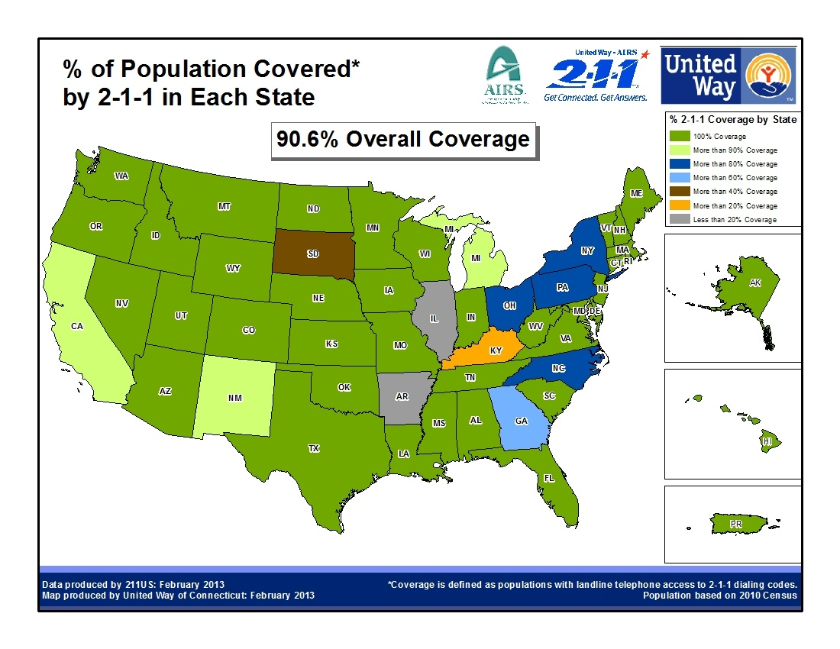

Slide 15
General 2-1-1 Standards:
Computerized data base (accurate and up-to-date)
  Database elements
  Database classification (Taxonomy
Call protocols
Technology & other infrastructure
24/7 capability
Accredited by the Alliance of Information and Referral Systems (AIRS)
Web accessible
Automated call distribution system
TTY and multi-language capability
Ongoing public education capacity
Call tracking capability
Crisis call capacity or MOU with local crisis center

Slide 16
What is a typical call to 2-1-1?
2-1-1 centers respond to all kinds of human service needs.
The most frequent needs include:
  financial assistance with rent or utilities
  housing
  food
  where to donate goods
  counseling or support groups
  employment assistance
  legal aid
  parenting classes

Slide 17
I&R Impact Stories

Slide 18
What Can 2-1-1 Do For The Community?
2-1-1 is a useful planning tool. By using aggregate data about types of calls, communities are in a better position to understand and anticipate demand for services and mobilize resources to meet changing needs.
2-1-1 can play a pivotal role in time of disasters and public health emergencies to assist in the dissemination of information to our community.

Slide 19
Why Is 2-1-1 Good For My Clients and Myself?
Free access to the region’s Health and Human Service information 24/7 via telephone and internet.
By helping us keep your agency data accurate, we can make sure we are sending you only those people who you are able to serve.
Accurate referrals means less wasted time for your staff in redirecting inquiries to your service.
Your services will be publicized without any further effort on your part.
2-1-1 can save agency time from maintaining your own information on resources, you can simply call or go to the web and get it.

Slide 20
Faster Access To Comprehensive Information
“As a Social Worker in an emergency room, I need fast and accurate resource information for my patients before they are discharged. I access the 2-1-1 website to find all of the information I need, print it out, and give it to my patients to take home with them.”

Slide 21
For More Information…
For national information visit www.211us.org
To find your regional 211visit www.211.org
Specialized I&R:
Aging and Disability Resource Centers:
http://www.adrc-tae.acl.gov/tiki-index.php?page=HomePage&view=ADRC&submitter=Select+Program
National Association of States United for Aging and Disabilities: http://www.nasuad.org
To connect with your closest crisis center 1-800-273-TALK (8255) or visit www.suicidepreventionlifeline.org

