Slide 1
An Introduction to
Self-Employment and Entrepreneurship for People with Disabilities
Stephen J. Swain, ATP
National AgrAbility Project/Indiana AgrAbility Project
Breaking New Ground Resource Center, Purdue University

Slide 2
Basic Webinar Instructions
Need speakers or headphones to hear the presentation
Meeting > Manage My Settings > My Connection Speed
  Dial-up not recommended
Questions about presentation – use chat window or call 800# provided at the end
Problems: use chat window or email racz@purdue.edu
4 quick survey questions at the end*
Session recorded and archived at www.agrability.org at future date

Slide 3
About AgrAbility
USDA-funded program serving farmers, ranchers, and other agricultural workers with disabilities
Today’s examples focus on agriculture, but apply to other enterprises
Breaking New Ground also does non-AgrAbility work for Indiana Vocational Rehabilitation (VR)

Slide 4
Purposes
To help professionals and consumers determine whether or not self-employment ideas are worth pursuing
To give an overview of the business planning process
To provide resources for ongoing work

Slide 5
Session Outline
Why self-employment?
Who is suited for self-employment?
How should self-employment be explored?

Slide 6
Why Self-employment?

Slide 7
Growth in Entrepreneurship
Rural Indiana Strategy for Excellence
VR small business assistance has grown from 1 business plan in 2002 to 20 in 2007
Purdue New Ventures Team

Slide 8

Potential Benefits to the Client
Create a new occupation
and increase personal income
Do what they enjoy doing
More control of personal
circumstances
Satisfy personal goals
Achieve business goals

Slide 9
Potential Drawbacks for the Client
Uncertainty of income
Risk losing invested capital
Long hours and hard work
High levels of stress
Discouragement

Slide 10
Who is suited for self-employment?

Slide 11
Entrepreneurial Potential Test
See handout
Have consumer consider each personality trait carefully.
Have consumer assign a score from 0 to 10, with 0 being the lowest and 10 being the highest.

Slide 12
Key
Score | Entrepreneurial Potential
170-200 | Very Strong
135-169 | Strong
95-134 | Fair
94 or below | Weak

Slide 13
Entrepreneurial Potential Test
A low score does not mean that the client will not be successful in the business venture.
It does mean is that there are more barriers and that the entrepreneur must surround themselves with people who are strong in areas they are weak and rely on them.

Slide 14
Other Abilities
Can client generate ideas about new methods and products?
Can client interpret and translate ideas into realistic activities?
Can client accurately interpret the feelings, wants, and needs of others?

Slide 15
Attitudes
Willing to accept total responsibility?
Committed to the idea of operating a small business?
Willing to take risks?
Tolerate irregular hours?
Self-disciplined?
Self-confident?

Slide 16
What are the Goals of the Business Venture?
Goals can be broad or general
  Should give a future target
  Dreams with deadlines
Goals can be:
  Personal - Business - Service
  Profit - Social - Growth
  All of the above
Notes:
Goals are defined in section III.C. of the Required Business Plan Content Outline.

Slide 17
Define Goals
What are reasons for developing this enterprise?
What are the benefits to the customer and entrepreneur?
Where does entrepreneur see self and business in 5 years?
How will success be measured?

Slide 18
How should self-employment be explored?

Slide 19
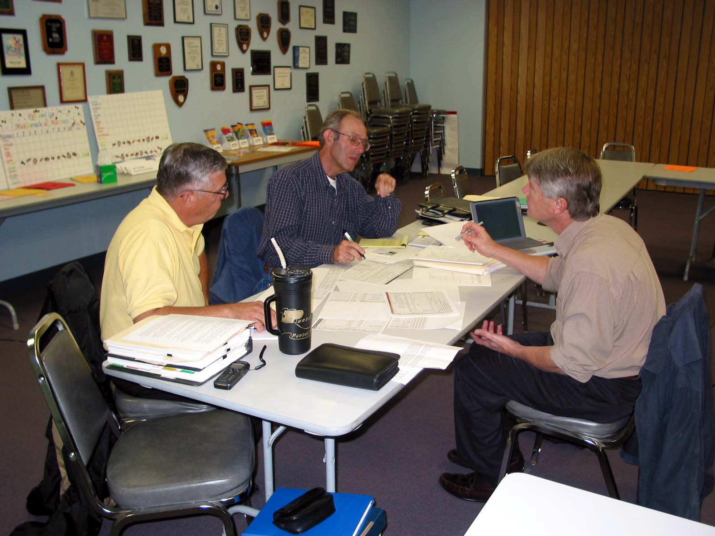
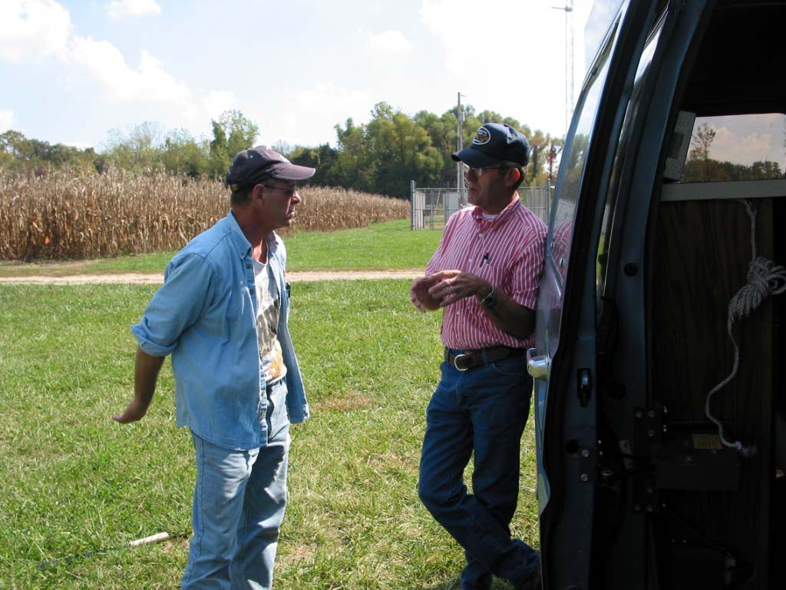
Exploration

Slide 20
Evaluating New Ideas
5 key criteria
  Uses existing resources
  Provides enough profit margin
  Increased demand for product
  Low cost product development
  Will lead to future product line

Slide 21
Evaluating New Ideas
Use a criteria evaluation matrix (Baumgartner 2004).
Rate each idea using a rating of 0 to 5.
  0 is the lowest
  5 is the highest
Multiply by 4 to get a rating close to 100 points.

Slide 22
Evaluating a New Product
Criteria Product 1 Product 2 Product 3 Product 4
Use existing resources | 2 | 3 | 5 | 5
High profit margin | 3 | 5 | 4 | 1
Increasing demand | 3 | 5 | 4 | 2
Low development costs | 4 | 2 | 3 | 5
Lead product | 2 | 5 | 5 | 3
Total | 14 | 20 | 21 | 16
Multiply by 4 | 56% | 80% | 84% | 64%

Slide 23
Evaluating New Ideas
A worthwhile idea has a rating between 80-100%.
Improve accuracy by weighting criteria. (More important criteria have a higher weight and vice versa.)
Also let others evaluate idea using the matrix to get a more accurate and realistic view.

Slide 24
Evaluating New Ideas
Conduct a feasibility study
  Who is the target market?
  What is the geographic location of the target market?
  What is the demand for your products?

Slide 25
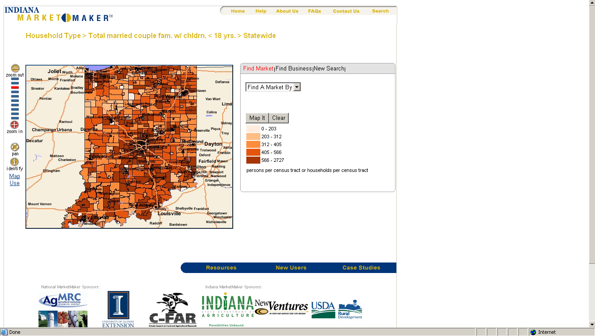

Slide 26
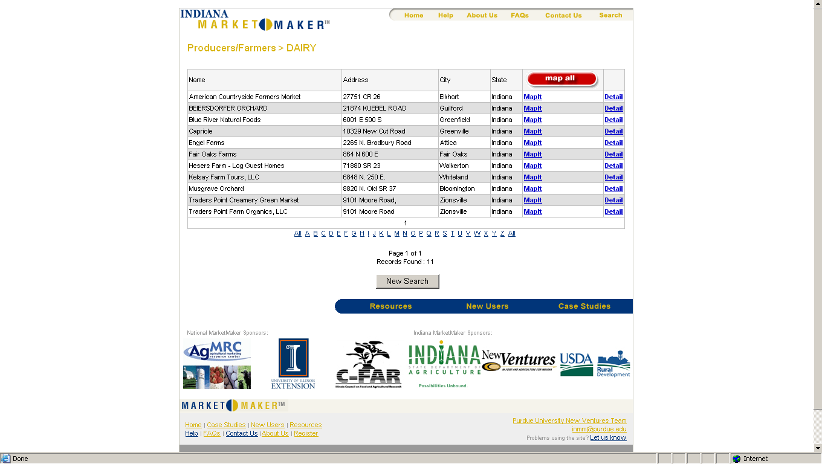

Slide 27
Evaluating New Ideas
  How could the economy affect your business?
  Who is the competition?
  What is the competition doing right and wrong?
  What will be your niche in the marketplace?

Slide 28
Evaluating New Ideas
What is your pricing strategy or formula?
How will you advertise?
What are your distribution methods?

Slide 29
Evaluating New Ideas
Financial considerations
  2-3 year cash flow projections
    Sales
    Variable expenses
    Fixed expenses
    Wages
    What is left
    Where is the breakeven point?

Slide 30
Indiana VR Small Business
Enterprise Program
Requires a comprehensive business plan
Only for start-ups; cannot expand an existing business.
Offers up to $30,000 the first year and up to $15,000 the second year for products and modifications to start a business.

Slide 31
What can VR pay for?
Provides up to 75% of start-up costs.
Client is responsible for a 25% match of cash or in-kind.

Slide 32
What can VR pay for? (cont.)
Training
Professional and trade certifications
Technical assistance or consultations
Market analysis
Necessary assistive technology
Initial and turnover stock of raw materials and inventory

Slide 33
What can VR pay for? (cont.)
Insurance: liability and property
Building remodeling
Accounting, bookkeeping, legal counsel
Advertising, Internet
Heating and cooling, electricity, telephone, cell phone
Equipment, including computers

Slide 34
VR Services Process
Apply for services or reopen client case
Complete initial Individual Plan of Employment (IPE)
Some cases, VR pays for client to attend Small Business Development Center business planning classes

Slide 35
VR Process (cont.)
Refine business plan to VR’s outline
Submit business plan to VR
VR reviews the business plan
If questions about plan, return to client

Slide 36
VR Process (cont.)
Resubmit business plan to VR
Review by Independent Review Committee
Business Plan Reviewed by VR Supervisor
Approved, Refined, or Denied

Slide 37
Basics of the Required VR Business Plan Outline
See handout
Importance of market feasibility section

Slide 38
Case Study
  Client wanted to raise cattle, hogs, turkeys, ducks, geese, and rabbits to sell to the public
  No acreage to raise the animals
  Post traumatic stress syndrome
  Wife worked in town

Slide 39
Case Study
Visited client at his home
Conducted informal feasibility for livestock production
Questioned ability to generate enough income
Asked client for 2-year cash flow projections

Slide 40
Case Study
Client decides pressure from dollar amounts too much stress
Client explores contract production – still too much stress
Client moves to wildlife control – much less stress – plan approved and funded

Slide 41
Other Resources
Purdue New Ventures Team: www.agecon.purdue.edu/newventures/
Agricultural, Innovation and Commercialization Center Resources: www.agecon.purdue.edu/planner/resources.asp
INVenture Business Planner: www.agecon.purdue.edu/planner

Slide 42
Other Resources
Indiana MarketMaker:
in.marketmaker.uiuc.edu/
National MarketMaker
national.marketmaker.uiuc.edu/index.html

Slide 43
Other Resources
Extension Entrepreneurs: www.extension.org/entrepreneurship
Indiana Small Business Development Centers:
http://209.200.81.27/ourlocations.aspx
Score:
www.score.org/

Slide 44
Other Resources
Start-Up America
www.start-up-usa.biz/
Idea Café
www.businessownersideacafe.com

Slide 45
Questions?

